Slide 1
Chemical Energetics
(A) Thermodynamics
Thermodynamics is a physical science which deals with the study of quantitative relationship between heat energy and many other forms of energies like, (i) mechanical energy involved in the working of machines, (ii) electrical energy used in the process like electrolysis, (iii) light energy concerned with photography and (iv)chemical energy associated with the chemical substances. All these energies are different and distinct from one another and are interconvertible into each other. Energy is nothing but the capacity of a system or body to do the work. In a chemical reaction energy is released or absorbed. Thermodynamics deals not only with energy change involved in a chemical process but also helps to predict whether reaction can occur or not, why the reactions reach to equilibrium, what is its direction and so on.
In brief, thermodynamics deals with energy transformations involved in various physical and chemical processes and determines feasibility, direction and equilibrium condition of reactions.

Slide 2
Basic Concepts of Thermodynamics
Before we begin to study this unit, it is essential to recapitulate certain important basic terms or concepts used in thermodynamics as follows:
1. Energy: Energy is defined as capacity to do work.
2. Work: Work is a motion against an opposing force. It is expressed
W = F X dx
where, F = force applied against which work has to be done,
dx= displacement distance.
There are many kinds of work such as work of expansion (PΔV), electrical work (nEF).
The SI and C.G.S. units of work are joule (J) and erg respectively.
1 J = 1 Nm = 1 kg m² s-²
1 erg = 1 dyn^{-cm} = 10⁷ ergs.
3. Heat: Heat is a transfer of energy as result of temperature.
Heat is expressed in joules (S.I.) and in calories (C.G.S).
1 calorie = 4.184 joules.

Slide 3
4. System and surroundings: A part of the universe under thermodynamic study is called system and the rest part is surroundings. For example, water in a sealed tube placed in a water bath. Here, water is system and water bath is surroundings. Three types of systems can be distinguished as,
(i) Open system which can exchange both energy and matter with its surroundings. For example, reaction in a open flask to which one can add or remove substances and can heat or cool the flask.
(ii) Closed system which can exchange only energy but not the matter with its surroundings. For example, reaction in a stoppered flask, here, energy such as heat can enter or leave but contents in the flask remain the same.
(iii) An isolated system which can exchange neither energy nor matter with its surroundings For example, reaction in a thermos flask.
5. Thermodynamic variables: Temperature (T), pressure (P), system. These properties define the system completely and are called thermodynamic or state variables. In addition to these, work (W) and heat (q) are also considered as thermodynamic variables but these two are not state properties
6. Change of state: State of the system is defined by specifying thermodynamic properties (e.g. P. V. T etc.) of the system. If one or more of these properties would change, the state of the system changes. (*The term change of state should not be confused with the term phase change such as Solid-Liquid, Liquid Vapour etc.) For example, water in a beaker is a system. Its initial temperature is 25°C and pressure, 1 bar. Suppose, it is heated to 50°C under pressure of 1 bar. As one of the properties, for example temperature changes, the system suffers a change in state.

Slide 4
7. Thermodynamic functions: Thermodynamic variables (or properties) like P, V, T etc. are quite sufficient to describe the system completely. However, if these variables are related mathematically, new relations are formulated. These new functions are called thermodynamic functions as given in Table 1.1.
Table 1.1 Thermodynamic Functions
8. State functions: Thermodynamic functions are state functions. Their value depends only upon initial and final states of the system and not on the path followed to bring the change in state of the system.
E, H, G, S are the state functions. P, V, T are also state functions.
9. Internal energy (E): The total energy of a system is known as its internal energy E.
We cannot measure E but we can measure its change AE for any process.
Thus, ΔE = Ef - Ei
where, Ef and Ei represent internal energy in final and initial states of the system respectively.
Relation | Function | Name
dE = dq-dW | E | Internal energy
dS = dq _{rev} /T | S | Entropy
H = E+ PV | H | Enthalpy
G = H-TS | G | Gibbs free energy
A = E-TS | A | Helmholtz free energy (or Work function)

Slide 5
10. Thermodynamic process: The operation that brings the change in state of the system is called process.
For example, water in a beaker is heated. Heating is the process. Similarly, boiling, vaporisation, freezing, expansion, contraction etc. are the various operations by which the state of system changes, so all these are called processes.
The process can be carried out under various conditions and accordingly named as:
(i) Isothermal process: The process carried out at constant temperature is called isothermal process. For an ideal gas E is a function of temperature only. So in isothermal process, ΔE = 0. (ii) Adiabatic process: In this heat is allowed neither to enter nor to leave the system and therefore, q = 0. However, temperature of the system may rise or fall.
(iii) Isochoric process: It is the process in which volume of the system remains constant i.e. change in volume, ΔV= V₂-V₁=0.
(iv) Isobaric process: It is the process in which pressure of the system remains constant i.e. change in pressure, ΔP = P₂-P₁ =0.

Slide 6
(v) Cyclic process: The process in which the system after series of changes is brought to its initial state is called cyclic process In cyclic process the final state is the same as initial state and therefore, change in each state function is zero, i.e. ΔT = ΔP = ΔV = ΔE = ΔH =0. However, q and W need not be zero in cyclic process.
(vi) Reversible process:
A reversible process, in thermodynamic sense, is the process that can be reversed by an infinitesimal modification of a variable. In reversible process, the system is always in pressure and temperature equilibrium with its surroundings. The process is carried out very slowly and in large number of steps. A reversible process, therefore, would require an infinite time to complete it. Reversible process is of great importance because it yields the maximum amount of work that may be obtained from a given net change. Reversible process is a idealization.
(vii) Irreversible process:
If the change is produced rapidly and the system is not in a pressure and temperature equilibrium with its surroundings are reversible and hence, spontaneous, for example, flow of heat from hot body to cold body, running of the ball down the slope. Once the process occurs in particular direction, it cannot be reversed without the help of external source. Irreversible process is a real process.

Slide 7
11. Work done: Energy may be exchanged in the form of work, the most commonly, P-V type of work. Thus, W = PdV
(a) Work in expansion into vacuum: When gas expands into vacuum where external pressure is zero, P = 0, no work is done, W = 0. This is called free expansion of gas.
(b) Work in expansion against constant external pressure: Integration of equation, W= - PdV at constant pressure gives,
W = -P(V₂-V₁) = -PΔV
This equation represents P-V type of work done in an isothermal irreversible expansion of gas (V2> V₁). In compression, V2 <V₁ and W is-ve.
Then, first law of thermodynamics can be written as,
q = ΔΕ + ΡΔV
(c) Work in reversible expansion: Substituting P=n RT/V
In equation, W = -PdV and integrating between the limits, the maximum work in isothermal reversible expansion of n moles of an ideal gas will be given by,
W_{m} =nRT In V₂ / V₁
W_{m} = -nRT In P₁ / P₂

Slide 8
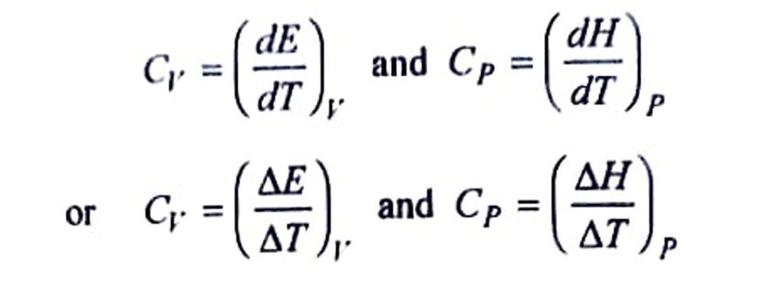
12. Heat capacity:
Heat capacity is defined as the rate of change of heat with temperature of the substance. If amount of substance is 1 g, it is called specific heat and if amount is 1 mol, it is known as molar heat capacity.
Molar heat capacity can be measured either at constant volume (Cv) or at constant pressure (Cp).
For solids and liquids Cp Cv, but for gas it is related through the equation,
Cp-Cv = R
where, R is gas constant.

Slide 9
First Law of Thermodynamics: The first law of thermodynamics which is also known as principle of conservation of energy can be stated in different ways as given below.
(i) Energy can neither be created nor destroyed though it may be converted from one form to another.
(ii) When a quantity of one kind of energy disappears, then an equivalent amount of another kind of energy appears.
(iii) The total amount of mass and energy of an isolated system remains constant.
(iv) It is not possible for any machine to produce work without consuming energy.
(v) The total energy of the universe remains constant.
The mathematical statement of the law is,
q = ΔΕ – W where, q=heat absorbed by the system
-W = work done by the system ΔE = change in internal energy of the system.
It can also be expressed as, ΔE= q+W
Sign conventions: (IUPAC)
q=heat absorbed by the system. -q=heat lost by the system.
- W = work done by the system. +W= work done on the system.
Sign convention of state function like ΔE depends on the value of the function in the initial and final states. e.g. ΔE = E2 – E1 If E2> E1, ΔE is positive while, If E1> E2, ΔE is negative.

Slide 10
Spontaneous and Non-spontaneous Processes (Definitions, distinguishing points and examples)
All real changes have a direction which is natural. The transformation in the opposite sense would be unnatural.
In nature, rivers run from the mountains to sea and never in a reverse way. A tree blossoms, bears fruit and later throws away its leaves. It is natural but to think that dry leaves rise on their own, attach to the tree and once again the tree blossoms, is quite absurd. Heat flows spontaneously from hot end of metal bar to the cold end till temperature is uniform and never in opposite direction. Water flows spontaneously from higher level to the lower level and not in reverse way. However, water can be made to flow from lower to higher level by using motor pump, so work has to be done. Thus, somethings happen as natural processes while somethings do not. This is our every day observation.
The processes can, therefore, be divided into two classes:
(a) Spontaneous processes, and
(b) Non-spontaneous processes.

Slide 11
Spontaneous Process:
The process that occurs of its own accord is called spontaneous process.
(i) The spontaneous process has a natural tendency to occur and therefore, it takes place without doing any work to bring it about. The well known examples are flow of heat from hot body to cold body, flow of water from the top of mountain into a deep valley, rolling of ball down the slope, expansion of gas from a region of high pressure to that of low pressure (fig. 1.1).
(ii) Most of the natural processes are spontaneous. In fact, all human activities and all the processes occurring in the universe obey this concept to a greater extent. For example, the production of wheat from seeds, formation of clouds in the sky, fall of rain from clouds, the growth and multiplication of micro-organism when food is digested, are all spontaneous processes.
(iii) All spontaneous processes are irreversible, When it goes in particular direction, the process will not occur in reverse direction spontaneously. Heat, for example, flows spontaneously from hot body to cold body but reverse is not true.
(iv) A spontaneous process may be harnessed to do work.
A spontaneous process on its own cannot perform work but can be made to do work. For example, the reaction Zn + CuSO4 → ZnSO4 + Cu, being spontaneous, is allowed to take place in the Daniell cell and is made to do electrical work i.e. electrical energy is produced. Water fall is a spontaneous process ; a big turbine, placed under it, is connected to generator to produce electricity.

Slide 12
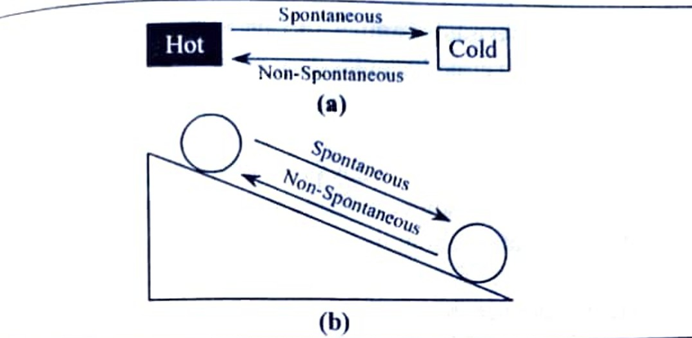
(v) Spontaneous changes are always accompanied by a dispersal of energy into a more disordered form.
A ball, for example, bounces on a floor. It is spontaneous process. The ball does not rise as high after each bounce because on each bounce some of its energy is degraded into thermal motion of the atoms of floor and that energy disperses. The reverse is never observed.
(b) Non-spontaneous process:
The process that does not occur of its own accord is called non-spontaneous process.
Non-spontaneous process does not have a natural tendency to occur and therefore, can be made to occur by doing work. Examples include the compression of gas by pushing piston, lifting of water from lower to higher level by using motor pump, decomposition of water by passing electric current and rolling the ball up the slope by doing mechanical work.

Slide 13
In any system, reverse of a spontaneous process must be non spontaneous. This is illustrated in fig. 1.1.
Spontaneous and non-spontaneous processes can be distinguished as follows. (Table 1.2)
Table 1.2 Distinction between spontaneous and non spontaneous processes
Spontaneous process (Irreversible) | Non-spontaneous process (Reversible)
1. It is a natural process. | 1. It is a hypothetical process.
2. Opposing force is much less than the driving force. | 2. Driving and opposing forces differ by a very small amount.
3. Equilibrium is attained only when the process is complete. | 3. There is an equilibrium at every stage.
4. As opposing force is much less, a lot of energy is dissipated and maximum work cannot be obtained. | 4. As driving and opposing forces are nearly equal, maximum work can be obtained.
5. Process may be fast or slow. | 5. Process is slow.
6. e.g. Flow of heat from hot to cold body | 6. e.g. Reversible expansion of an ideal gas.

Slide 14
Second Law of Thermodynamics and its Statements
The first law of thermodynamics does not tell us why a spontaneous reaction proceeds in one direction and not in the opposite direction.
The first law of thermodynamics does not provide the information about the practical probability of any process. The first law is unable to put any restriction on the source of heat and its direction of flow. It does not give the information about the spontaneity, direction and extent of chemical changes. The first law does not give any idea regarding the ease or extent or convertibility of one form of energy into another i.e. it is unable to state the conditions under which the absorbed heat energy will be converted into work. Hence, there is a need of second law of thermodynamics. All these inabilities of first law of thermodynamics form the basis of second law of thermodynamics which gives the conditions or limits under which heat energy can be converted into other forms of energy. Thus, for establishing the limitations governing the transformation of heat into work and predicting the direction of a spontaneous process under a given set of conditions, there is a need of second law of thermodynamics.

Slide 15
Clausius and Kelvin put forward the second law of thermodynamics which can be stated in different ways as follows:
(i) Heat cannot pass of its own accord from a colder to a hotter body.
(ii) All naturally occurring processes tend to proceed in a direction in which equilibrium will take place.
(iii) All spontaneous processes are irreversible.
(iv) Every natural or spontaneous process leads to the dissipation (wastage) of energy i.e. energy cannot be completely converted into work.
(v) It is impossible for a self acting machine to convey heat from a body at low temperature to the body at higher temperature without aid of any external agency.
(vi) It is impossible to construct a machine which will convert heat into an equivalent amount of mechanical work without aid of external agency and without producing changes elsewhere.
(vii) No machine has 100 % or unit efficiency.
(viii) Entropy of the universe is increasing while free energy decreasing but the total energy of the universe is always constant. Or Entropy of Universe

Slide 16
Carnot's Cycle and its Efficiency
Sadi Carnot (1824) devised a cycle to represent the operation of an idealized heat engine.
The arrangement of Carnot's heat engine is as shown in Fig. 1.2.
The arrows indicate that in one cycle the engine receives heat q₂ from hot reservoir at temperature T₂, rejects remainder q₁ to the cold reservoir at temperature T₁ and does the work W. In the present case, q₂ is positive, q₁ is negative and W is positive. The engine consists of working substance, such as 1 mol of an ideal gas, in an idealized cylinder fitted with weightless and frictionless piston.
The cycle involves isothermal and adiabatic processes.
For isothermal change, cylinder is placed in a hot reservoir (source) at T₂ or in a cold reservoir (sink) at T₁. Adiabatic change is achieved by insulating cylinder thermally so that q = 0. The Carnot cycle consists of the following four steps, all carried out reversibly and are represented in P-V diagram called indicator diagram. (fig. 1.3).

Slide 17
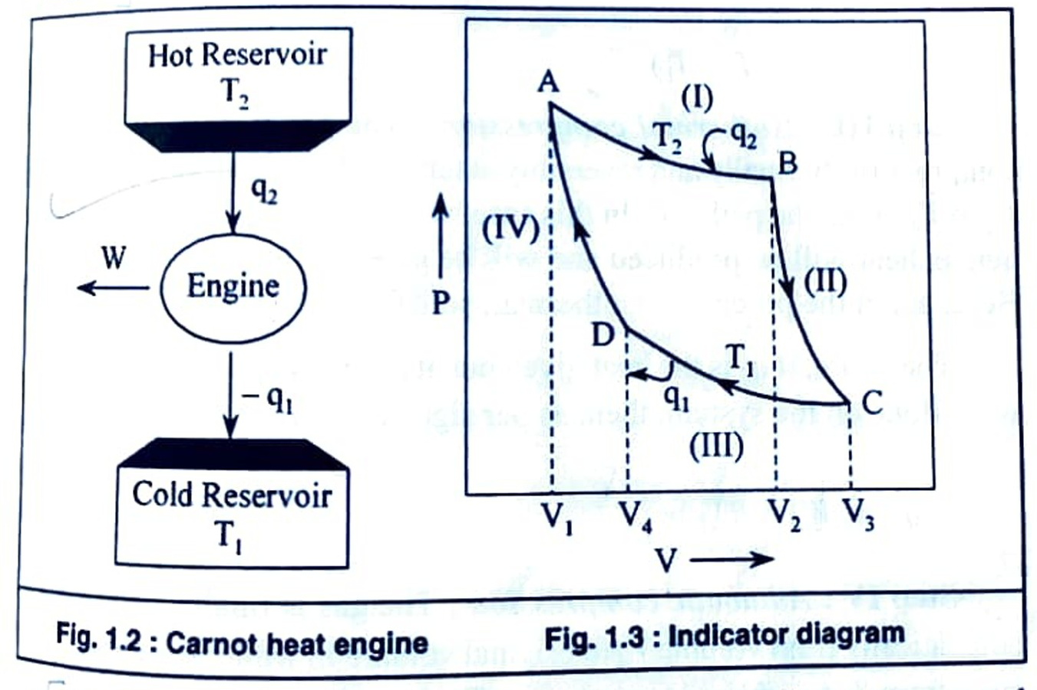
Fig. 1.2: Carnot heat engine

Slide 18
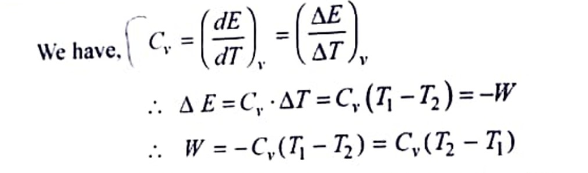
Step I: Isothermal expansion:
The gas at T2 is allowed to expand isothermally and reversibly from the volume V₁ to V2 along the path AB as shown in Fig. 1.3. Since, in the isothermal expansion, ΔE=0, it follows from the first law equation (ΔE = q + W), that the heat absorbed is equal to the work done by the system on the surrounding. Let q₂ be the heat absorbed at temperature T₂ and W₁ be the work done, then,
q₂ = - W₁ = RT₂ ln V₂ / V₁ …….(1.1)
Step II: Adiabatic expansion:
The gas is now allowed to expand adiabatically and reversibly from volume V₂ to V₃ along the path BC. Since, the system does the work adiabatically (i.e. q=0), the temperature of the system falls from T₂ to T₁. As q = 0, from first law equation (ΔE= q + W), we can write ΔE = W, But for expansion ΔE= - W

Slide 19
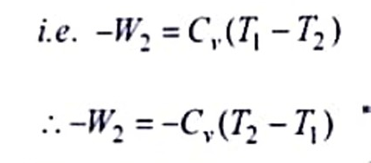
Let the work done by the system in this step be -W₂,
Step III Isothermal compression:
The gas is now allowed to compress isothermally and reversibly at temperature T₁, from the volume V₃ to V₄, along the path CD. In this case, work is done on the system and hence, heat will be produced and will be given up to the surroundings. Here, again the process is isothermal, so ΔE = 0.
Therefore, if q₁ is the heat given out at temperature T₁ and W₃ is the work done on the system, then, as per sign conventions,
-q₁ = W₃ = RT₁ ln V₄ / V₃
Step IV: Adiabatic compression:
The gas is finally compressed adiabatically from volume V₄ to original volume V₁ while the temperature rises from T₁ to original temperature T₂ along the path DA. In this case, work is done on the system, say + W₄ and q = 0, then from first law equation (ΔE = q + W) we can have,
ΔE = W₄ = Cv ΔT = Cv (T₂ – T₁)
W4 = Cv (T₂ – T₁)
where. (T₂ – T₁) is the increase in temperature during adiabatic compression.
The net heat absorbed (q) by the ideal gas in the complete cycle is given by.

Slide 20
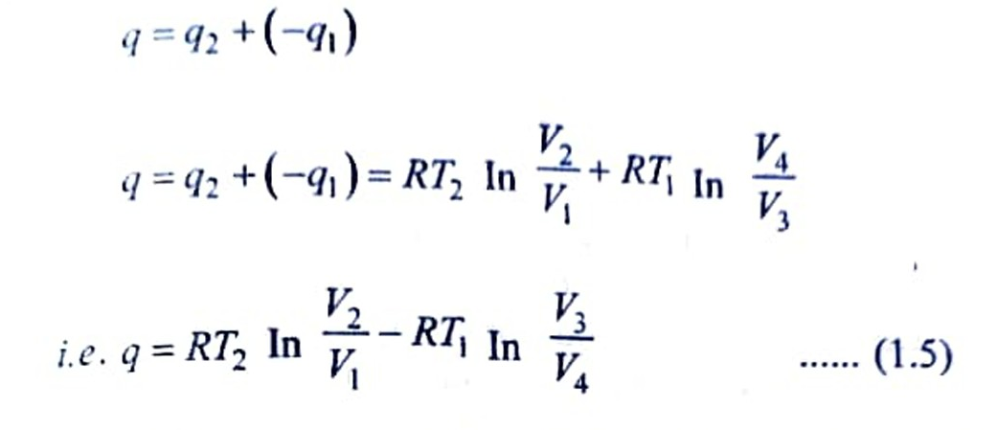
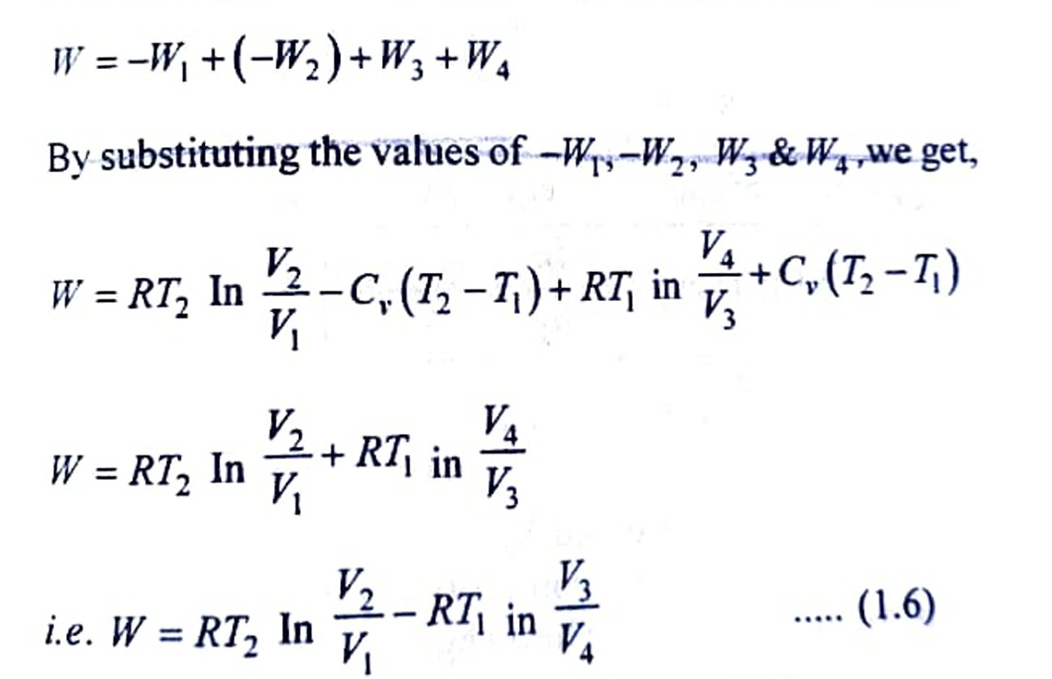
Similarly, the net work done (W) by the gas given by,

Slide 21
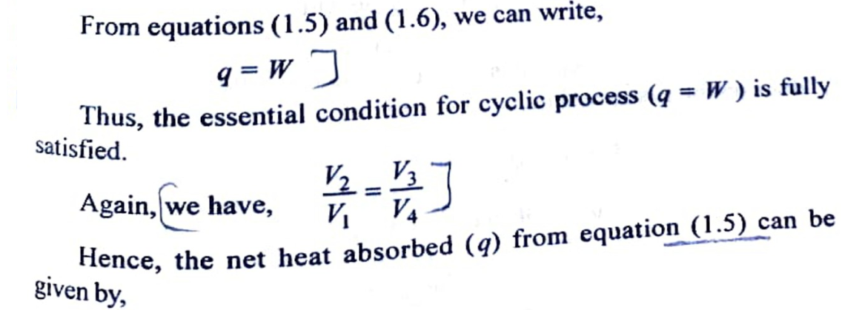
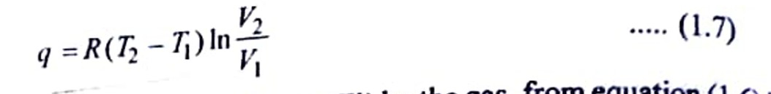
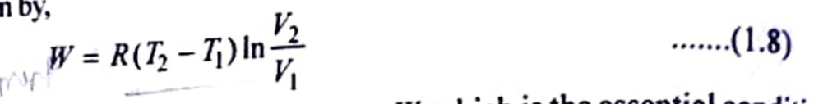
Similarly, the net work done (W) by the gas, from equation (1.6) given by,
From these equations again, q= W, which is the essential condition for cyclic process.

Slide 22
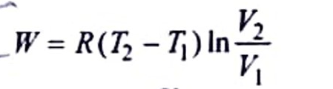
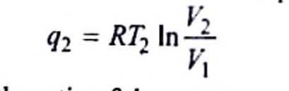
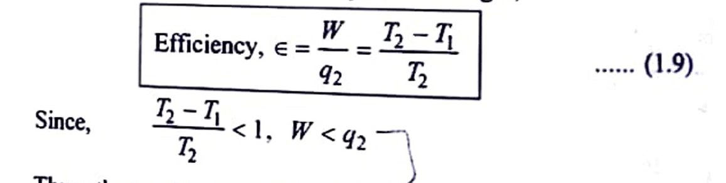
Efficiency of Carnot cycle (Efficiency of heat engine): The relationship between the net work (W) and quantity of heat absorbed at the higher temperature T₂ can be obtained from the following two equations and it is known as thermodynamic efficiency (e).
Taking the ratio of these two equations we get,
Thus, the total heat absorbed by a system cannot be completely converted into work. The equation (1.9) also gives the efficiency of heat engine. Again, efficiency of heat engine is always less than one of, it is impossible to construct a heat engine which has efficiency unity.

Slide 23
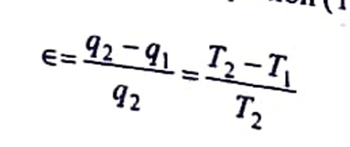
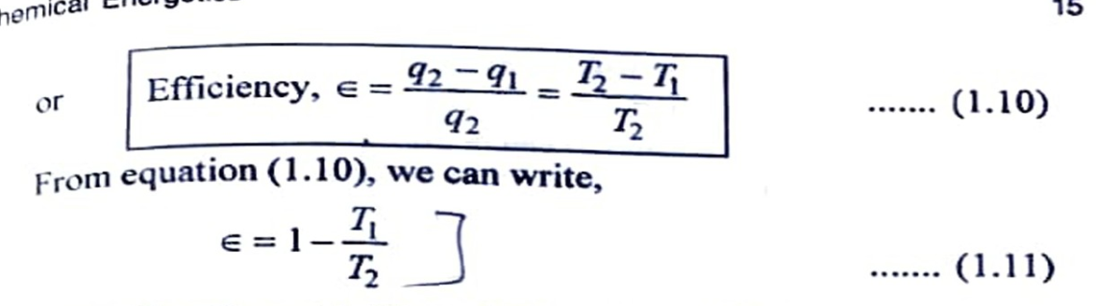
The net heat absorbed by the system is q = 92-9, and according to first law of thermodynamics, this must be equivalent to the net work done by the system. Thus,
W=q₂ - q₁
Putting this value of Win equation (1.9), we get,
Since, T2 > T₁, < 1. Thus, the equation (1.11) suggests that,
(a) Efficiency of any machine is always less than one.
(b) Efficiency is independent of working substance.
(c) Efficiency e = 1, only when T₁ = 0.
(d) Efficiency of all reversible heat engines operating between the same two temperatures is the same. (e) Lower the temperature T, of the sink for a given temperature T₂ of the source, greater will be the efficiency.

Slide 24
Concept of Entropy
According to second law of thermodynamics, heat cannot be completely converted into work. Some amount of heat is not available to do work. Clausius invented a term entropy S, which is a measure of such unavailable part of energy (e.g. heat) to do work. This can be clarified with following example.
Process A: q amount of heat is absorbed by the gas filled in a cylinder fitted with an idealised piston. The gas will expand. Piston will be pushed. The work done (w) = P x ΔV.
Process B: Now work equivalent to PΔV, is done on the gas. The gas would be compressed. Heat will be evolved. However, the amount of heat evolved in process B is less than that absorbed in process A. It means that whole of the heat absorbed in process A is not converted into work.
When heat is absorbed by the gas, the kinetic energy of the gas molecules will be increased and the gas molecules move faster. They collide with (i) each other, (ii) the walls of container and (iii) the face of the piston, thereby pushing the piston. Only third type of collision brings the expansion of gas [Fig. 1.4 (b)]. The first and second types of collisions are not effective in bringing the expansion. Thus, some collisions and hence some fraction of heat is not utilised for expansion of the gas.
Therefore, the work due to expansion is not exactly equivalent to the amount of heat absorbed. Some heat goes waste only due to random motion of the gas molecules. Thus, randomness can be correlated with unavailable. i.e. entropy. So, entropy is a measure of randomness of a molecule.
In brief, it can be summarized as, entropy is a measure of energy system. (a) unavailable part of energy to do work and (b) order and disorder of the system.

Slide 25
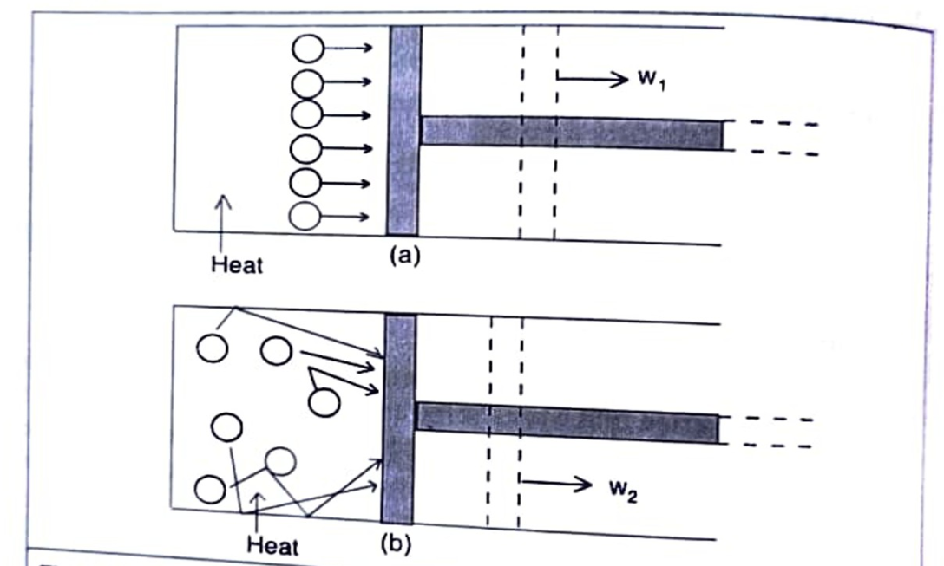
Fig. 1.4: Conversion of heat into work. (a) Ideal case of complete conversion. (b) Partial conversion due to randomness (dotted lines represent the position of the piston after expansion and w, > W₂).

Slide 26
Entropy (S) (Definition, Mathematical Expression, Entropy as a State function)
Entropy may be defined as, "the thermal property of the substance mathematically defined as, "the ratio of heat change to the temperature at which heat change occurs."
Thus, Clausius (1865), defined the entropy by the relation, (mathematical expression) as,
dS = dq_{rev} / T ........ (1.12)
Where, dq rev= heat absorbed by a system in an infinitesimal reversible process.
T= absolute temperature in Kelvins.
The entropy change from state 1 to state 2 is given by the integral of equ. (1.12),
ΔS = (S₂-S₁) = q_{rev} / T ........(1.13)
For an isothermal reversible process, the integral can be evaluated as,
ΔS = q_{rev}/ T ………...(1.14)
The value of ΔS depends only on the initial and final states of the system and not on the path. Hence, entropy is a state function. The entropy is a measure of the current state of disorder of the system and how that disorder was achieved is not relevant to its current value.
Unit of Entropy
The entropy is an extensive property. So, its value depends upon the quantity of substance. The units of entropy are Joules per degree Kelvin (JK-¹). When we use 1 mole substance, the entropy is molar entropy, an intensive property, with units Joules per degree Kelvin per mole (JK-mol-¹).

Slide 27
Physical Significance of Entropy
As mentioned earlier, entropy is a measure of order and disorder and unavailable energy of a system as well as probability which can be explained as follows:
Entropy as a measure of order and disorder:
Spontaneous processes are always accompanied by an increase in the 'disorder' or randomness' or 'chaos' of the system. Water, for example, can exist in two different states: Solid (ice) and Liquid (water). In ice, the molecules are arranged in an orderly way with the molecules in fixed positions in the crystal. Melting of ice is a spontaneous process. On melting, ice changes to liquid water. In water, molecules are free to move around. Orderly structure of ice is destroyed and disorderly arrangement of water molecules in water increases. Thus, disorder increases leading thereby increase in entropy.
The same type of change, order to disorder, occurs when one gas diffuses into another, when gas expands in vacuum, when a concentrated solution diffuses into pure water and so on for other spontaneous (irreversible) processes. All these processes are accompanied by increase in entropy. For example, disorder increases with increase in temperature from solid to liquid to gas and vice-versa as shown in Fig. 1.5.

Slide 28
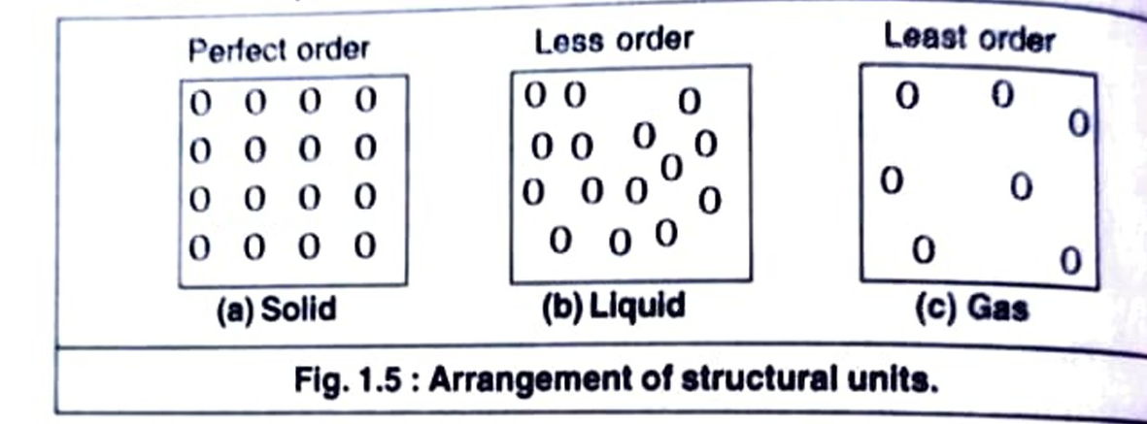
(b) Entropy as a measure of unavailable energy of a system:
According to second law, heat cannot be converted completely into work. It means some part of the total energy goes waste and is not available to do work. So, the total energy is made up of two parts:
Total energy = Available energy to do work (free energy) + unavailable energy
i.e. H = G + TS Or ΔG = ΔΗ + TΔS
The unavailable energy is represented as the product of entropy S and absolute temperature T. Thus, unavailable energy is TS. Higher the temperature, more is the disorder and more is the unavailable energy to do work. Thus, entropy becomes a measure of unavailable energy.
For example, when heat energy is supplied to a solid, some of the energy is used to melt the solid. This energy is unavailable part of energy i.e. entropy and remaining energy is used to do the work.

Slide 29
(c)Entropy and probability: It is found that the system has a tendency te sume the most probable state. The most probable state is the most random arrangement of the molecules in system. It means that there is a greater probability of the disordered state than the ordered state. The disordered state has higher, entropy than the ordered state. For example, water liquid has number of arrangements of H₂O molecules, while ice has a single ordered arrangement. Thus, water has higher entropy than that of ice.
Thus, we can identify the entropy as a function of the probability of thermodynamic state. Since both the entropy and thermodynamic probability increase simultaneously in a process, we can consider the state of equilibrium as the state of maximum probability. It means that a system tends to attain a state of equilibrium.
Third Law of Thermodynamics
Each of the first three laws of thermodynamics leads to the existence of a state function: The zeroth law leads to temperature, first law leads to the concept of internal energy, E and second law leads to the concept of entropy. S. However, first and second laws do not give any idea about the measurements of absolute values of E and S respectively. Determination of absolute value of energy is not feasible and only energy changes can be determined. However, the entropy concept is of great importance and its absolute value can be determined with the help of third law of thermodynamics.

Slide 30
Statement: The scientist Max Planck (1913) was the first to state the third law: The entropies of all perfectly crystalline substances are zero at 0 K
T. W. Richards and W. Nernst studied independently the entropy changes of certain isothermal chemical reactions and found that the change in entropy approaches zero as the temperature was reduced. This is true only in case of reactions, where the reactants and products are perfect crystals. Experimental evidences have shown that the entropy of solutions and supercooled liquids is not zero at 0 K. For pure crystalline substance, third law has been verified repeatedly and it was found that all pure crystals of pure substances have the same entropy at 0 K. If they have the same entropy at 0 K, this value might be taken as zero.
Absolute Entropy and Evaluation of Absolute Entropy
An important application of the third law of thermodynamics is that affirms that S (0 K)= 0 for any perfect crystalline substance, on this permits to calculate absolute entropies of the substances. The third law basis it is possible to calculate absolute entropies at some higher temperature, using the methods of thermochemistry. Suppose, we want S(298 K) for certain gaseous substance, then we start with crystal solid of that substance as close to 0 K as possible and determine the entropy change on warming it to its melting point.

Slide 31
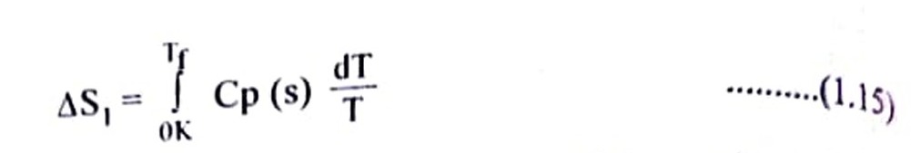
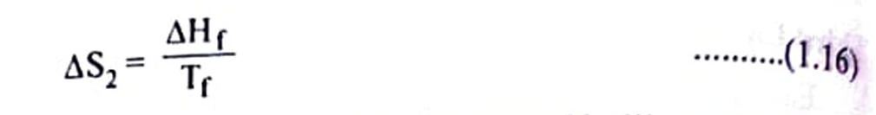
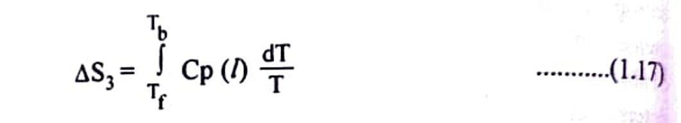
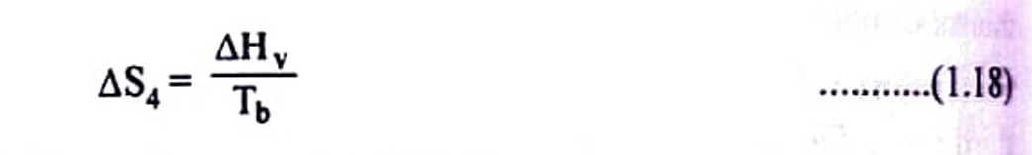
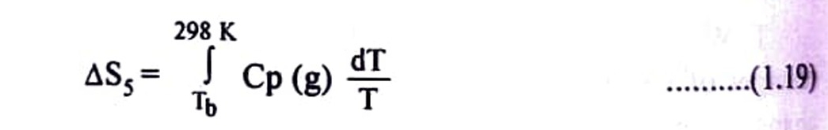
There is next entropy change due to melting of the solid,
The liquid is then further warmed to its normal boiling point, Tb and entropy change is given by,
Now, add entropy change due to vaporization of liquid,
Finally, the gas is warmed to 298 K,

Slide 32
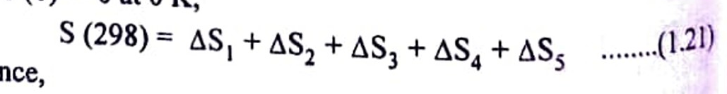
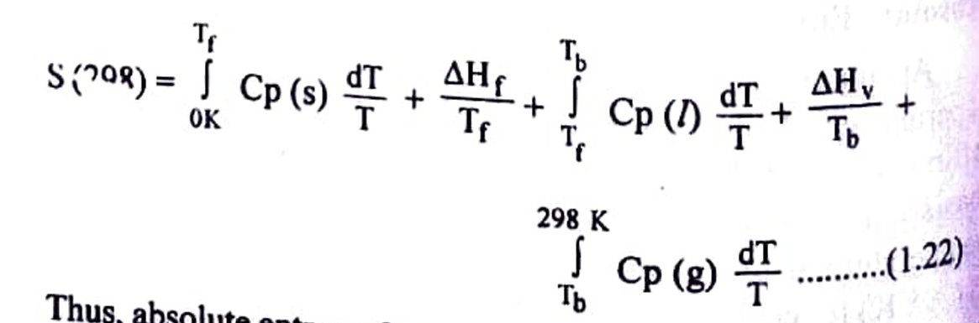
The sum of all above terms gives the entropy change as,
The sequence is illustrated in Fig. 1.6.
Since, S (0) = 0 at 0 K,
and hence,

Slide 33
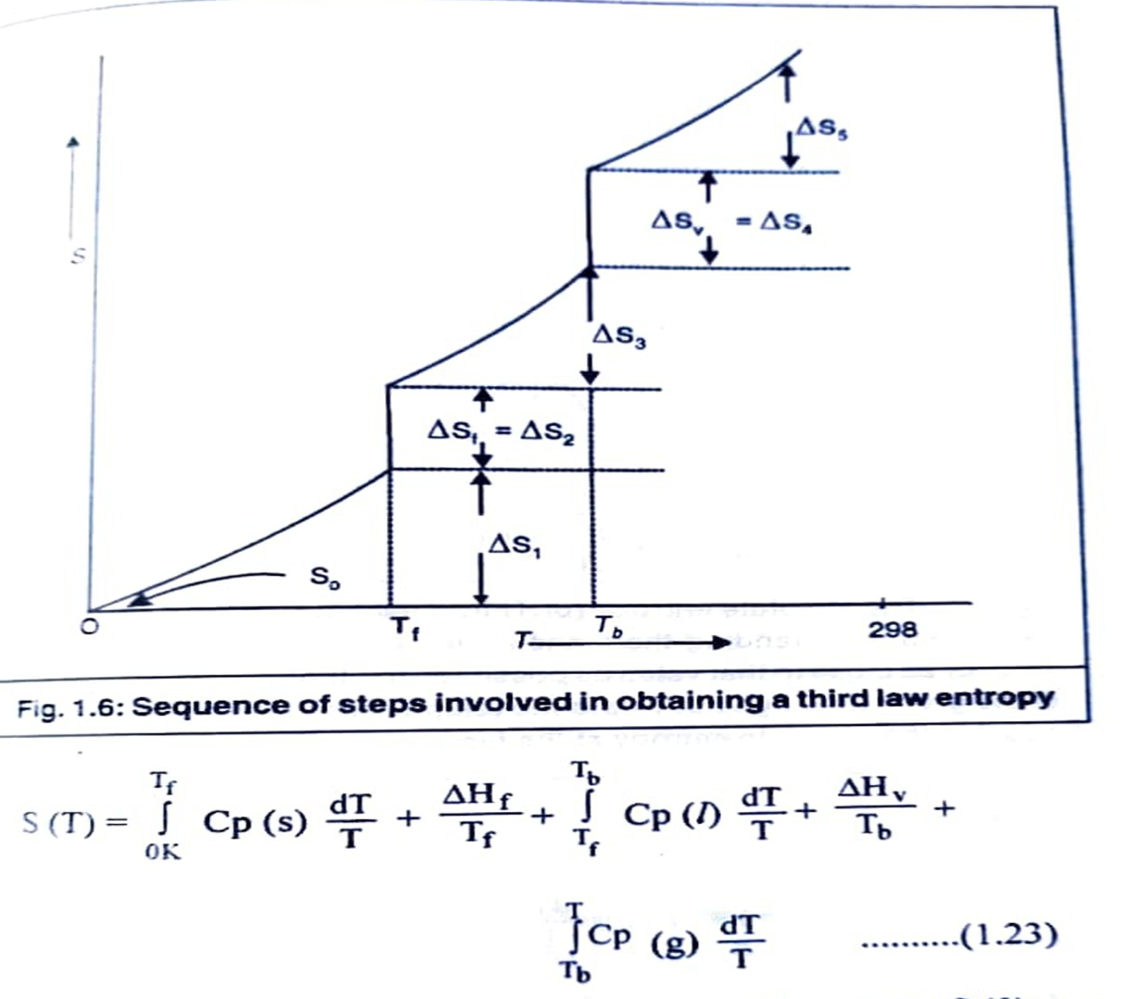
Thus, absolute entropy from 0 K to any desired temperature, T can be evaluated, using the above eqn. (1.22) as,

Slide 34
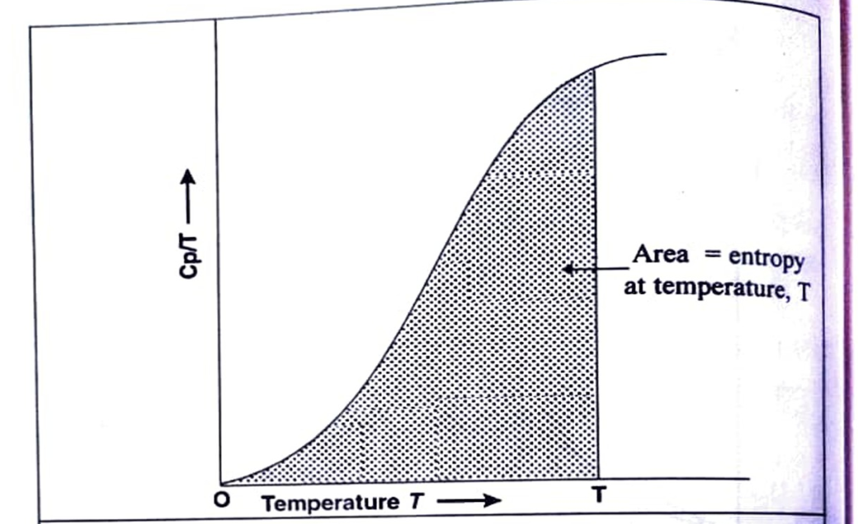
S(T) is always positive quantity. All the properties, except S (0), can be measured calorimetrically. The integrals can be evaluated by numerical integration or graphically. In a graphical method (Fig. 1.7), the area under the curve of Cp/T against T (or Cp vs In T) is the value of integral.
If there are various solid forms (e.g. SR -------- SM), corresponding entropies of transitions are also to be added in the above eqn. (1.23).
In practice, heat capacities, Cp, are usually measured from approximately 20 K to a desired temperature, T. At very low temperature (10 to 15 K), Cp values are obtained from Debye equation,
Cp = a T³.......(1.24)

Slide 35
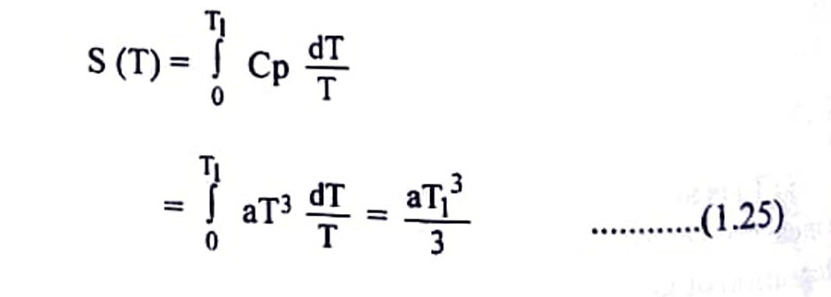
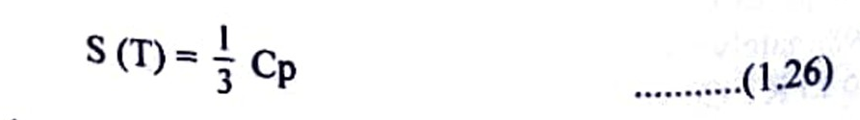
Fig. 1.7: The absolute entropy (or Third Law entropy) of a substance is calculated by extending the measurement of heat capacities down to T=0 (or as close to that value as possible) and then determining the area of the graph Cp/T against T upto the temperature of interest. The area is equal to the absolute entropy at the temperature T.
Then,
Thus, Debye equation is used to evaluate interval from 0 K to the lowest possible temperature T,. Since Cp = aT³, eqn. (1.25) becomes, over the interval
If a substance is solid at T, only the first integral of eqn. (1.23) applies with Tf= T, when it is liquid, the first three terms are used with Tb=T and when it is a gas, the full equation (1.23) must be used.

Slide 36
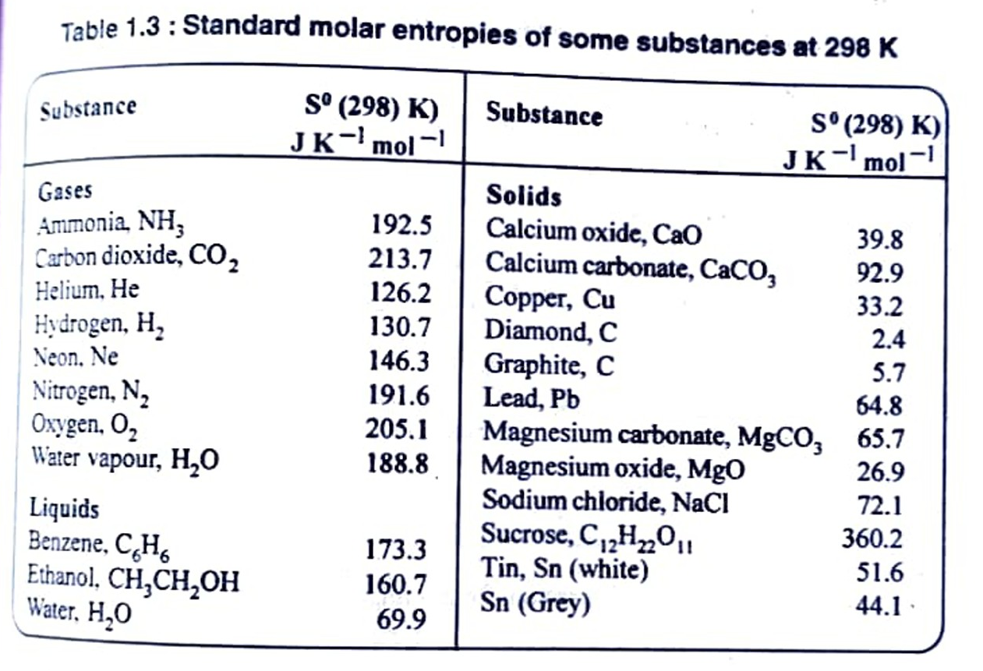
S(O)=0 for perfect crystals at 0 K. Entropies reported on the basis of S(0) 0. are called third law entropies. When the substance is in its standard state (The standard state of pure gas, pure liquid or pure solid substance is 1 bar pressure at each temperature) at temperature T, the standard (third law) entropy is denoted by S(T). Third law entropies of some substances are listed in Table 1.3.
Table 1.3: Standard molar entropies of some substances at 298 K

Slide 37
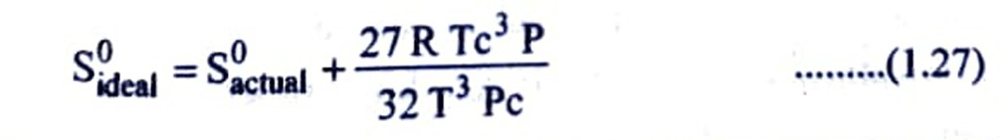
As an illustration, the determination of third law entropy, Sº (298), for SO, gas is shown in Table 1.4. The actual value is 247.85 J K-¹ mol-¹ at 298 K and at 1.01325 bar. A small correction due to non-ideality of the gas has to be applied using Berthelot equation,
Where, Tc and Pc are critical temperature and critical pressure. For SO2, Te 430.3 K, Pc 78.63 bar, P 1.01325 bar and T = 263.08 K (b.p.). The correction value comes to be 0.395. Hence, standard entropy (ideal) of SO₂(g) at 298 K is,
S⁰(298) = 247.85 +0.395 = 248.245 J K-mol-1.

Slide 38
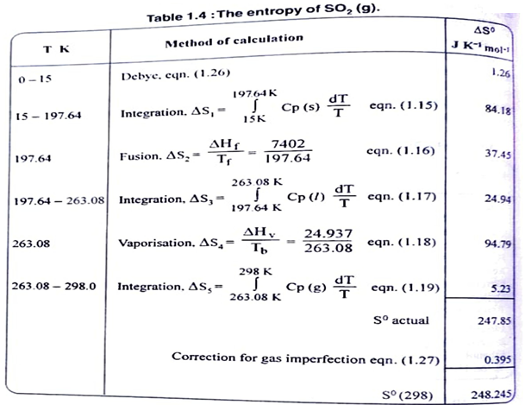

Slide 39
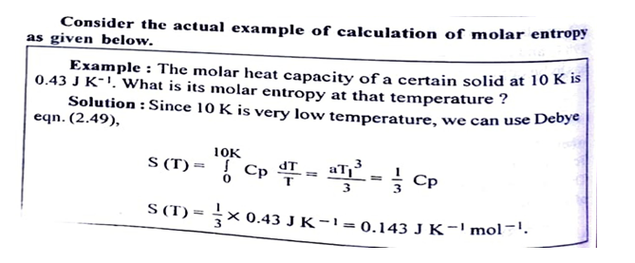

Slide 40
(B) Thermochemistry
Important Principles and Definitions of Thermochemistry
Almost all chemical reactions are accompanied by energy change generally in the form of heat change. It may appear in the form of absorption or evolution of heat. Thermochemistry is the branch of physical chemistry which deals with heat changes in chemical reaction.
In a chemical reaction, some bonds of reactant molecules are broken and some new bonds in product molecules are formed. Energy is used or consumed in the breaking or dissociation of bonds and energy is evolved or given out in the formation of bond. If energy evolved in the formation of bond is greater that the energy consumed in breaking of bonds then net result is release of energy while if energy consumed in breaking of bond is greater than energy released in formation of bond then there is absorption of energy in the chemical reaction. All chemical reactions are associated with energy change. This energy may be in the form of heat, light, mechanical work, electricity etc.
e.g.
(i) Burning of coal in air produces heat.
C(s) + O2(g) + → CO2(g) +heat
(ii) Reaction taking place in galvanic cell produces electricity as in Daniel cell.
Zn(s) + Cu(aq) → Zn ++ + Cu(s) ~ (aq) + + electric energy
(iii) Burning of Candle (wax) in air produces light and heat.

Slide 41
Internal Energy (E) and Enthalpy (H)
Internal energy: Every substance have its definite amount of energy called as intrinsic energy or internal energy (E). The absolute value of internal energy can not be determined but change in internal energy can be determined and it can be given as,
ΔE = E₂-E₁
For a chemical reaction change in internal energy (ΔE) is considered as energy or heat change at constant volume and may be given as
ΔE = Eproduct - EReactant
Enthalpy (H): When any process is carried out at constant pressure and temperature then there is a change in volume. If the volume increases some mechanical work is done by the system. Hence internal decreases and if volume decreases, mechanical work may be done on the system and internal energy increases.
In all such processes taking place at constant pressure and temperature, total energy of a system is given by thermodynamic quantity called as heat content or enthalpy of the system denoted by H.
Mathematically enthalpy H can be given as,
H=E+PV
Where, E is internal energy of system, P is Pressure and V is volume of system at constant temperature.
So enthalpy of system may be defined as sum of internal energy and product of pressure and volume of system at constant temperature i.e. the enthalpy of a system is the amount of energy stored within the system available for conversion into heat.

Slide 42
Change in Enthalpy (ΔH): Like internal energy enthalpy is also a state function. Absolute value of enthalpy can not be determined so change in enthalpy (ΔH) for any system can be given as,
ΔH = H₂-H₁
For a chemical reaction change in enthalpy (AH) can be given as,
ΔΗ_{reaction} = Σ H_{products} - Σ Η_{Reactants}
The relation between enthalpy (H) and internal energy (E) is given as,
H= E+ PV
ΔΗ = ΔΕ + ΡΔV ΔV=V₂ - V₁ = Change in volume
Hence change in enthalpy (AH) is given as,
ΔE = E₂-E₁ = Change in internal energy.
Hence change in enthalpy (AH) of a system can be defined as the sum of change in internal energy (AE) and pressure - volume work done by the system.
The enthalpy change is nothing but the heat absorbed or evolved by the system at constant pressure. Then it is given as,
q_{p}= ΔΗ

Slide 43
Units of energy (heat) change: The energy change i.e. heat change is expressed in calories, kilocalories, joules or kilojoules. 1 cal = 4.184 J and 1K cal = 4.184 KJ.
The SI unit of heat is joule or kilojoule.
Work is measured in ergs or joules. The S.I. Unit of work is joule.1 Joule = 107 erg.
Sign conventions for ΔE and ΔH or q and W
(i) When heat is absorbed by the system, q and ΔH is positive
(ii) When heat is given out by the system, q and ΔH is negative
(iii) When energy is absorbed by the system, ΔE is positive
(iv) When energy is given out by the system, ΔE is negative
(v) When work is done on the system, W is positive
(vi) When work is done by the system, W is negative
Generally if anything is given to the system it is positive & if anything is given out of the system it is negative.
The physical states of substances (reactants and products) are stated by the symbols Like (g), (l) and (s) which indicates gaseous, liquid and solid state of substance respectively.

Slide 44
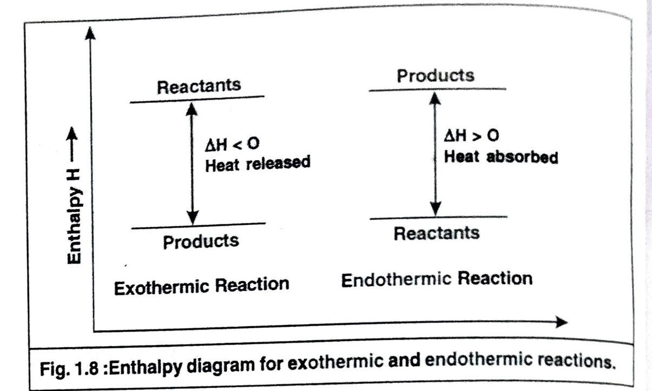
Exothermic and Endothermic Reactions
Exothermic reactions: The reactions in which heat is given out i.e. the reactions which are accompanied by evolution of heat, are called as exothermic reactions. In such reactions, enthalpy of products is less than enthalpy of reactants. i.e. Hp < H_{R}
So that ΔH is negative (-ve)
Endothermic reactions: The reactions in which heat is absorbed or the reactions which are accompained by absorption of heat are called as endothermic reactions. In such reactions enthalpy of product is greater than enthalpy of reactants i.e. Hp> H_{R}
So that ΔH is positive.

Slide 45
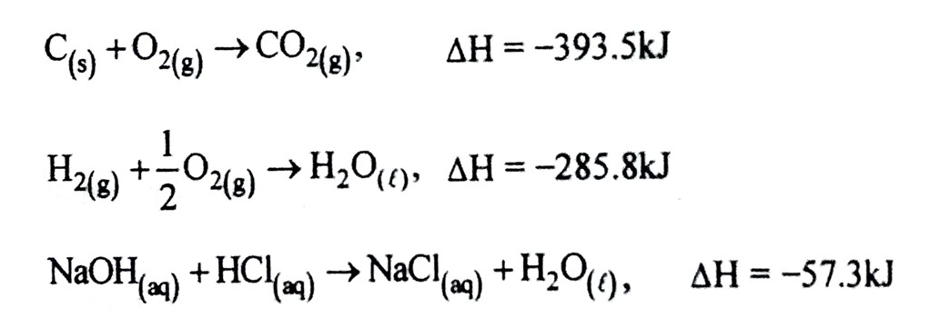
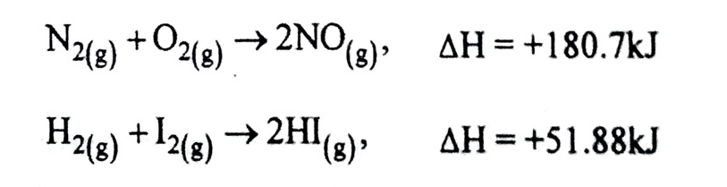
Examples of Exothermic and Endothermic reactions
Exothermic Reactions:
Endothermic Reactions:

Slide 46
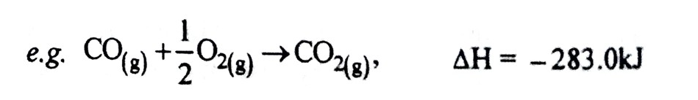
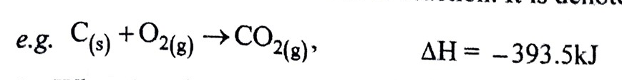
Thermochemical Equation: A balanced chemical equation indicating not only the quantities of reactants and products but also indicating heat absorbed or evolved is called as thermochemical equation. Above equations are the thermochemical equations.
Heat of Reaction or Enthalpy of Reaction (AH)
The amount of heat evolved or absorbed in a chemical reaction when number of moles of reactant given in the chemical equation are completely reacted is called as heat of reaction. It is denoted as ΔH.
i.e. When 1 mole i.e. 12 g of carbon reacts with 1 mole i.e. 32 g of oxygen gas produces one mole i.e. 44 g of carbon dioxide, then 393.5 kJ of heat is evolved and this is the heat of reaction (ΔH).
Heat of Reaction (ΔH) = Enthalpy of Products -Enthalpy of Reactants
When the reaction is reversed sign of ΔH is also reversed.

Slide 47
Concept of Standard State
It is not possible to determine absolute values of enthalpies so that it is necessary to define some arbitrary standard states in order to assign enthalpy values of various compounds.
The most commonly used standard state for the elements is their stablest form at 298 K (25°C) and 1 atm. pressure. For calculation it is supposed that all elements in their standard state [298 K and 1 atm] have zero enthalpy. But an element not in its standard state has not zero enthalpy.
The standard state of any substance, element or compound is defined as its most stable physical form at a temperature and pressure which for Convenience and Convention is chosen as 298 K and latm.
The enthalpy change of a reaction involving reactants and products in their standard states is represented as AH and termed as standard enthalpy change or standard heat of Reaction.
Standard enthalpy of formation (AH^{O} or AH°f) or Standard heat of Formation
It is the change in enthalpy in the formation of 1 mole of a compound from its constituent elements. When all the reactants and products are in their standard states i.e. temperature 298 K and pressure 1 atm.

Slide 48
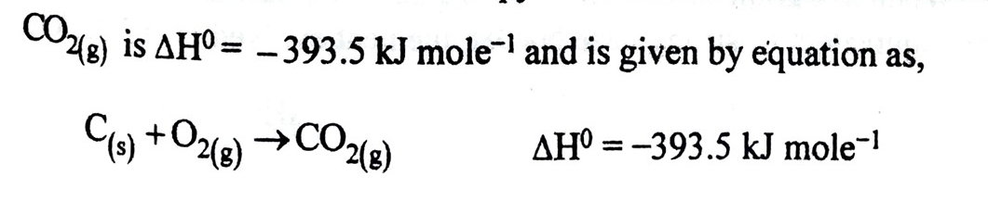
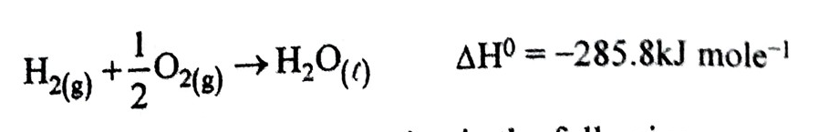
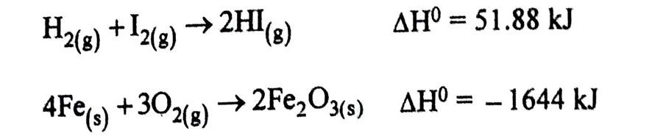
It is important to note that enthalpy of formation or heat of formation is referred to 1 mole of compound.
AH at temperature other than 298 K are not standard values. For example, standard enthalpy of formation or heat of formation of
The standard heats of reaction in the following cases are not heats of formation.
These are heats of reaction in the formation of 2 moles of HI & Fe₂O, respectively.
The standard molar enthalpies of formation or heats of formation in kJ/mole in these cases are 25.94 kJ mole- and -822 kJ mole respectively.

Slide 49
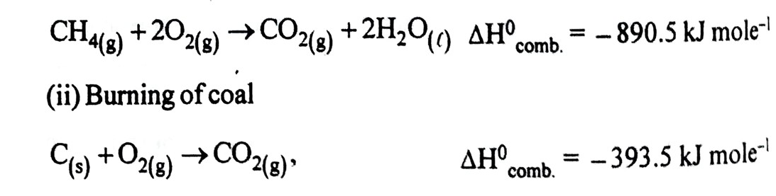
Standard Enthalpy of Combustion (or Heat of Combustion):
It is defined as enthalpy change accompanying a complete combustion of one mole of substance at 298 K (25 °C) and latm. pressure. It may be represented as AH comb. or ΔΗΰc.
Combustion means burning of substance i.e. reaction with oxygen.
e.g. (i) Combustion of methane, CH4B)

Slide 50
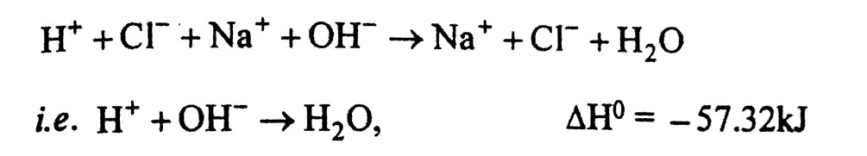
Standard Enthalpy of Neutralization or Heat of Neutralization
It is the change in enthalpy when on gram equivalent of an acid is neutralized by one gram equivalent of a base, in dilute solutions.
Heat of neutralization of a base by an acid is defined in a same way as change in enthalpy when one gram equivalent of a base is neutralized by one gram equivalent of acid in dilute solutions.
When one gram equivalent of strong acid HCI is neutralized by one gram equivalent of strong base NaOH, the heat evolved is -57.32 kJ.
It is found that enthalpy of neutralization of any strong acid by any strong base is constant and equal to -57.32kJ. This is because all such neutralization reactions involves the reaction between H+ (from acid) and OH (from base) ions to produce H₂O as,

Slide 51
If either the acid or the base or both are weak the enthalpies of neutralization are less negative than -57.32 kJ. This is because some of heat produced during the reaction is used for the complete dissociation of weak acid or weak base.
Thus, the enthalpy of neutralization of a weak acid (acetic acid) by a strong base like NaOH is less than 57.32 kJ and it is about -55.23 kJ.
Enthalpy of Solution or Heat of Solution When a solute is dissolved in a solvent to form a solution, heat is either absorbed or liberated.
Enthalpy of solution is defined as the amount of heat absorbed or evolved when I mole of solute is dissolved in such a large volume of solvent that further addition of solvent does not produce any more heat change.
Integral and Differential Enthalpy of Solution
There are two kinds of enthalpy of solution as follows:
Integral enthalpy (heat) of solution: The enthalpy change per mole of a solute dissolved varies with concentration of solution. So change in enthalpy with reference to concentration of solution is given in terms of integral enthalpy of solution.

Slide 52
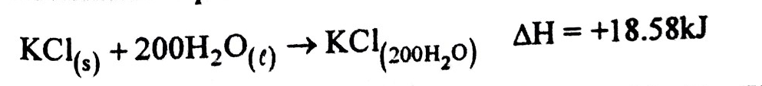
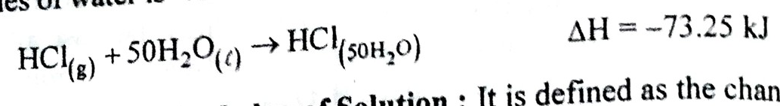
It is defined as the change in enthalpy when one mole of a solute is dissolved to give a solution of particular concentration. For example, if one mole of potassium chloride (KCI) is dissolved in 200 moles of water heat absorbed i.e enthalpy charge is +18.58kJ. This is the integral enthalpy of solution of potassium chloride at this concentration. This is given by thermochemical equation as,
Similarly if one mole of gaseous hydrogen chloride (HCl) is dissolved in 50 moles of water, heat evolved i.e. enthalpy change in 50 moles of water is -73.25 kJ. The thermochemical equation is given as,
Differential Enthalpy of Solution: It is defined as the change in enthalpy when I mole of solute is dissolved in large volume of solution at a particular concentration.
Consider a solution containing one mole of potassium chloride dissolved in 100 moles of water. Now if we take large volume of this solution, say 200 dm³ and dissolve one more mole of potassium chloride in it, then the heat change or enthalpy change produced is called as differential enthalpy of solution of potassium chloride when the solution is already at the given concentration.

