Slide 1
INTRODUCTION to SPECTROSCOPY

Slide 2
WHAT IS SPECTROSCOPY?
The study of the interaction between ELECTROMAGNETIC (EM) RADIATION and MATTER
SPECTROSCOPIC ANALYSIS
covers
ATOMIC SPECTROSCOPY
MOLECULAR SPECTROSCOPY

Slide 3
To Understand Spectroscopy We
Must Understand Electromagnetic
Radiation
What is Electromagnetic Radiation?
Electromagnetic Radiation is a form of energy that has both Wave and Particle Properties.
For example: Ultraviolet, visible, infrared, microwave, radio wave.

Slide 4
WAVE PROPERTIES
EM radiation is conveniently modeled as waves consisting of perpendicularly oscillating electric and magnetic fields, as shown below.
At 90° to the direction of propagation is an oscillation in the ELECTRIC FIELD.
At 90° to the direction of propagation and 90° from the electric field oscillation (orthagonal) is the MAGNETIC FIELD oscillation.
y
x
z
Electric Field
Magnetic Field
Direction of propagation

Slide 5
Wave parameters
₊
Wavelength (λ)
Amplitude (A)
0
Electric Field
-
Time or Distance
We Use Symbols to Designate the Various Properties of Waves
  λ is the wavelength of the waves
  V is the frequency of the waves
  c is the speed of light

Slide 6
Definitions
Period (p) – the time required for one cycle to pass a fixed point in space.
Frequency (V) – the number of cycles which pass a fixed point in space per second.
Amplitude (A) – The maximum length of the electric vector in the wave (Maximum height of a wave).
Wavelength (λ) – The distance between two identical adjacent points in a wave (usually maxima or minima).
Wavenumber (ν) - The number of waves per cm in units of cm
Radiant Power ( P ) - The amount of energy reaching a given area per second. Unit in watts (W)
Intensity ( I ) - The radiant power per unit solid angle.

Slide 7
Relationship Between These Variables
Speed of light = Wavelength x Frequency
c = λV
λ = c/V
V = c/λ
For Electromagnetic Waves the Speed (c) is a Constant
c = 3.00 x 10⁸ m/sec = 3.00 x 10¹⁰ cm/sec
This Constant Speed Means a Direct, Inverse Relationship Between Wavelength and Frequency
∝ 1/V
The Higher the Frequency the Shorter the Wavelength . The Longer the Wavelength the Lower the Frequency.

Slide 8
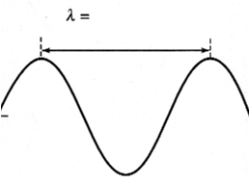
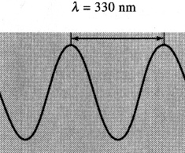
The Relationship Between
Frequency and Wavelength
800 nm
Infrared radiation
V = 3.75 x 10¹⁴ s⁻¹
Ultraviolet radiation
V = 7.50 x 10¹⁴ s⁻¹
Wavelength is inversely proportional to frequency

Slide 9
Particle properties of Light: Photons
Wave theory failed to explain phenomena associated with the absorption and emission of radiation of radiant energy.
Thus, EM is viewed as a stream of discrete particles, or wave packets, of energy called photons.
We can relate the energy of photon to its wavelength, frequency and wavenumber by
E = hV V - frequency
= h c λ - wavelength
λ υ - wavenumber
= h c υ
  h – Planck’s constant =6.63x10⁻³⁴ J·s

Slide 10
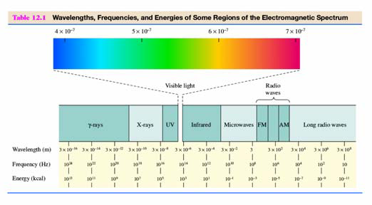
The Electromagnetic Spectrum

Slide 11
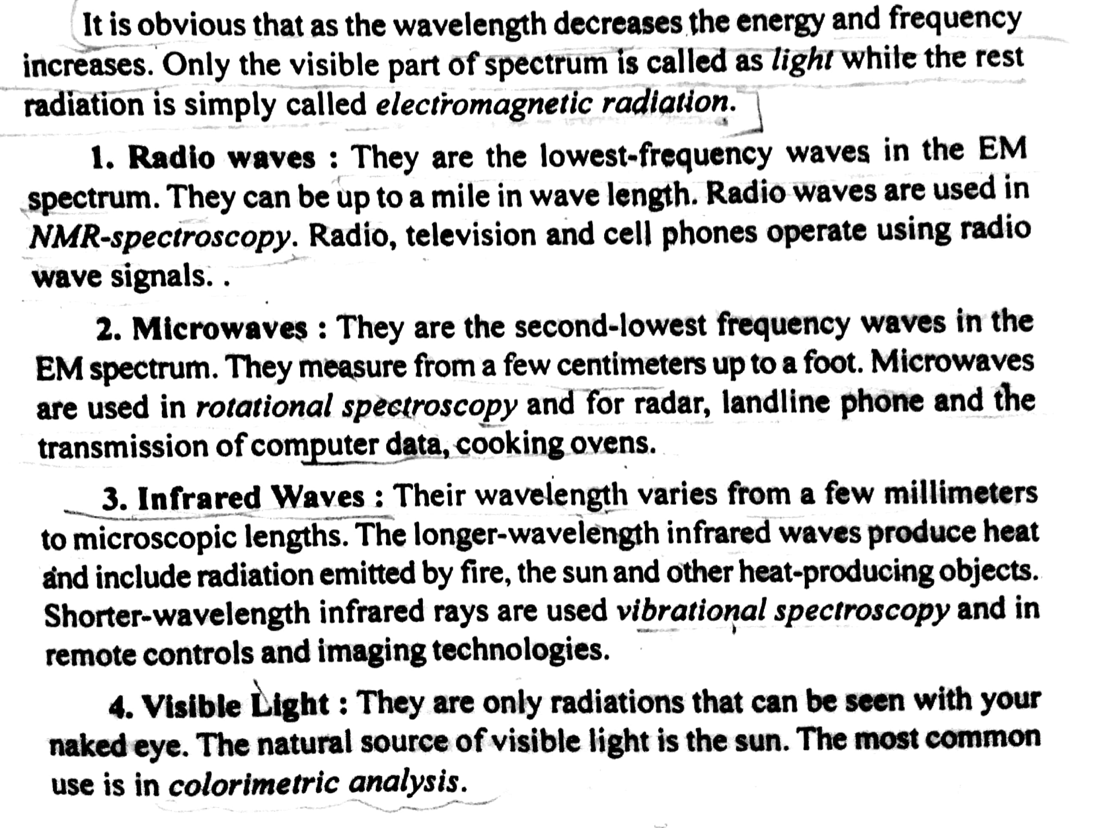

Slide 12
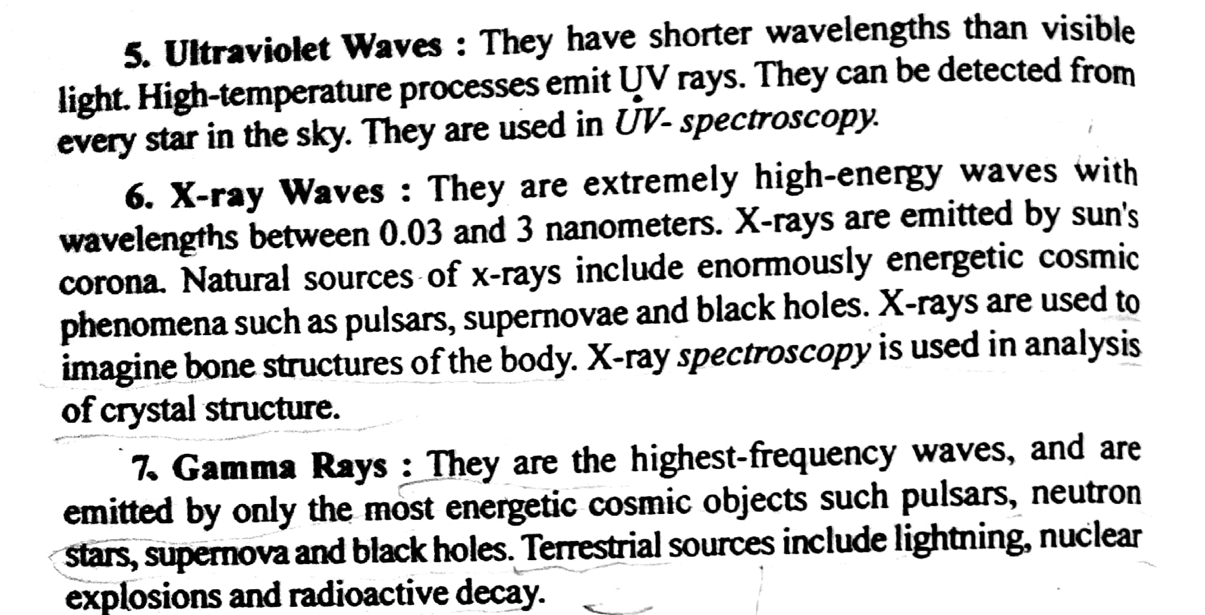

Slide 13
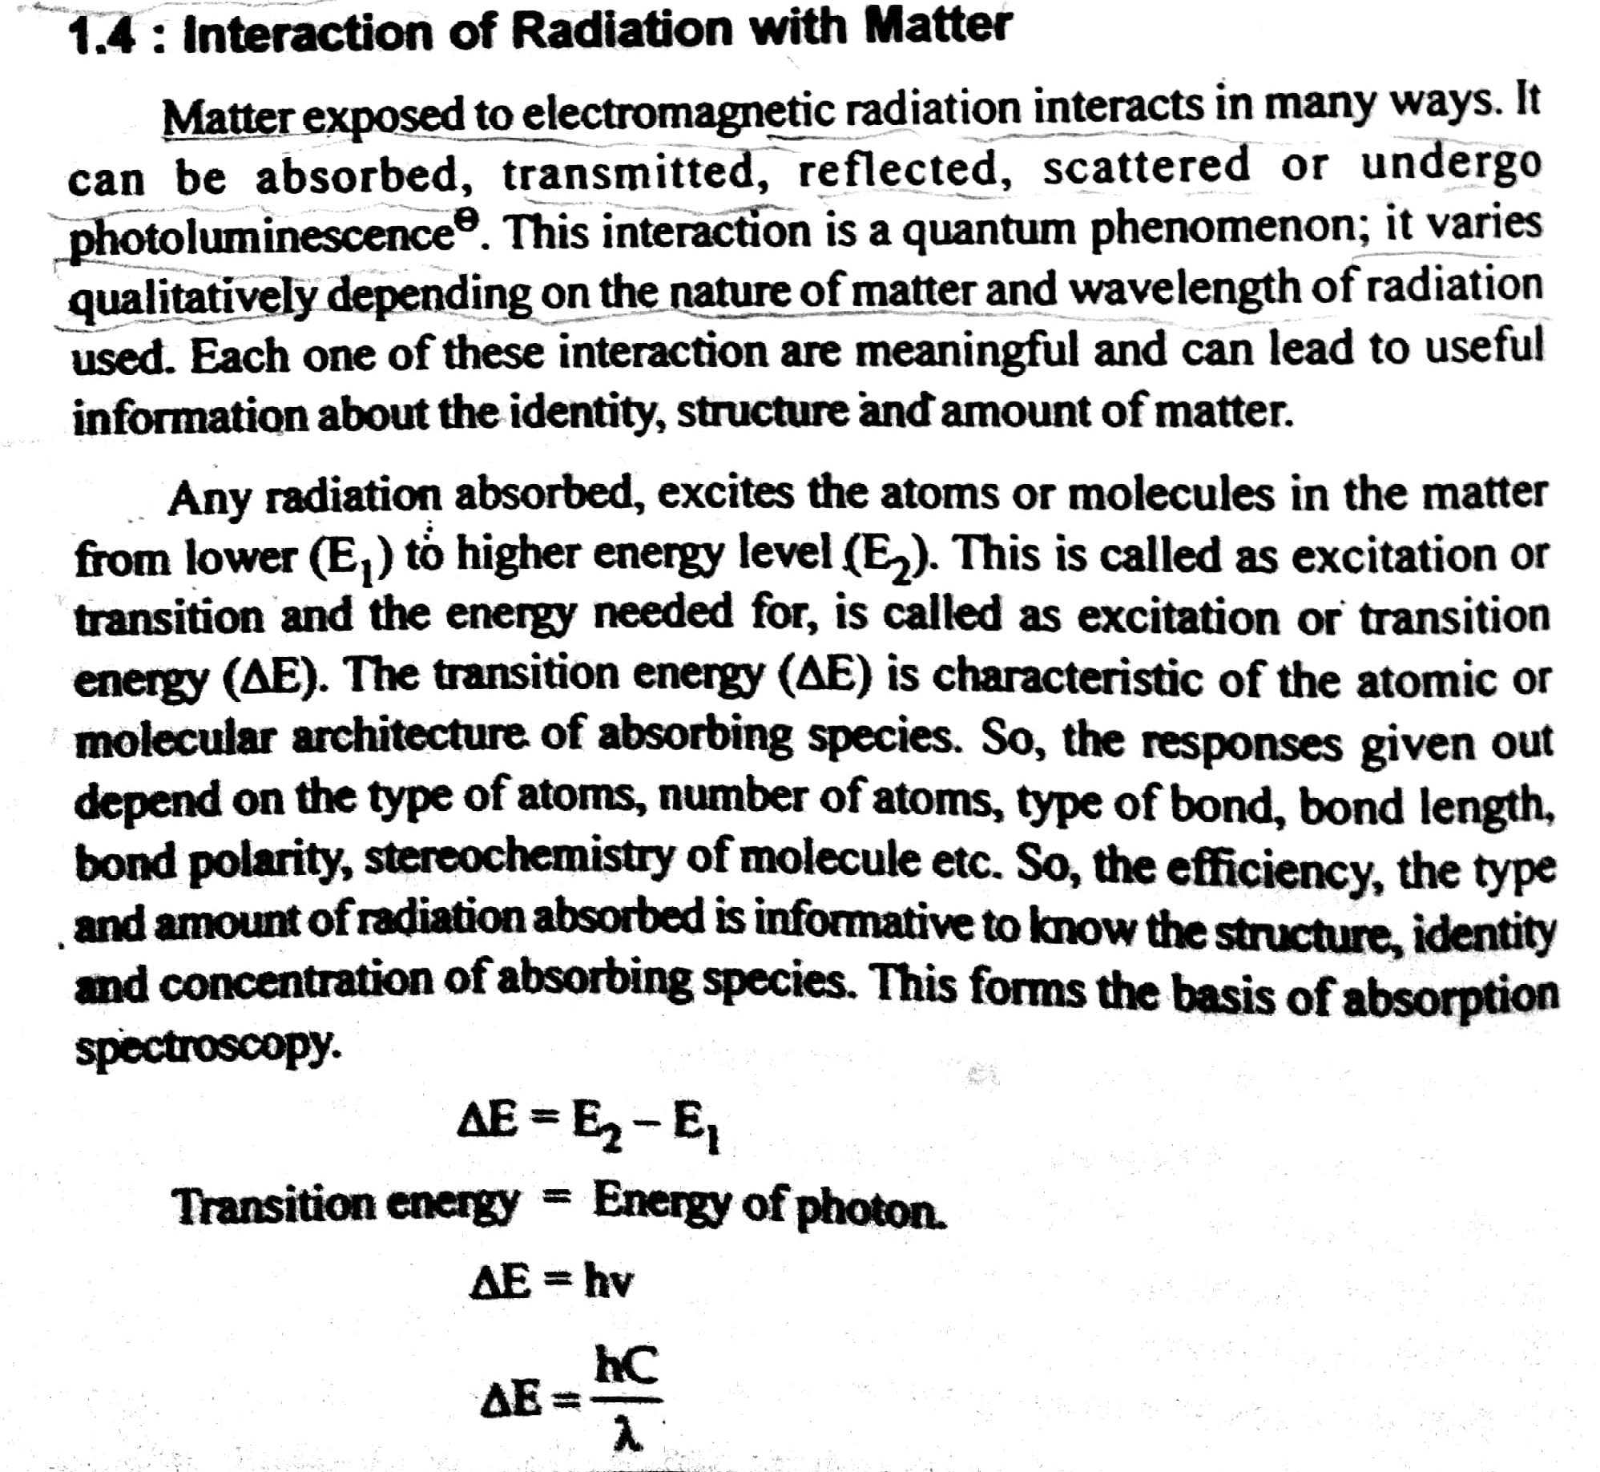

Slide 14
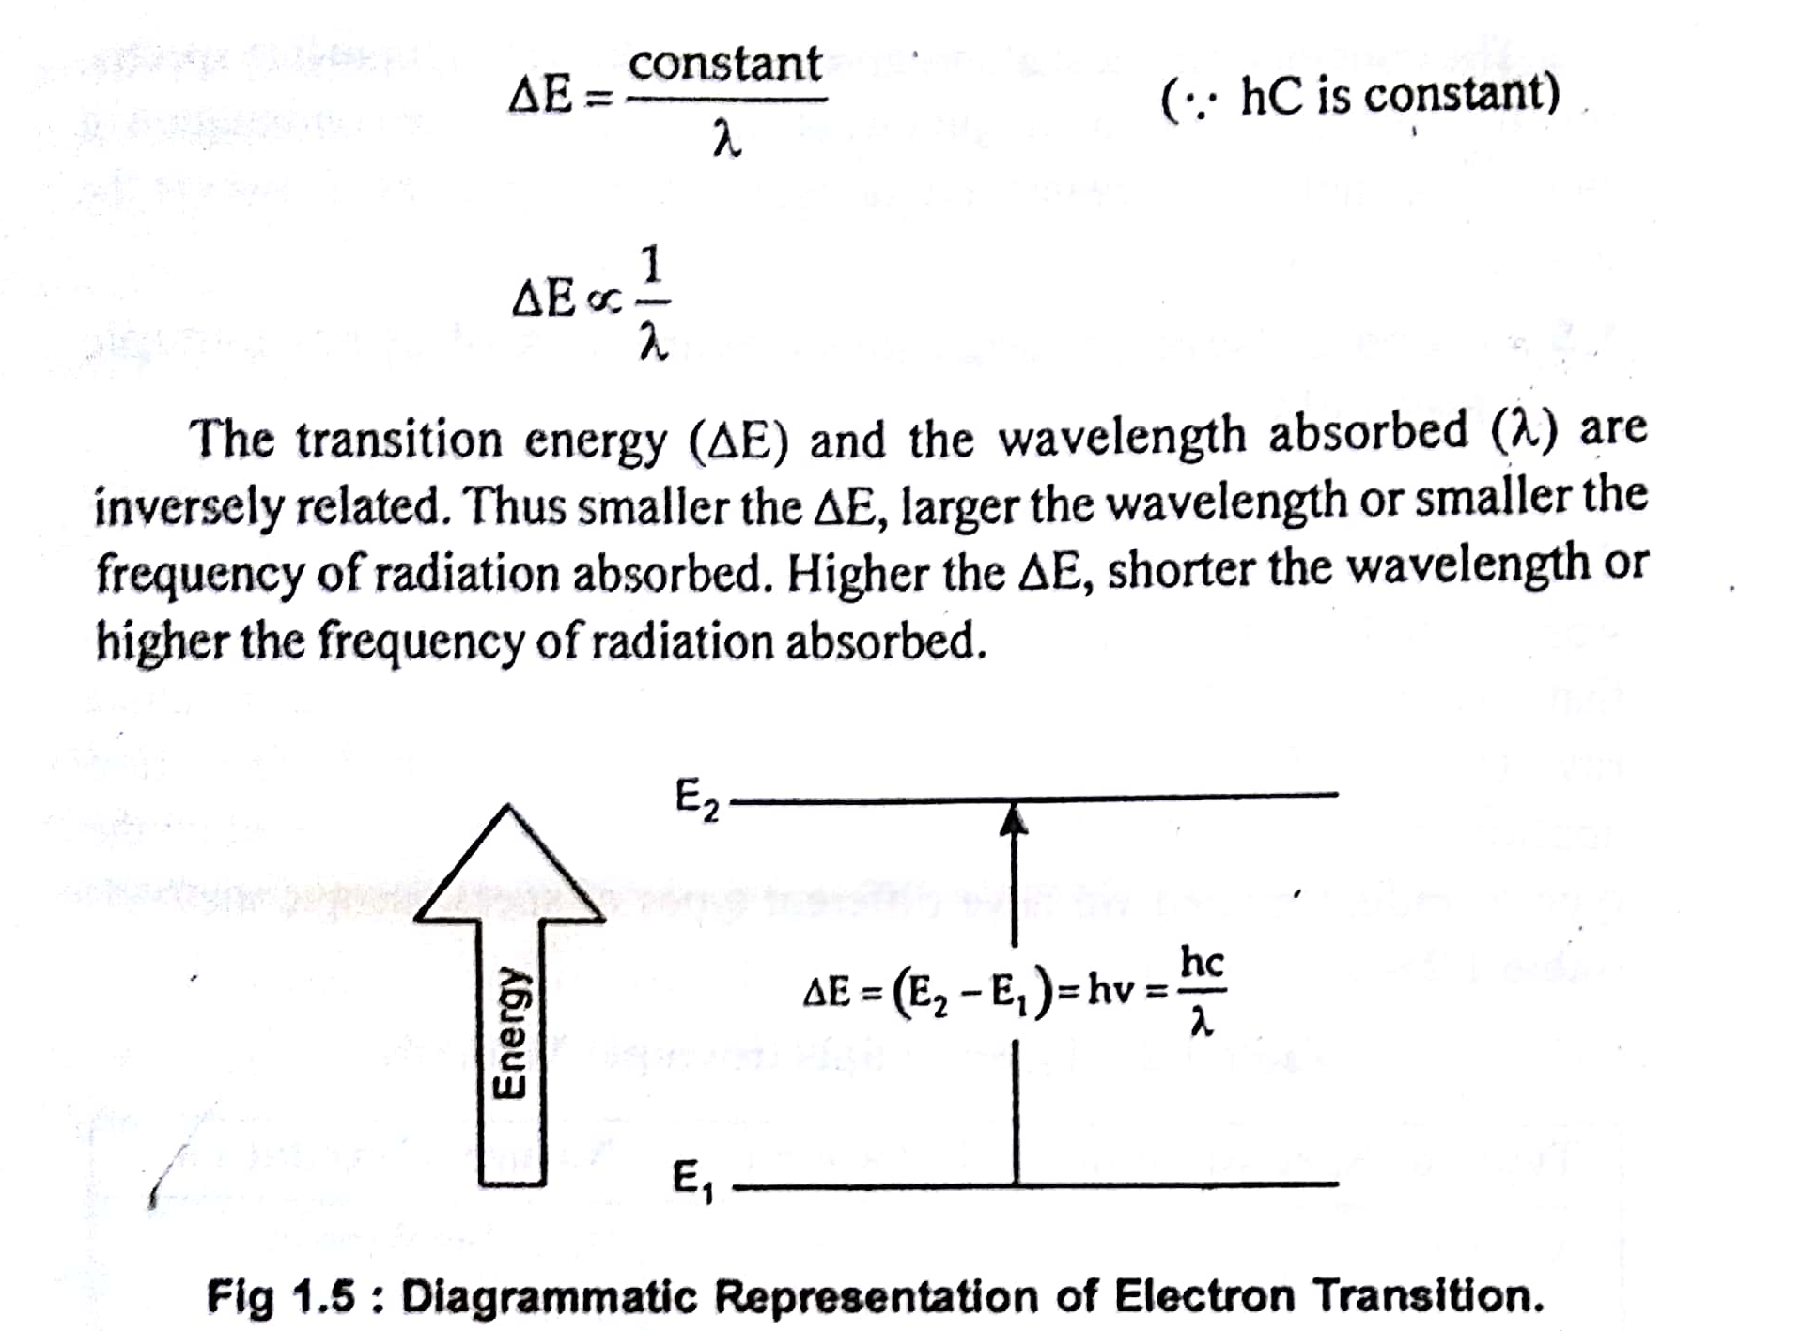

Slide 15
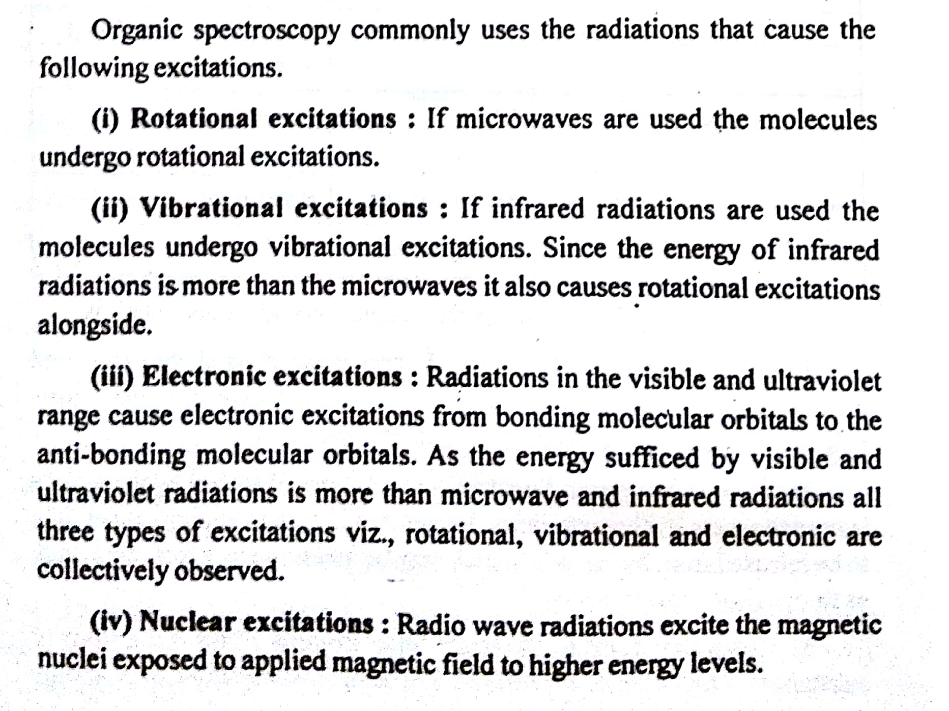

Slide 16
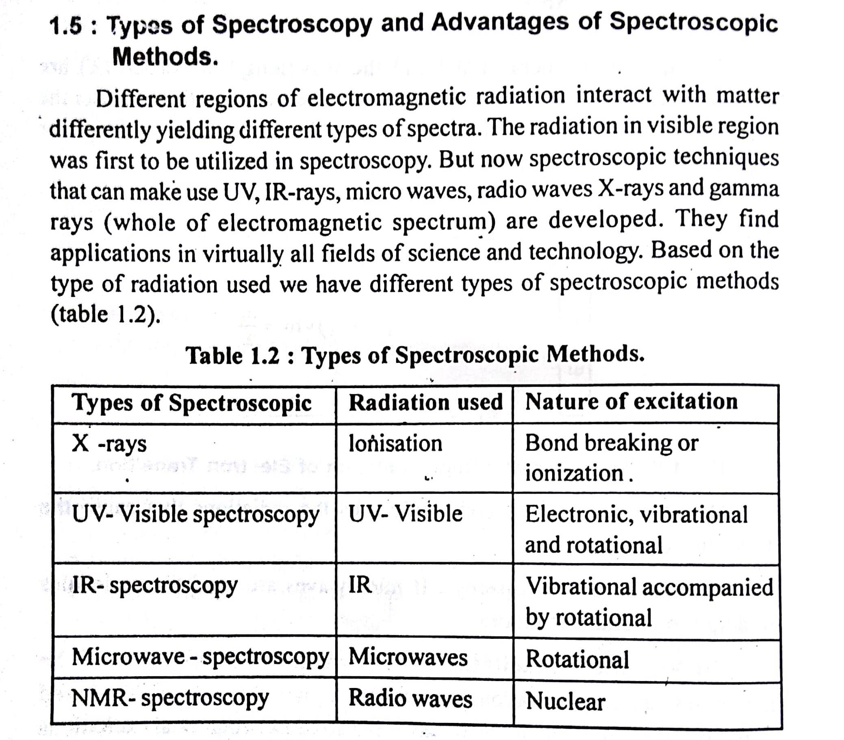

Slide 17
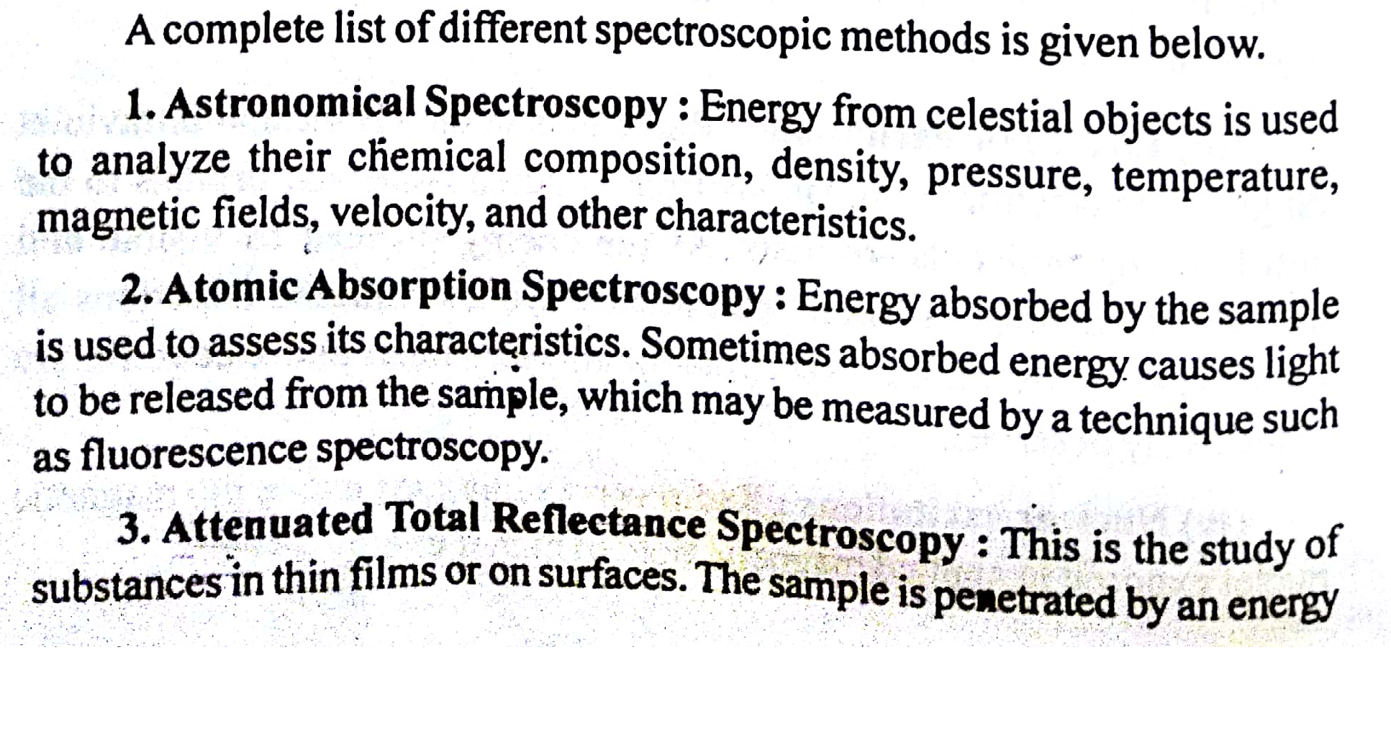

Slide 18
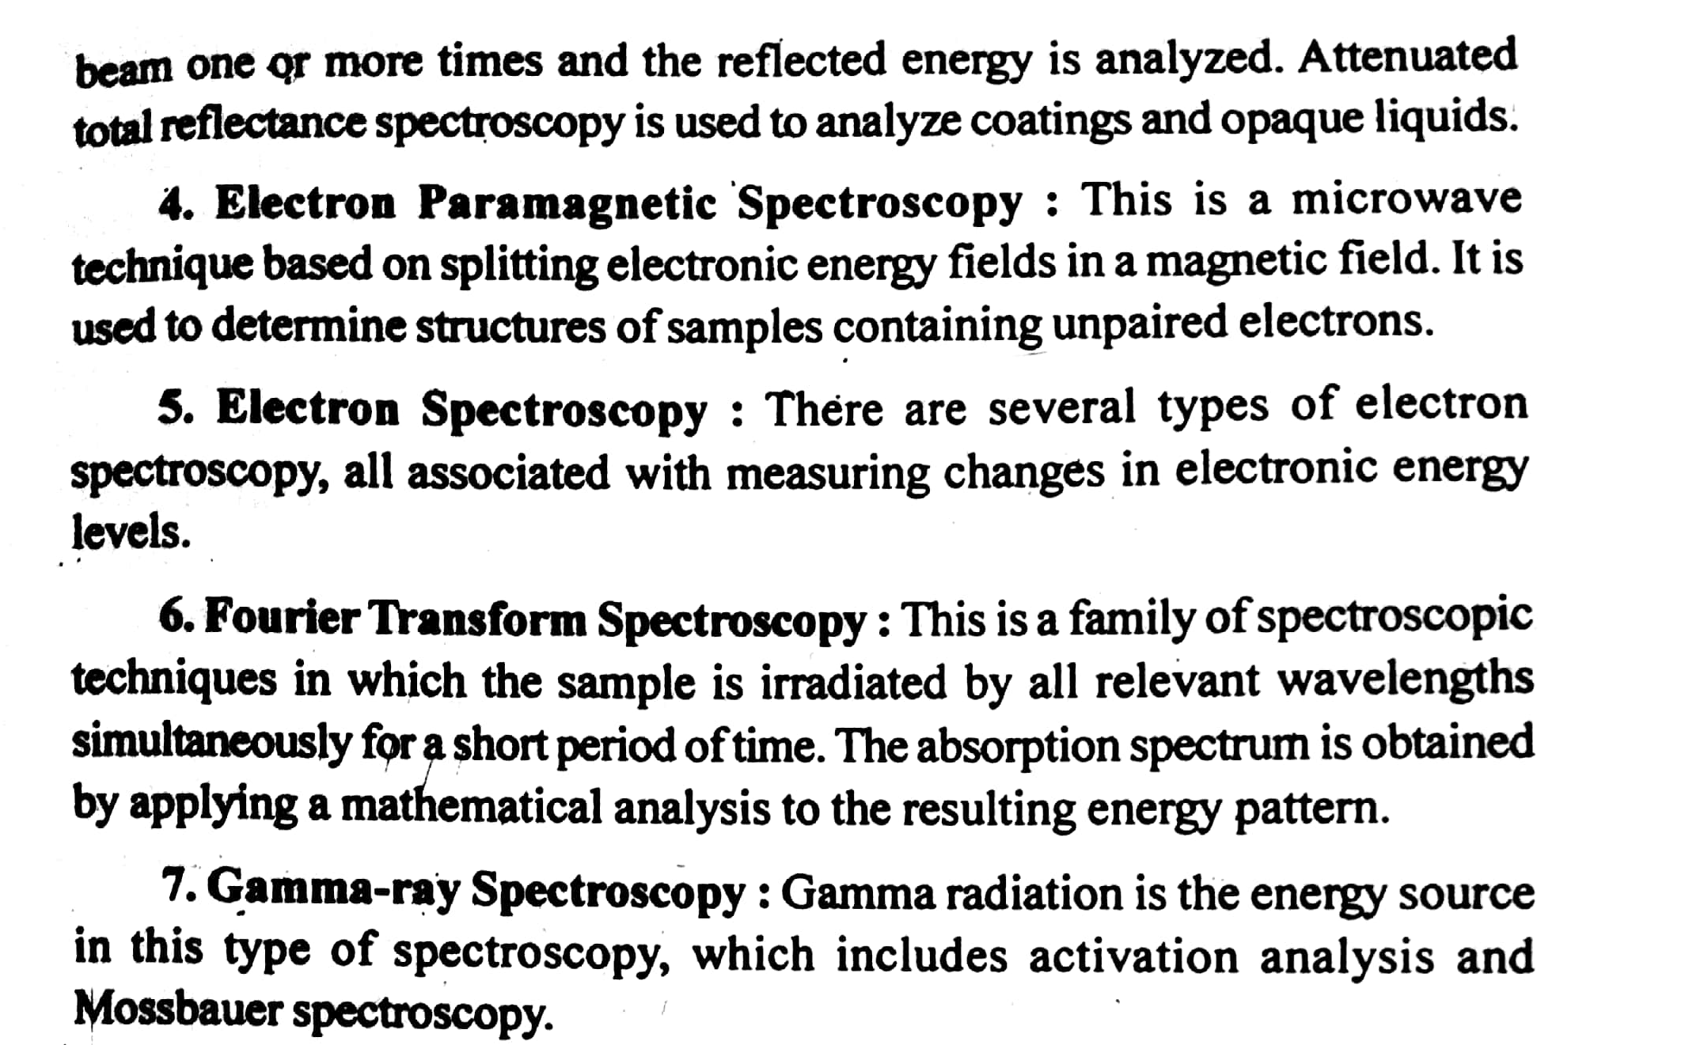

Slide 19
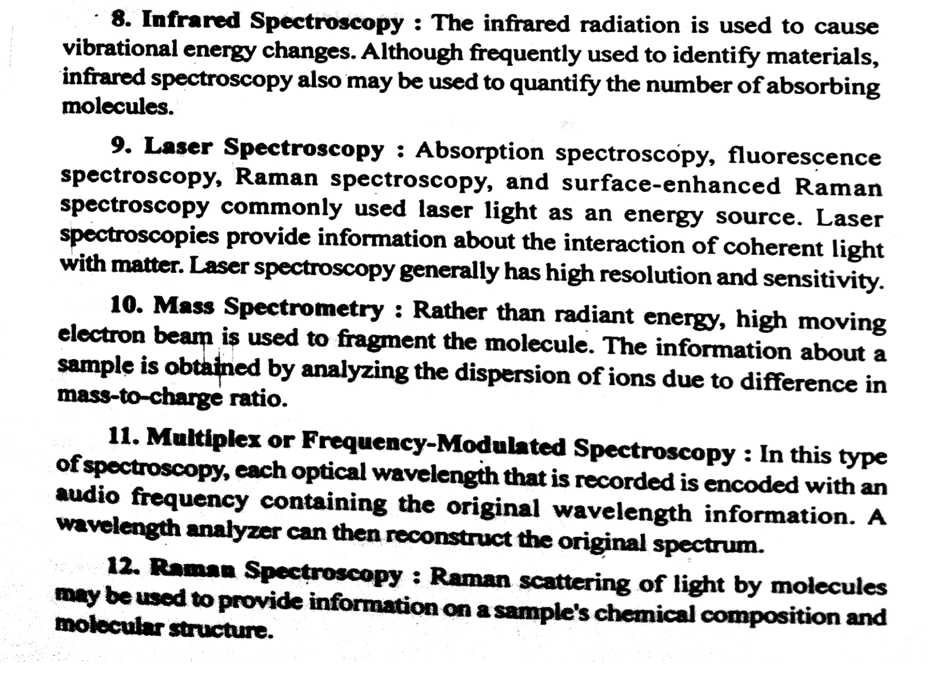

Slide 20
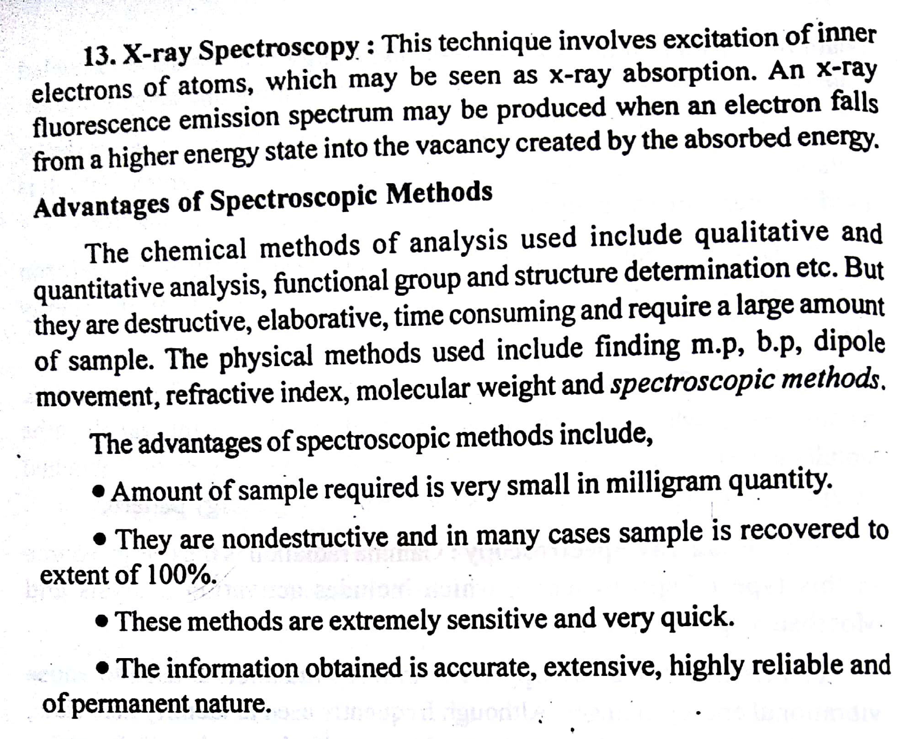

Slide 21
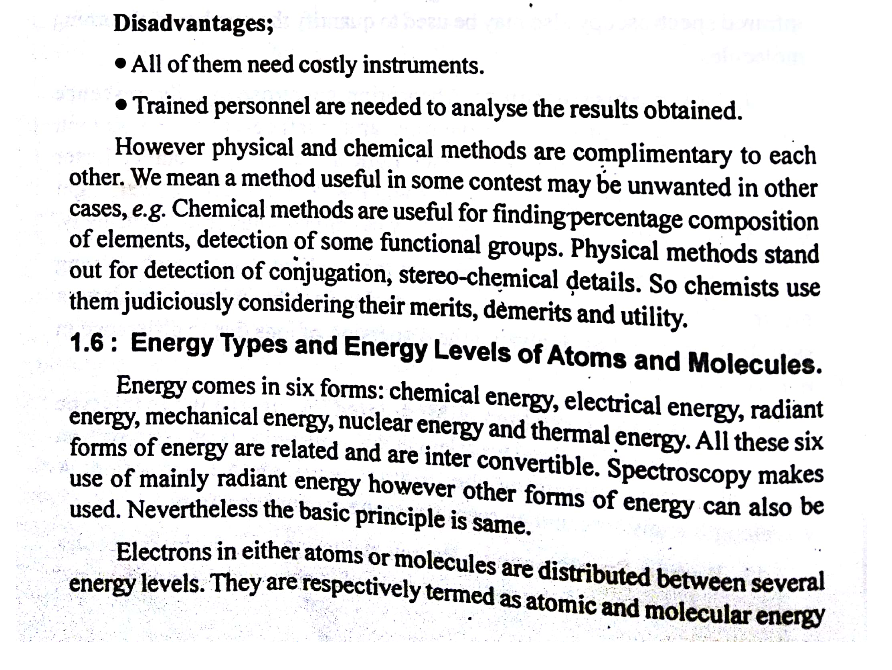

Slide 22
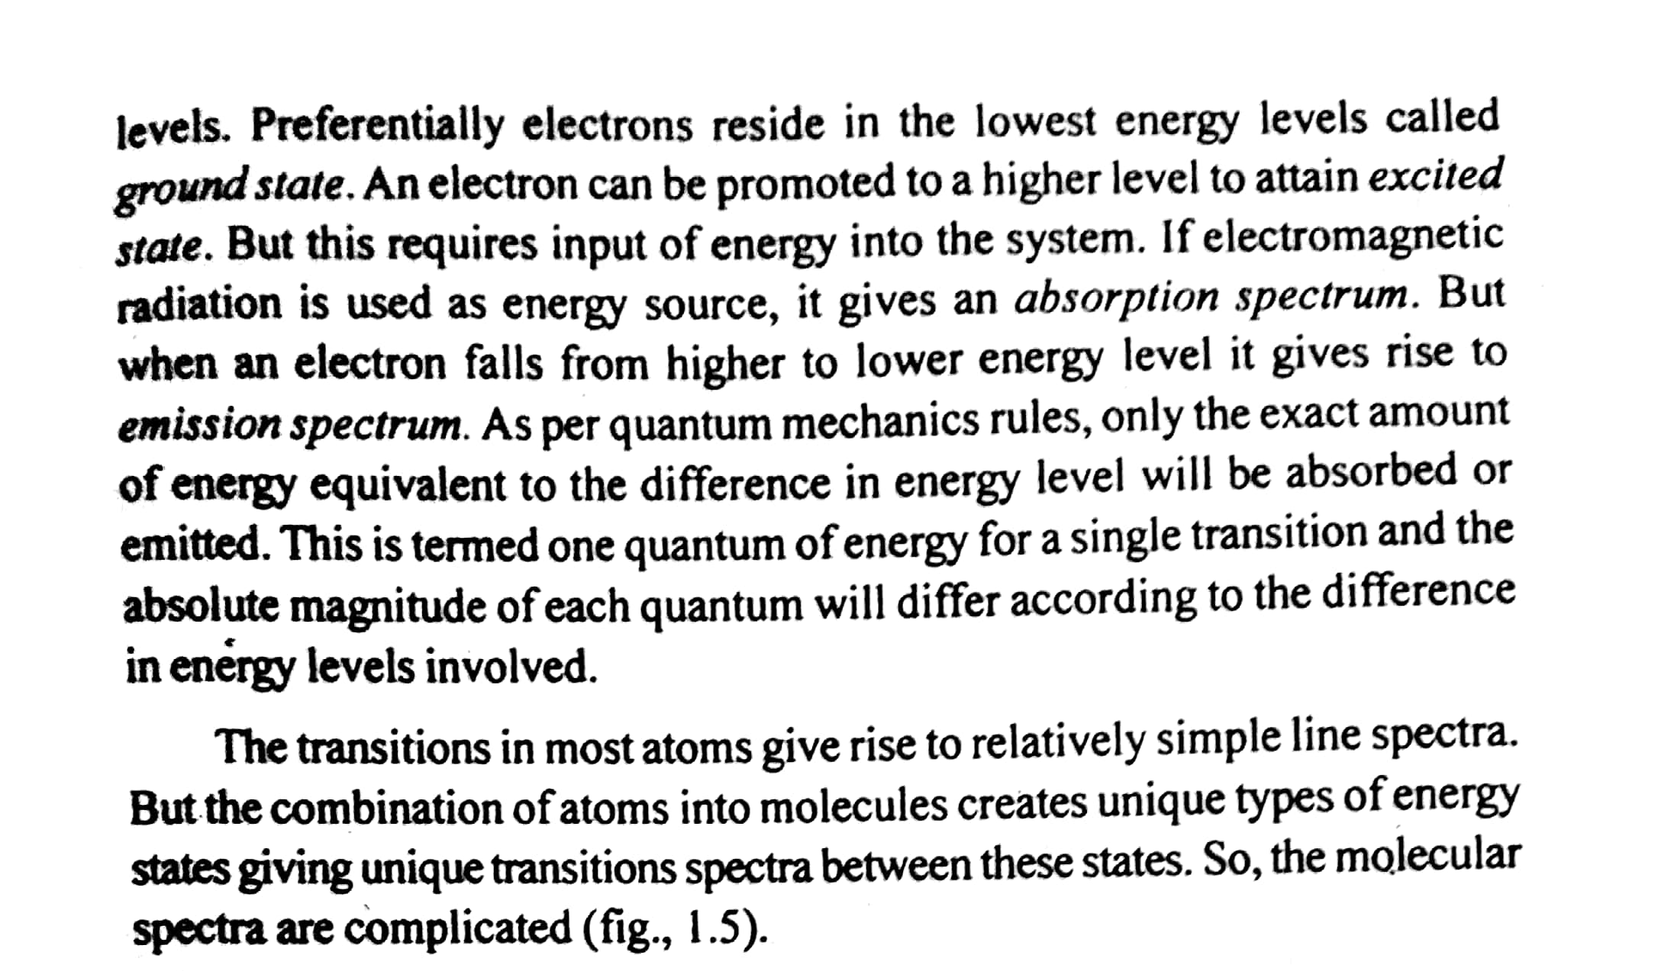

Slide 23
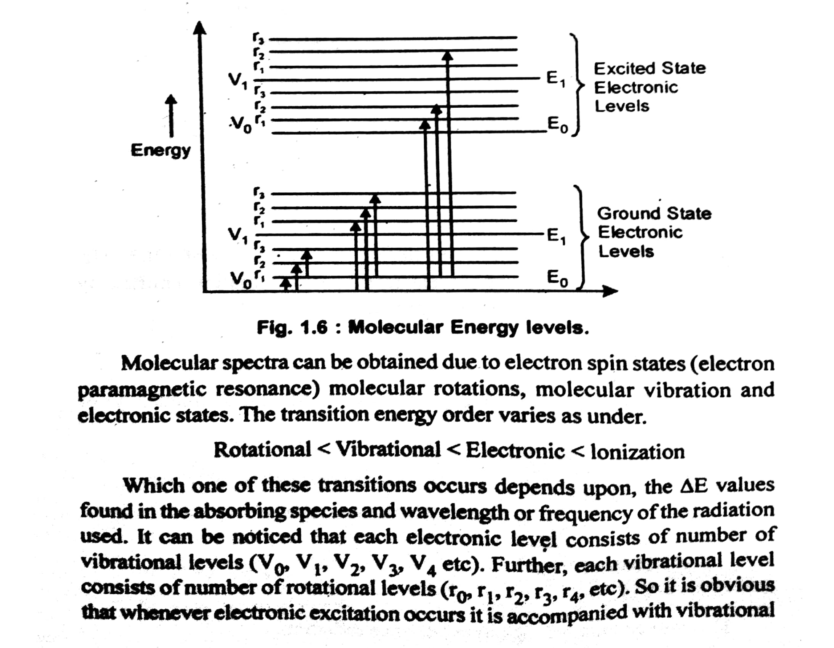

Slide 24
Thank You

