Slide 1

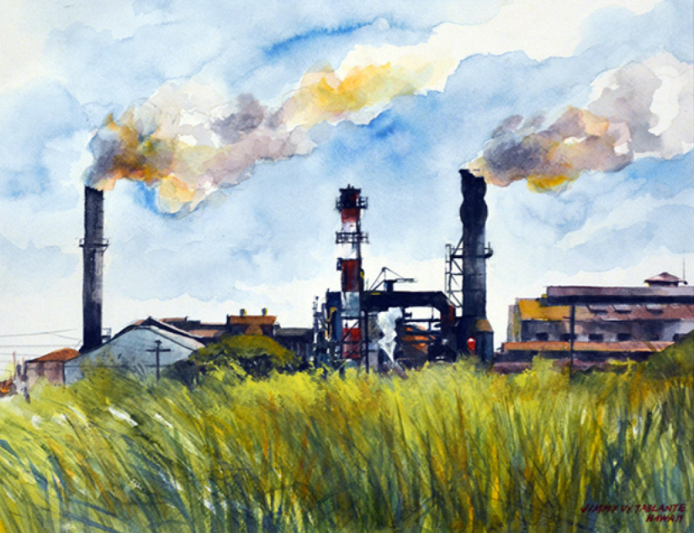
Manufacture of cane suger
Welcome

Slide 2
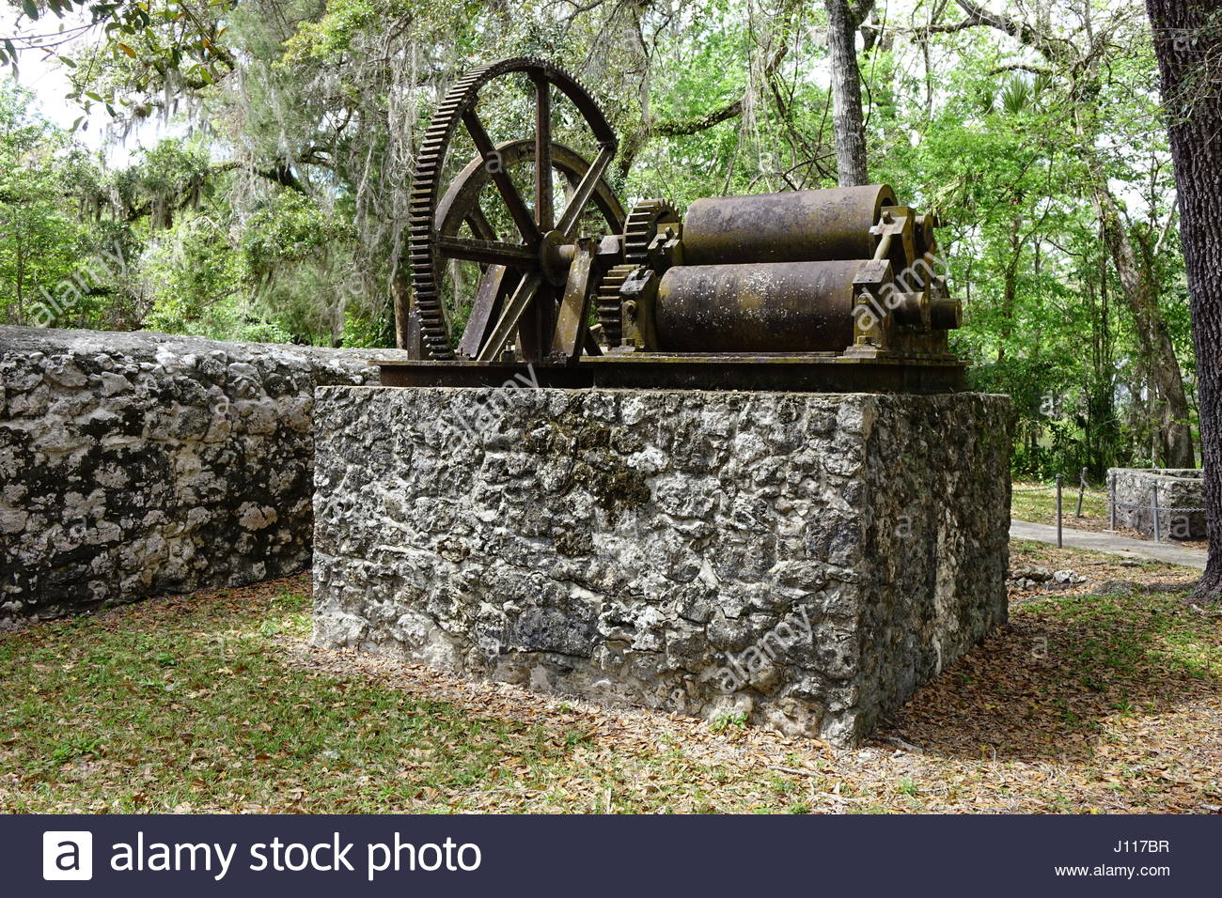
Extraction Of Juise
The cane is first washed to remove mud and dirt. Then cut digonally into small pieses by rapidly rotadly knives (400-600 rpm). The cane chips are then send to milling train consisting of a two rolled crusher followed by three rolled mills, usually 3 to 4 in serise.

Slide 3
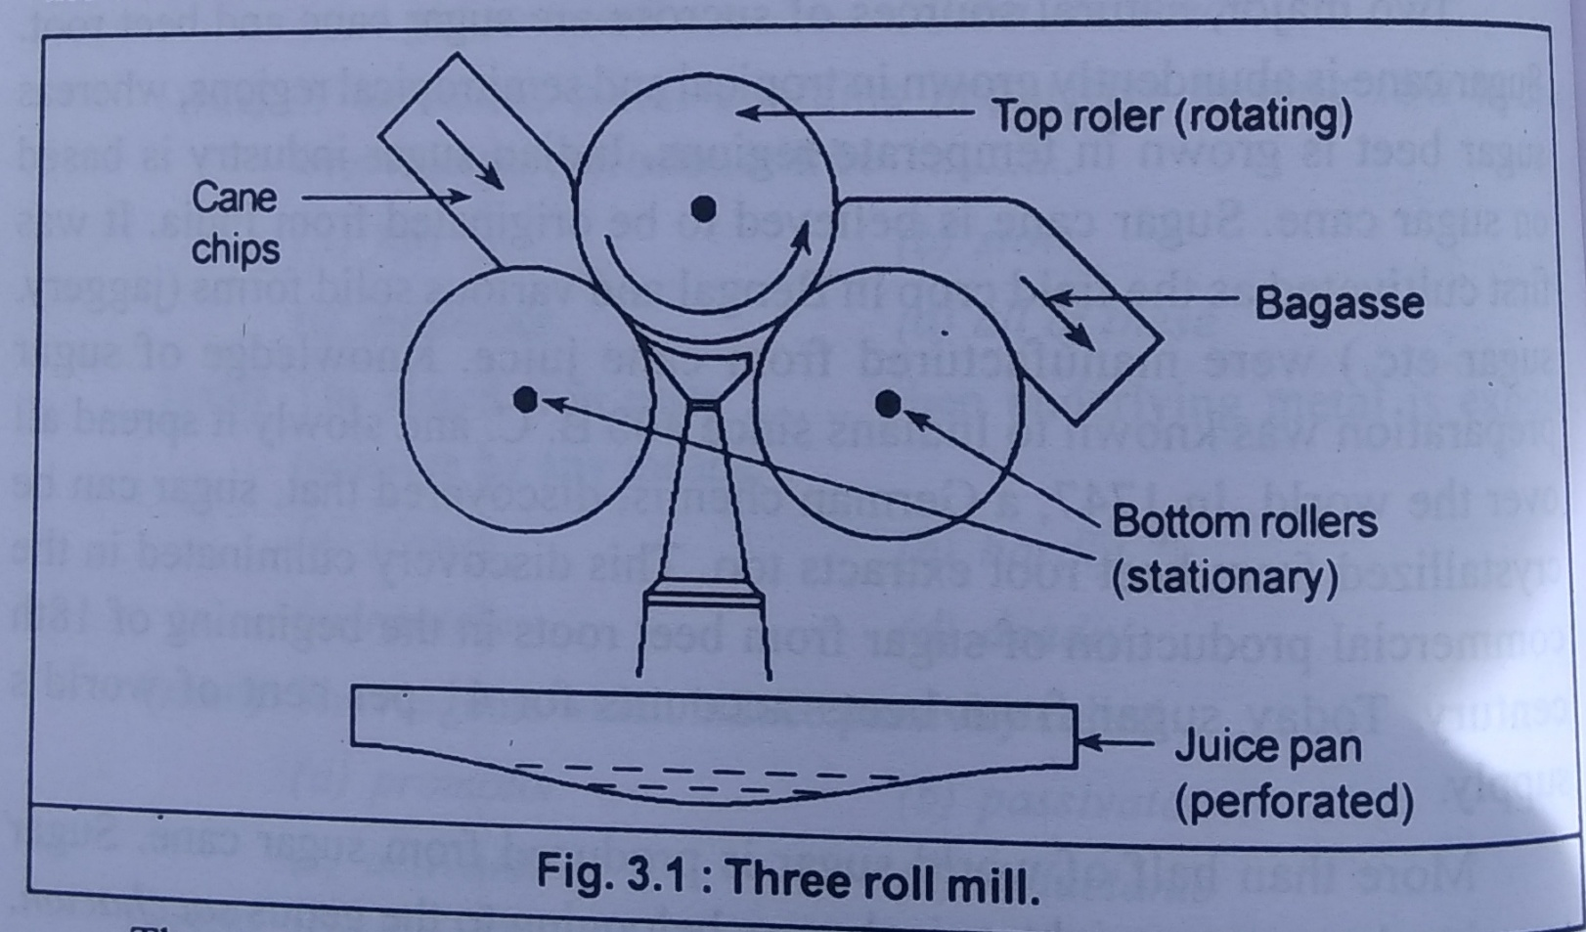
A mill consist of three horizontal rollers ( about 6 ft. in length & 3 ft. in dimetetr) arranged in trianguler Pattern. Only the top roll rotates and the tow bottom rollers remain stationary (Fig)

Slide 4
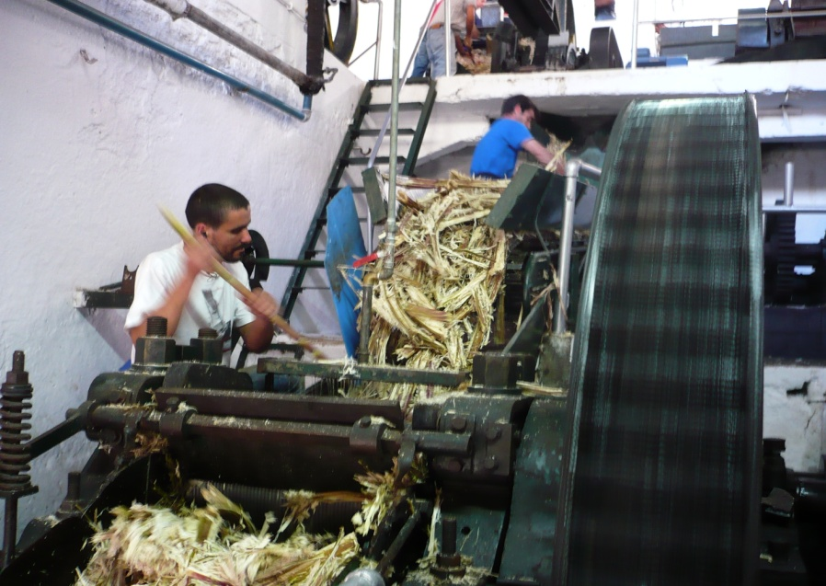
The pressure on top roller is maintained at 75 to 80 tons per meter of roller length. Below crusher and the first mill there is vibrating porous pan. The cane juice collected in the pan is freed of big suspended matter and the raw juice is send to boiling house.

Slide 5
The 2^{nd,} 3rd and 4th mills are providing with the simple
containers. When the chips are crushed in crusher only
about 60 - 70% of juice is extracted. The bagasse containing
the rest of juice is then passed to 1^{st,} 2^{nd,} 3rd & 4th mills.
After every sucessive milling, juice extraction from bagasse becomes incresingly difficult. So compound imbibition
technique is used. here hot water is sprayed on the bagasse passing from the 3rd mill. The dilute juice from the 4th mill
is sprayed between the 2nd & 3rd mills.

Slide 6
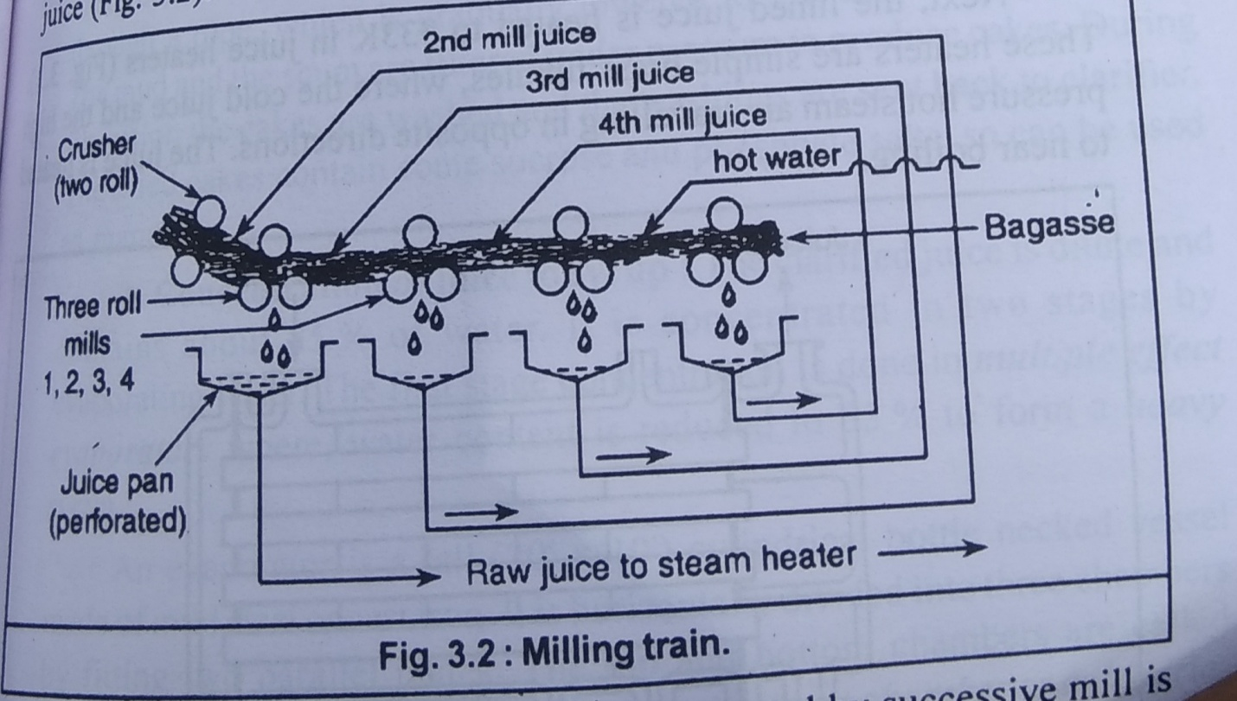
The juice from the 3rd mill is sprayed between 1st and 2nd mills. The juice from 2nd mill is sprayed on the bagasse coming from the crusher. The moistening of bagasse helps efficient extraction of cane juice. (fig)
The approximate percentage of juice extract by succesive mill is below.

Slide 7

Thank you…!

