Slide 1
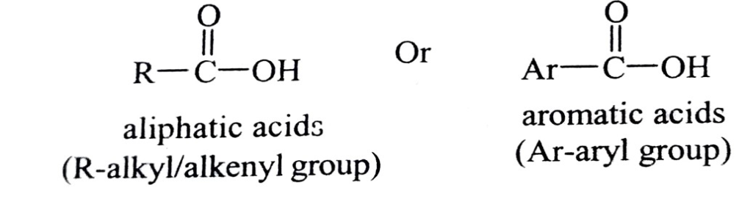
UNIT: 1. Carboxylic Acids and their Derivatives
Introduction
Organic compounds containing carboxyl (-COOH) group are known as carboxylic acids. The carboxyl group is made up of a carbonyl (C=0) group attached to a hydroxyl (-OH) group hence the name carboxyl.
The carboxylic acids can be grouped into mono, di, tri and poly carboxylic acids depending on the number of carboxylic groups. Further based on the nature of secondary functional group(s) in the side chain, they can be grouped into halo acids, (R-group carries halogen), hydroxy acids (R-group carry - OH group), amino acids (R- group carry -NH₂ group), keto or oxo acids (side chain carry C=O group).
1.1: Monocarboxylic Acids
The acids containing only one carboxylic group in their molecule are called as monocarboxylic acids. The carboxyl group is attached to an alkyl or aryl or alkenyl or alkynyl group. Irrespective of nature of side chain to which carboxyl group is attached the properties remain largely unaffected. They are represented as below,

Slide 2
Common monocarboxylic acids of different types are given below.
Saturated Acids: The carboxylic group is attached to alkyl radical (exception formic acid).
H-COOH CH3-COOH CH3-CH2-COOH
Formic acid (methanoic acid) acetic acid (ethanoic acid) propanoic acid
(b) Unsaturated Acids: The carboxyl group is attached to alkenyl radical
CH₂=CH-COOH CH3-CH=CH-COOH
Acrylic acid crotonoic acid
(c) Aromatic Acids: Carboxylic group is attached to aromatic ring (aryl radical) directly.
C6H5-COOH C6H5-CH=CH-COOH C6H5-CH₂ -COOH
Benzoic acid Cinnamic acid Phenyl acetic acid
Saturated monocarboxylic acids containing four or more carbon atoms are called fatty acids as they are obtained by the hydrolysis of oils and fats.

Slide 3
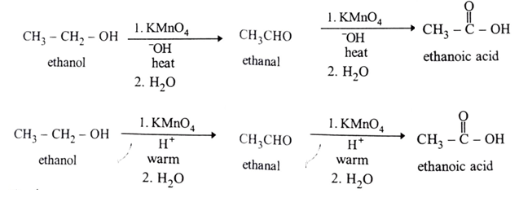
Methods of formation of Carboxylic acids Carboxylic acids are mainly prepared by the oxidation of a variety of functional groups.
1. Alcohols: The strong oxidizing agents oxidize primary alcohols first to aldehydes which get easily oxidized next to corresponding carboxylic acids. e.g., ethanoic acid is formed from ethanol via ethanal.
Potassium permanganate, potassium dichromate and chromium trioxide are strong oxidizing agents. Mild oxidizing agents such as manganese dioxide (MnO2) and Tollen's reagent [Ag(NH3)2OH] though oxidize alcohols to aldehydes they cannot oxidize aldehydes further to acids.

Slide 4
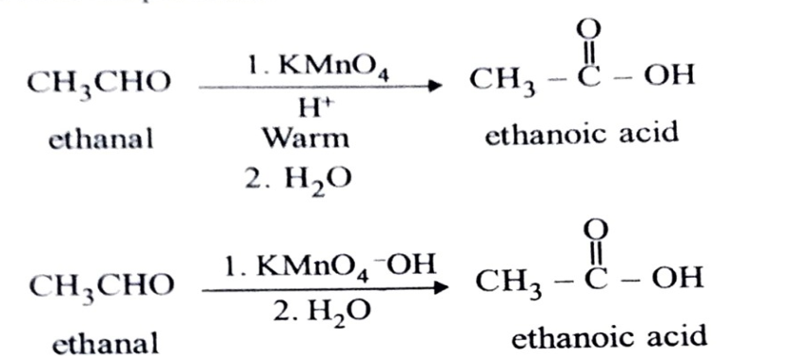
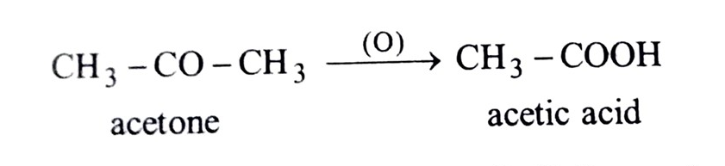
2. Aldehydes and Ketones: Oxidising agents like acid dichromate (K₂Cr₂O₇/H₂SO₄) and KMnO₄ oxidise aldehydes easily to carboxylic acids containing the same number of carbon atoms. The most common reagent used is CrO₃ in aqueous acid. This reaction generally gives good yields at room temperature.
The hydrogen atom attached to carbonyl carbon makes aldehydes to be strong reducing agents so they are very easily oxidised. Ketones lack hydrogen atom attached to carbonyl carbon and resistant oxidation. Ketones are oxidised by only very strong oxidising agents like potassium manganate (VII) (K2MnO4, potassium permanganate) solution. The oxidation of ketones occurs in a destructive way, breaking carbon-carbon bonds. So acids formed contain less number of carbon atoms. e.g., acetone forms acetic acid.

Slide 5
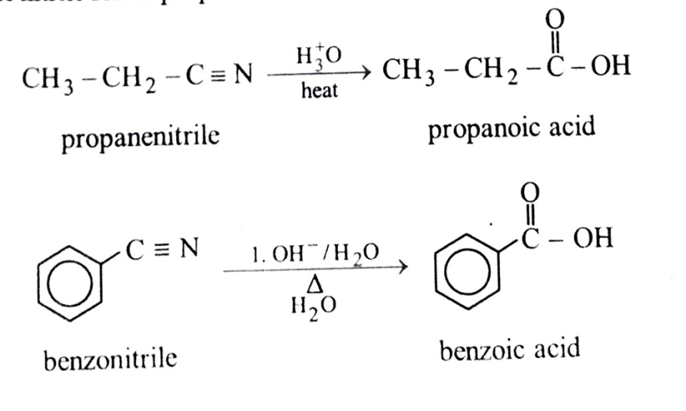
3. Nitriles:
The cyano group of nitriles undergoes hydrolysis under acidic or basic medium to give corresponding carboxylic acid e.g., propane nitrile forms propanoic acid and benzonitrile forms benzoic acid.
The mechanism of the reaction involves the formation of an amide followed hydrolysis to the acid.

Slide 6
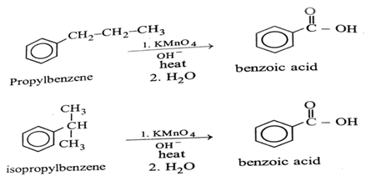
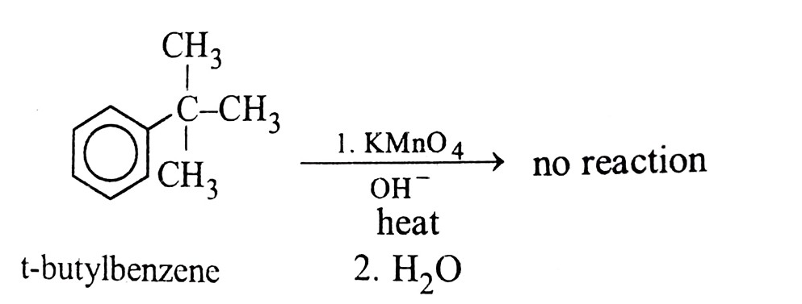
4. Alkyl benzenes: Alkyl benzenes carrying benzylic hydrogens (hydrogens on a-carbon to a benzene ring) undergo oxidation with strong oxidizing agents like, potassium permanganate (KMnO4) or potassium dichromate (K₂Cr₂O7) to form acids. e.g.,
A t-butylbenzene lacks benzylic hydrogen so doesn't undergo oxidation.

Slide 7
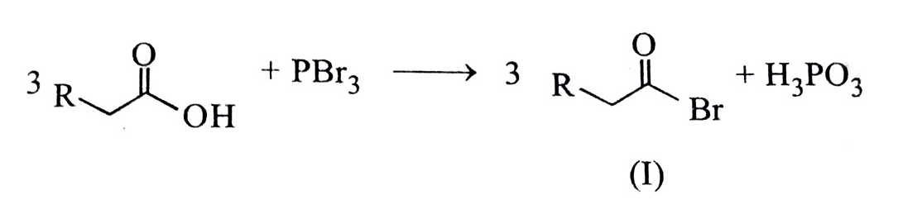
Chemical Reaction:
An important reaction of carboxylic acids was invented by German chemists Hell and Volhard and the Russian chemist Zelinsky. So it is named after them and commonly abbreviated as, HVZ reaction. It is used to halogenate carboxylic acids at α- carbon atom using a phosphorous catalyst and water. Phosphorus reacts with bromine to give phosphorus tribromide. 3/2 Br₂ + P PBr₃
In the first step this converts the carboxylic acid into an acyl bromide (1).
An acyl bromide (I) readily tautomerizes to enol form (II) which is rapidly brominated at the α-carbon. The monobrominted compound (III) is much less nucleophilic, so the reaction stops at this stage. This acyl intermediate (IV) undergoes bromide exchange with unreacted carboxylic acid via the anhydride. This allows the catalytic cycle to continue until the conversion is complete.

Slide 8
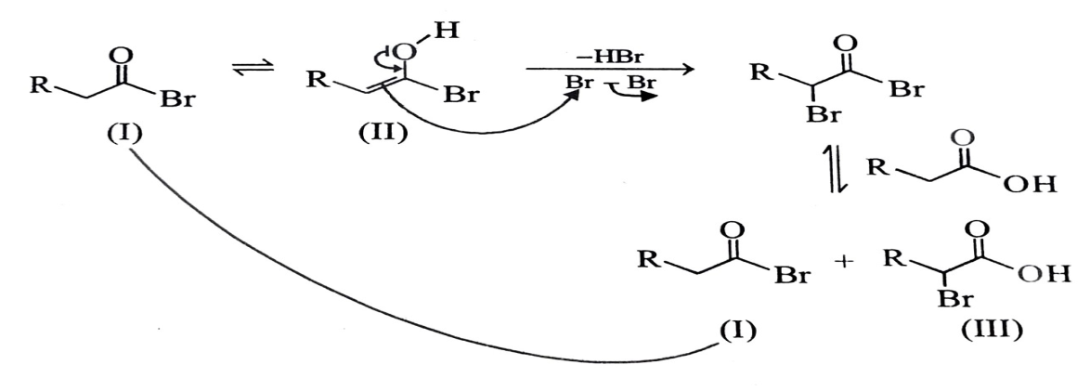
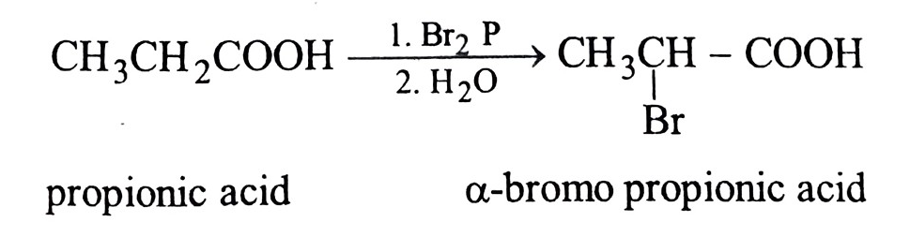
Thus, propionic acid forms α-bromo propionic acid.
Halogenation continues as long as α-H they are available. Chlorination can continue even beyond α-position only on exhausting all α-H. But bromination stops with monobrominated compound as it is much less nucleophilic.

Slide 9
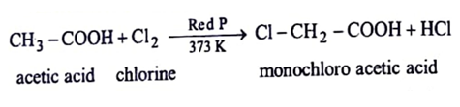
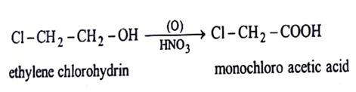
1.2: Formation of Halo Acids, Mono, Di, Tri- chloro acetic acid.
HVZ reaction is quite useful to form halo acids required to prepare a range of other acids. Thus they can form α-hydroxy acids (by hydrolysis), α-amino acids (by ammonolysis), α-ß unsaturated acids (by dehydrohalogenation and dehydration). We discuss below the methods used to prepare different chloro acids of acetic acid.
1. Monochloro acetic acid [CI - CH2 - COOH]: It can be prepared by any of the three methods given below:
(a) Hell-Vohlard-Zelinsky (HVZ) Reaction: Chlorination of boiling acetic acid in direct sunlight and in presence of red phosphorus gives mono chloro acetic acid.
(b) Industrially it is prepared by the oxidation of ethylene chlorohydrin with nitric acid.

Slide 10
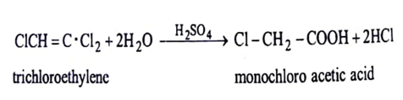
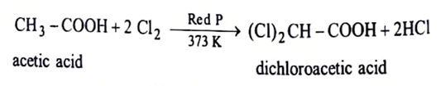
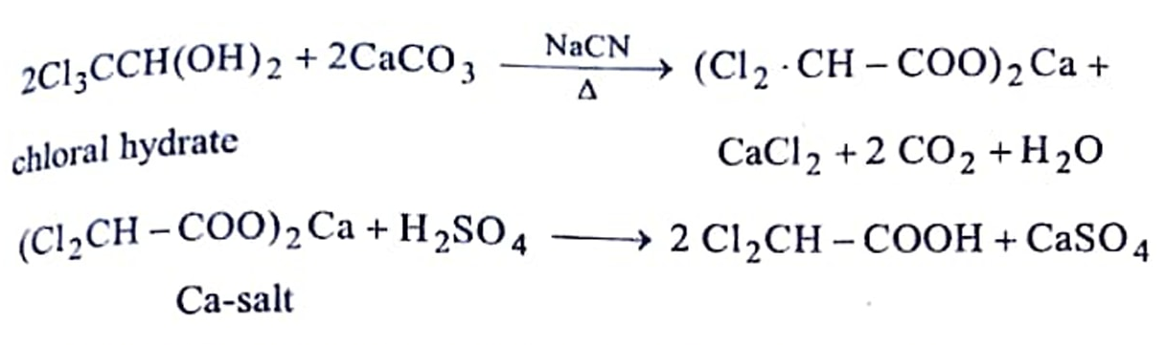
(c) It is manufactured by agitating tri-chloro ethylene with 90% sulphuric acid.
2. Dichloro acetic acid [(CI), CH- COOH]: It is prepared by any of the two methods given below.
Hell-Vohlard-Zelinsky reaction: Boiling acetic acid is treated with calculated quantity of chlorine in direct sunlight in the presence of red phosphorus.
(b) In laboratory and in industry it is prepared by adding calcium carbonate to warm and aqueous solution of chloral hydrate and then adding aqueous solution of sodium cyanide while heating the mixture. The calcium salt of acid on acidification gives dichloro acetic acid.

Slide 11
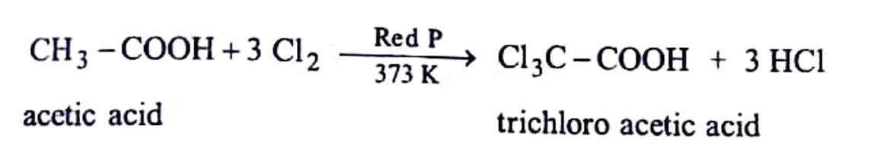
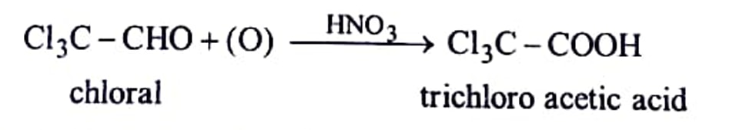
3. Trichloro acetic acid [Cl,C-COOH]: It is prepared by following two methods.
(a) Hell - Vohlard - Zelinsky reaction: Boiling acetic acid is treated with calculated quantity of chlorine in direct sunlight in presence of red phosphorus.
(b) It is also prepared by oxidation of chloral with concentrated nitric acid
1.3: Substitution Reactions of Monochloroacetic Acid.
Haloacids exhibit reactions of both alkyl halide and carboxylic group. Compared with alkyl halides, the α-halogen of haloacid is more reactive due to the presence of electron withdrawing carboxyl group.
Monochloroacetic acid undergoes nucleophilic substitutions at alkyl carbons much more easily. e.g. The halogen variety of nucleophiles like CN OH, I atom can be replaced by a and -NH₂.

Slide 12
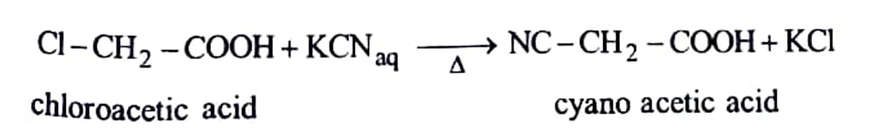
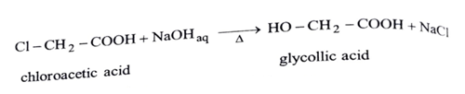
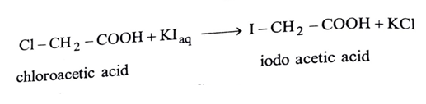
Action of potassium cyanide: Chloro acetic acid reacts with aqueous KCN and forms cyano acetic acid.
2. Action of alkali: Strong alkali like NaOH reacts with chloroacetic acid and forms glycollic acid (hydroxy acetic acid). Alternatively moist silver oxide can be used.
3. Action of potassium iodide Chloro acetic acid reacts with aqueous KI and forms iodo acetic acid.

Slide 13
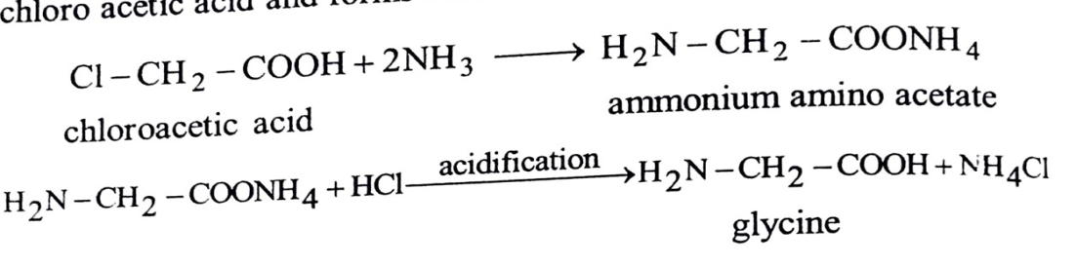
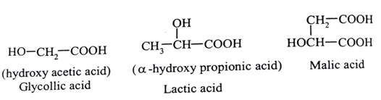
4. Action of ammonia Conc. solution of ammonia reacts with chloro acetic acid and forms amino acetic acid. i.e. glycine.
1.4: Hydroxy Acids
Acids containing hydroxy groups in their side chain are called as, hydroxy acids. Many of they are biologically important molecules. e.g.

Slide 14
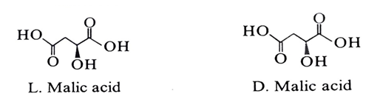
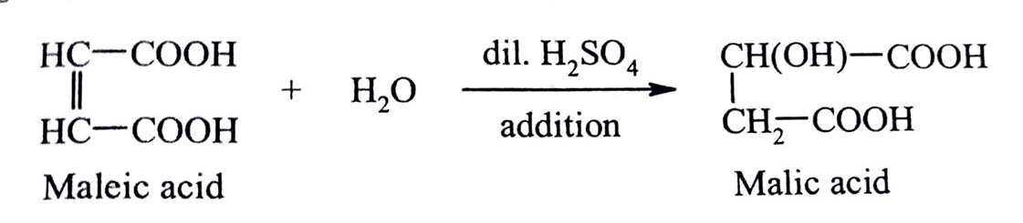
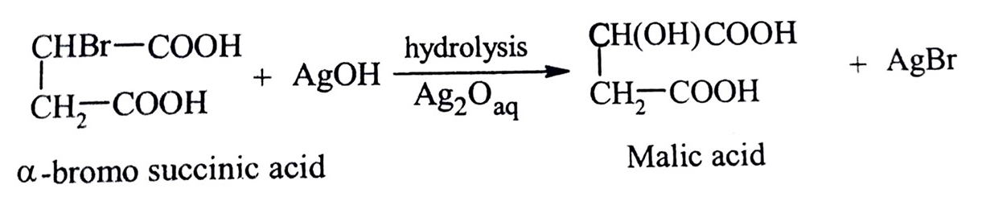
1.Malic acid (monohydroxy succinic acid): The name is derived from Latin word malum meaning apple. It is found in unripe (green) apples, grapes etc. and contribute to their sour taste.
Two stereoisomers of malic acid are D and L forms. But only the L-isomer exists in nature.
[A] Methods of preparation of malic acid
(a) From maleic acid: Maleic acid when heated with dilute acid H₂SO4 under pressure. It undergoes hydration and forms malic acid.
(b) From a -bromo succinic acid: When a -bromo succinic acid is treated with moist silver oxide malic acid is obtained.

Slide 15
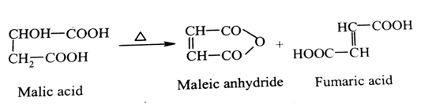
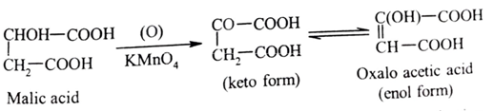
[B] Reactions of Malic acid: Malic acid gives the reactions of both secondary alcohol and a dibasic acid.
1. Action of heat: Malic acid on heating at 423-453 K forms a mixture of maleic anhydride and fumaric acid, an unsaturated acid.
This is a characteristic reaction of ß-hydroxy acids. Probably dehydration yields fumaric acid which isomerises to maleic acid followed by its dehydration to maleic anhydride.
2. Oxidation by KMnO₄: Malic acid on careful oxidation with KMnO4 gives oxalo acetic acid which exhibits keto-enol tautomerism.

Slide 16
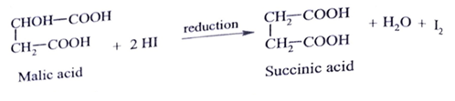
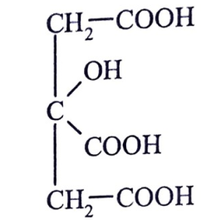
3. Reaction with HI (Reduction): Malic acid undergoes reduction with hydriodic acid (HI) and gives succinic acid.
[C] Uses of malic acid: It is used,
1. As substitute for citric acid in beverages deserts, backery products.
2. For preparing medicines which are used as purgatives and as remedy for sour throt, lozenges, cough syrups, tooth paste and mouthwash.
3. For preparing useful esters and salts.
4. As food acidulant and food flavour enhancer.
2: Citric acid (or 3-carboxy, 3-hydroxy pentan, 1,5 dioic acid) :
It is monohydroxy tricarboxylic acid, occurs naturally in unripe fruits of citrus family. Lemon juice contains 6-10% of citric acid.
[A] Methods of preparation of citric acid
(a) From glycerol: Glycerol gives citric acid by following series of reactions.

Slide 17
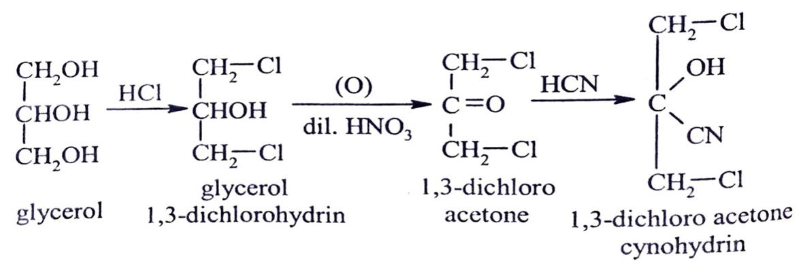
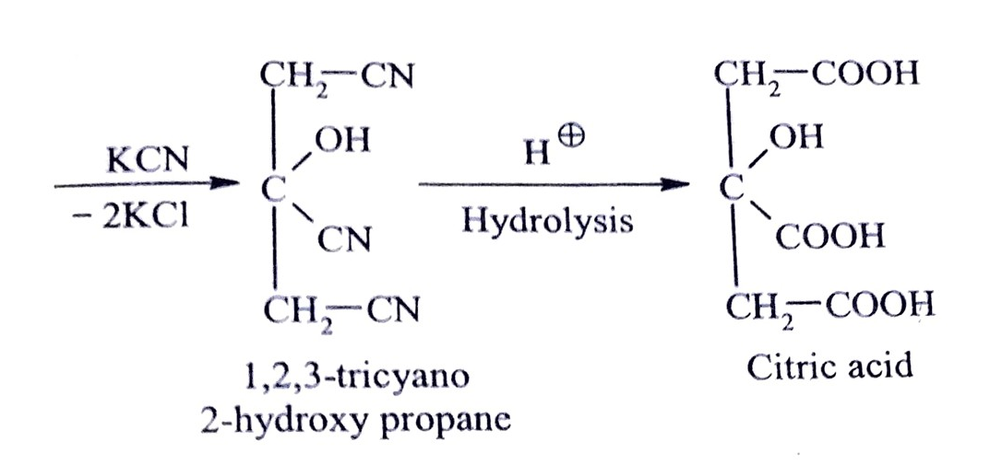
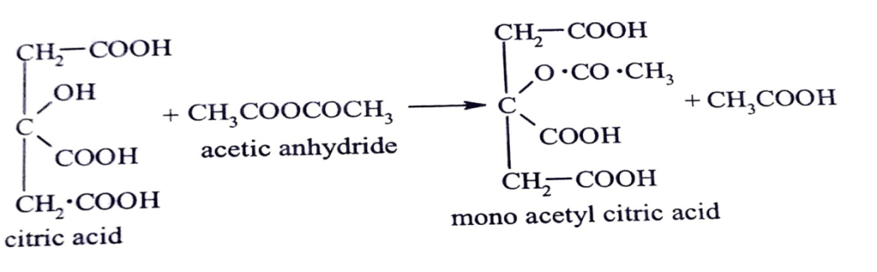
[B] Reactions of Citric acid
1. Acetylation by acetic anhydride: When citric acid is treated with acetic anhydride or acetyl chloride it forms mono acetyl derivative.

Slide 18
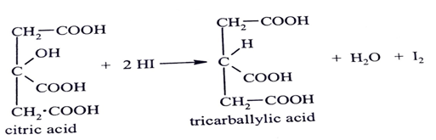
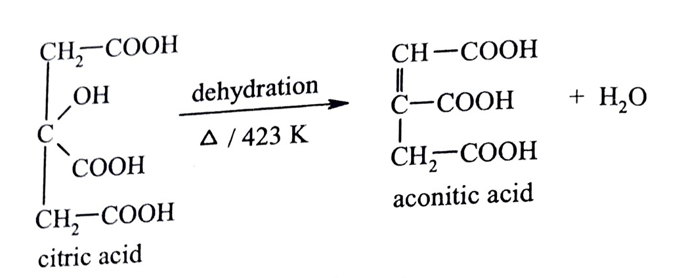
2. Reduction by hydrogen iodide (HI): Citric acid on reduction with HI forms tricarballylic acid.
3. Action of heat at 422 K: Citric acid on heating at 423 K loses a molecule of water like ß-hydroxy acid and forms aconitic acid.
[C] Uses of citric acid: It is used,
1. In confectionary and synthetic fruit drinks.
2. As mordant in dying and printing.
3. For cleansing metals.
4. Ferric ammonium citrate is used for making blue prints paper.
5. Citric acid esters (like tributyl citrate) are used as solvents in plastic industry.
6. Magnesium citrate is used as laxative and as antioxidant.

Slide 19
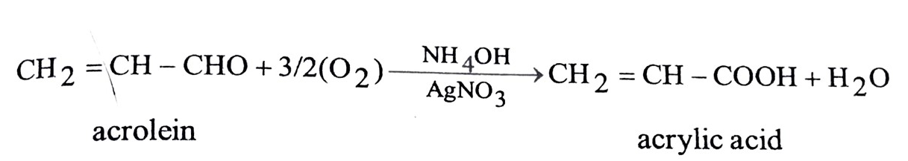
1.5: Unsaturated Acids
α, ß unsaturated carboxylic acids. They are carboxylic acids whose carboxyl group is attached to alkenyl radical. The most important ones are a -B unsaturated carboxylic acids having a double bond between α and B-position w.r.t. carboxylic group e.g.
CH₂= CH – COOH CH3-CH=CH-COOH C6H5- CH=CH-COOH
Acrylic acid Crotonic acid Cinnamic acid
(Propenoic acid) (But-2-enoic acid) (3-phenyl propenoic acid)
1. Acrylic acid (Propenoic acid) [CH₂ = CH - COOH]:
Acrylic acid is simplest unsaturated acid carrying a vinyl group (CH₂=CH-) connected directly to carboxylic group.
[A] Methods of formation of acrylic acid
From Acrolein: When acrolein (an a, ß-unsaturated aldehyde) is oxidised with ammoniacal silver nitrate (Tollens reagent), acrylic acid is obtained.
Tollens reagent being mild oxidising agent does not affect C=C bond.

Slide 20
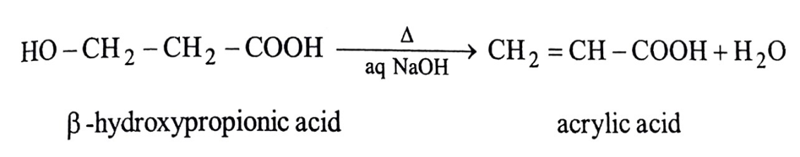
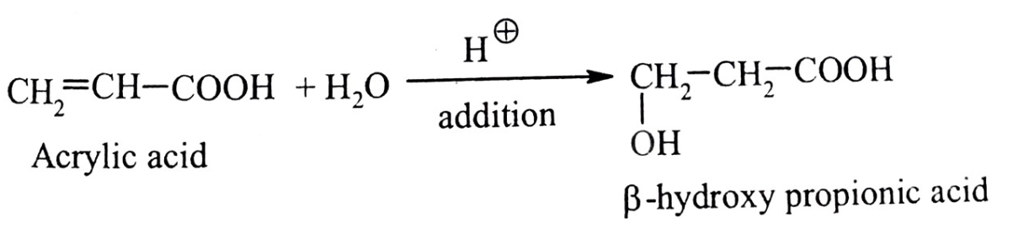
(b) From B-hydroxypropionic acid: The acid on heating with aqueous caustic soda (NaOH) or on distillation with ZnCl2 undergoes dehydration and forms acrylic acid.
[B] Properties of acrylic acid
Physical properties Acrylic acid is a colourless liquid, B.P. -415 K with pungent odour. It is miscible with water in all proportions. It is stronger acid than acetic acid.
Chemical properties: Acrylic acid gives two types of reactions, due to double bond (alkene) and due to carboxylic group.
When the double bond and carboxylic group are in conjugated position, their properties are mutually influenced.
1. Addition of water: Acrylic acid undergoes hydration reaction in presence of acid (or HgSO4 and H2SO4). The addition of water is slow and addition takes place contrary to Markownikoff's rule.

Slide 21
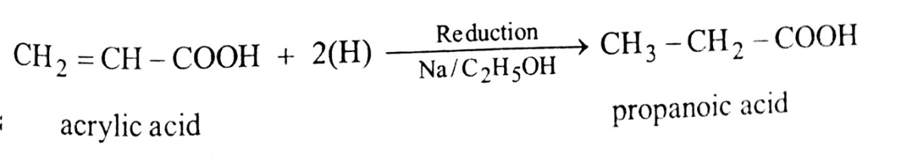
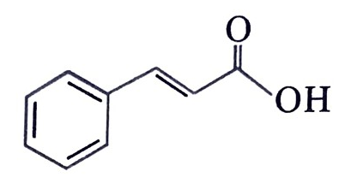
2. Reduction: Catalytic hydrogenation of acrylic acid with Na metal in ethanol gives propanoic acid.
C] Uses of acrylic acid: It is used,
1. For preparing esters.
2. It is also used as modifying agent for thermosetting resins.
3. Acrylamide is used for electrophoretic separation techniques.
4. Acrylonitrile is a important monomer of synthetic fibres and rubbers.
2: Cinnamic acid (B-phenyl acrylic acid)
It exists in cis and trans geometric isomeric forms. The cis isomer is called cinnamic acid and the trans isomer is known as allocinnamic acid. Cinnamic acid and its esters are found in oil of cinnamon, in balsams and resins.
[A] Methods of preparation
(a) From benzaldehyde using diethyl malonate: When benzaldehyde is refluxed with malonic ester, an unsaturated diester is obtained which on hydrolysis and decarboxylation forms cinnamic acid. This is Knoevenagel condensation.

Slide 22
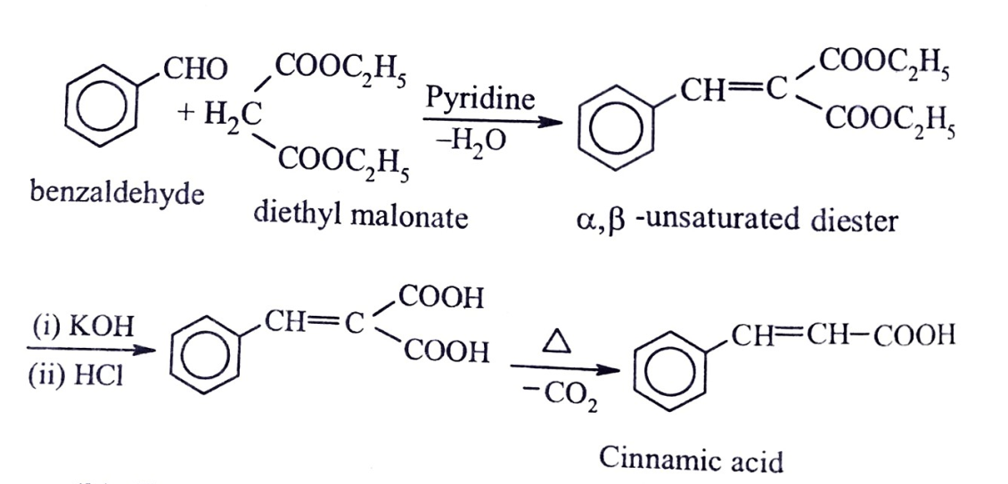
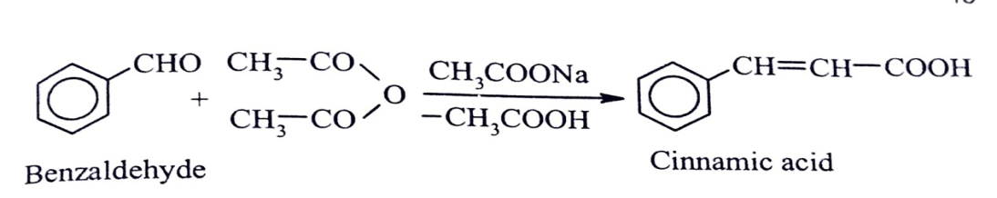
(b) From acetic anhydride and benzaldehyde: benzaldehyde is refluxed with acetic anhydride in the presence of sodium acetate, cinnamic acid is obtained. This is Perkins reaction.

Slide 23
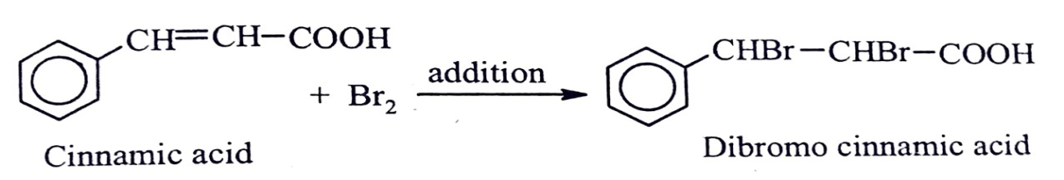
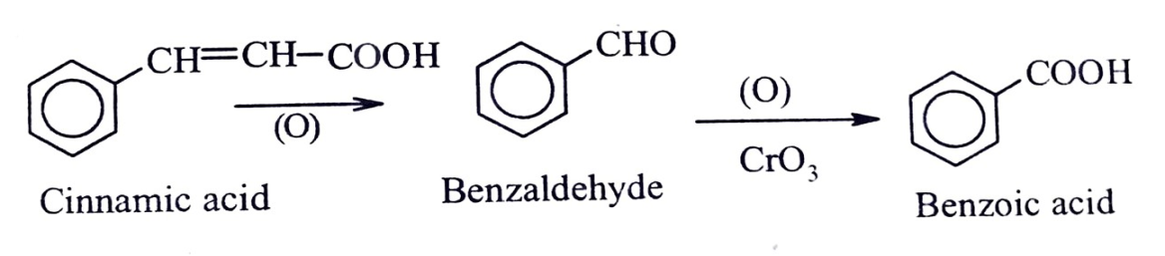
[B] Properties of cinnamic acid
Physical properties: It is a white crystalline solid, M. P. 406 K. It is sparingly soluble in water.
Chemical properties
Bromination (Action of bromine): Cinnamic acid reacts with bromine and forms addition product dibromo cinnamic acid.
2. Oxidation: Cinnamic acid when oxidised with chromic acid forms a mixture of benzoic acid and benzaldehyde.
[C] Uses of cinnamic acid: It is used,
1. In the synthesis of compounds used in pharmaceutical industry.
2. In perfumery cinnamic acid esters (methyl, ethyl and benzyl) are used for blending with rose and similar perfumes.
3. As a preservative for fruits and vegetables.
4. It is a precursor for the synthesis of sweetner called aspartame.

Slide 24
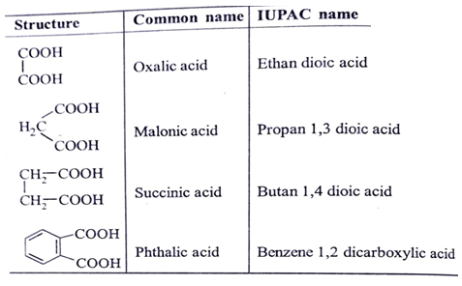
1.6 Dicarboxylic Acids
Acids containing two carboxylic groups in their molecule are called dicarboxylic acids. They may be aliphatic or aromatic, saturated or unsaturated.
Many of them are known by common names. e.g. oxalic acid is Obtained from sorrel, a plant of oxalis group.
In IUPAC system suffix dioic acid is attached to the name of parent alkane.

Slide 25
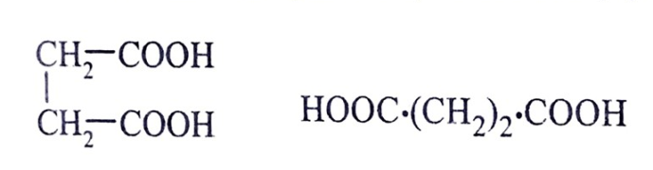
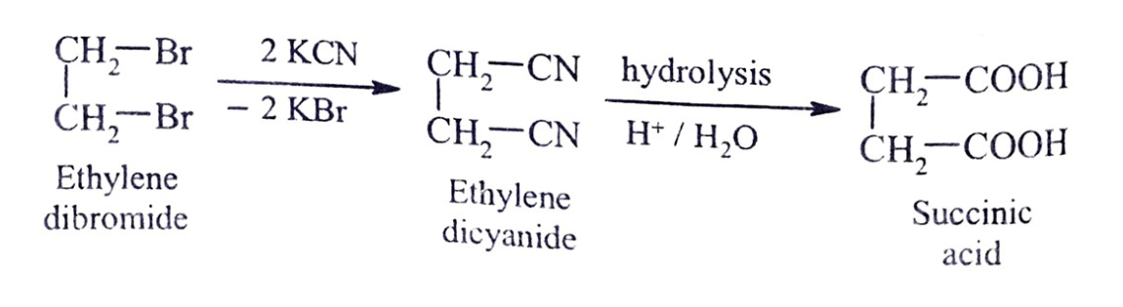
1: Succinic acid (Butan 1,4 dioic acid) [C4H604
It was first obtained by distilling fossil resin amber (Latin, amber meaning succinum). Hence the name succinic acid.
[A] Methods of preparation of succinic acid It can be synthesised by either of two methods given below.
(a) From ethylene dibromide: Ethylene dibromide on treatment with aqueous KCN gives ethylene dicyanide which on hydrolysis gives succinic acid.

Slide 26
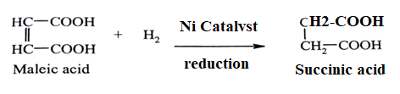
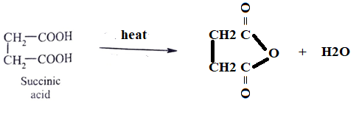
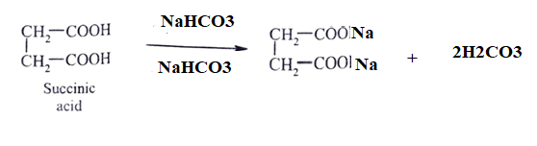
(b) From maleic acid: Maleic acid on reduction with hydrogen in presence of catalyst gives succinic acid.
[B] Properties
Physical properties: It is a white crystalline solid, M.P. 458 K, moderately soluble in water and alcohol.
Chemical Reaction
1. Action of heat: Succinic acid on heating above its melting point undergoes dehydration and is converted to its anhydride.
2. Action of NaHCO3: Succinic acid on treatment with NaHCO3 forms two series of salts.

Slide 27
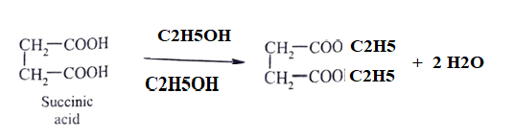

3. Action of C₂H5OH in presence of acid: Succinic acid on refluxing with ethanol in presence of conc. H2SO4 acid forms two series of salts.
[C] Uses of succinic acid: It is used,
(i) In the manufacture of dyes and perfumes.
(ii) In medicine.
(iii) In the manufacture of high polyester resins.
(iv) As a laboratory reagent in volumetric analysis.
2: Phthalic acid (Benzene o-dicarboxylic acid) C6H4(COOH)2
It is a aromatic dicarboxylic acid. For first time Laurent (1836 obtained it by oxidising naphthalene.

Slide 28



[A] Methods of preparation of phthalic acid
From o-xylene: Phthalic acid may be prepared from o-xylene by oxidation with permanganate.
(b) From naphthalene: Industrially phthalic acid is prepared by passing naphthalene vapour and air over vanadium pentoxide catalyst at
The anhydride formed is converted to free acid by heating it with alkali followed by acidification.

Slide 29



Physical Properties: It is a white crystalline solid, M.P. 504 K. is insoluble in cold water but fairly soluble in hot water.
Chemical properties
Action of heat: When heated it dehydrates (eliminates a molecule of water) to forms phthalic anhydride that sublimes readily.
Reaction with sodalime: On heating with sodalime (mixture of NaOH and CaO) it undergoes decarboxylation to form benzoic acid which further decarboxylates to form benzene.
3. Reaction with NH3: On heating with ammonia at 473 K under pressure phthalimide is obtained.

Slide 30

[C] Uses of phthalic acid
1. It is used in the preparation of benzoic acid, phthalic anhydride. Its anhydride is principle commertial form of phthalic acid used in large scale production of plasticizers for plastics.
2. It is important industrial chemical used in the manufacture of dyes.
3. Its monopotassium salt is used as standard acid (its pH is 2.89) in analytical labs.
1.7 Carboxylic Acid Derivatives
Introduction
Carboxylic Acid Derivatives are the functional derivatives formed by replacing the hydroxyl group of carboxylic acids by substituents like halo (X), alkoxy (R-O-), amino (-NH₂) and acyloxy (R-CO-0-). They are respectively called as acid halides (R-CO-X), esters(R CO-OR), acid amides(R-CONH,) and acidanhydrides (R-CO-O CO-R). They are valuable in organic synthesis as reagents and reaction intermediates.
Four different types of derivatives of acids are as under.

Slide 31



1. Acid halide derivative: The-OH group of carboxylic acid is replaced by a halogen atom.
Acetyl chloride / Ethanoyl chloride
It is obtained from acetic acid, by replacing the terminal - OH group by Cl. It is for most important acid halide.
[A] Methods of preparation
They are commertially prepared from carboxylic acid by the action of PCl3 or SOCl2
Acetyl chloride can be prepared by the action of PCI, on glacial acetic acid.
It can also be prepared by the action of thionyl chloride (SOCl₂) on acetic acid.

Slide 32



The product obtained is pure as SO2 and HCl being gases they escape out.
[B] Properties
Physical properties: It is a colourless, pungent smelling volatile liquid, B.P. 325 K. It fumes in moist air. It is soluble in ether, acetone and acetic acid but reacts with water and alcohol.
Chemical properties
Action of water: Acetyl chloride reacts with water and forms acetic acid.
2. Action of alcohol: Acetyl chloride reacts with alcohol and forms an ester.
Mechanism of Esterification: It is a nucleophilic acyl substitution reaction. Where in a molecule of nucleophile (R-O-H) attack on carboxyl group followed by loss of leaving group (X:).

Slide 33


Since there is transfer of acyl group from leaving group to the attacking nucleophile it is also called as, acyl transfer reaction.
3. Action of ammonia: Acetyl chloride reacts with ammonia and forms acetamide.
[C] Uses of acetyl chloride: It is industrially valuable chemical.
1. It is largely used as an acetylating agent.
2. For detection and estimation of - OH, - NH2, -NH groups in organic molecules.
3. In the preparation of acetic anhydride, acetamide, acitanilide etc.
4. In the synthesis of number of organic compounds.
2. Acid anhydride derivative
They are carboxylic acid derivatives formed by replacing - OH group of-COOH by - O-CO-R group.
It is obtained from acetic acid by the replacing the terminal - OH group by- OCOCH3 group.

Slide 34


[A] Methods of preparation
Dehydration of acetic acid: When vapours of acetic acid are passed over phosphorus pentaoxide (P₂O5), dehydration takes place to form acetic anhydride.
[B] Properties
Physical properties: It is a colourless liquid with irritating smell, B. P. 412.5 K. It is slightly soluble in water but readily soluble in ether and benzene.
Chemical properties
1. Reaction with water: It is slowly hydrolysed by water to form acetic acid.

Slide 35


2. Reaction with alcohol: Ethyl alcohol reacts with acetic anhydride to form an ester, e.g., with ethanol forms ethyl acetate.
3. Reaction with ammonia: Ammonia reacts with acetic anhydride and forms acetamide.
[C] Uses of acetic anhydride: It is used,
1. As an acetylating agent.
2. For detection and estimation of hydroxyl and amino group.
3. In the manufacture of acetate rayon, cellulose acetate, plastics polyvinyl acetate).
4. In the manufacture of dyes.
5. In the manufacture of pharmaceuticals like aspirin and phenacetin.

