Slide 1

WEL - COME

Slide 2
NMR Spectroscopy
Dr. C.B.Mane
Shree Vijaysinha Yadav Mahavidyalaya, Peth Vadgoan.

Slide 3
Chemistry
NMR Instrumentation
Magnetic and non magnetic nuclei

Slide 4
NMR Instrumentation
NMR – Nuclear magnetic resonance
Defination: The instrument used to measure absorption of energy by magnetic nuclei is called NMR spectroscopy.

Slide 5
NMR-Instrument
It contains following devices:
Sample tube
Electromagnet
Radio frequency transmitter
Receiver coil
Amplifier
Detector

Slide 6
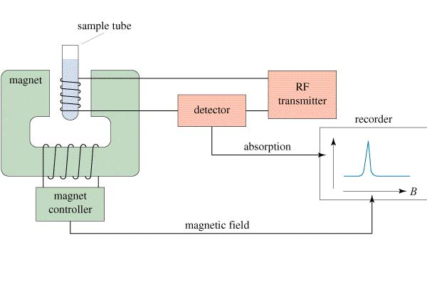
Block diagram of NMR spectroscopy

Slide 7
A. Magnetic nuclei
Defination: The substance which are strongly attracted by magnets are called magnetic substance.
Table : Spin quantum no. of magnetic nuclei
At. No | Mass No |  | I value | Examples
 | Proton | Neutron
odd | odd | even | 1/2 , 3/2 ,5/2 | ₇N¹⁵ , ₉F¹⁹, ₁₅P³¹……
Even | even | odd | 1/2 , 3/2,/ 5/2 ,7/2…..etc | ₆C¹³, ₈O ¹⁷……
odd | odd | odd | 1,2,3…. | ₇N¹⁴ , ₅B¹⁰…..

Slide 8
B.Non magnetic nuclei
Defination : The substances which are not attracted by magnets are called non magnetic nuclei.
At.NO. | Mass .NO. |  | I value | Example
 | Proton | neutron
Even | Even | Even | o | ₆C¹² , ₈O¹⁶ , ₁₆S³² ……

Slide 9

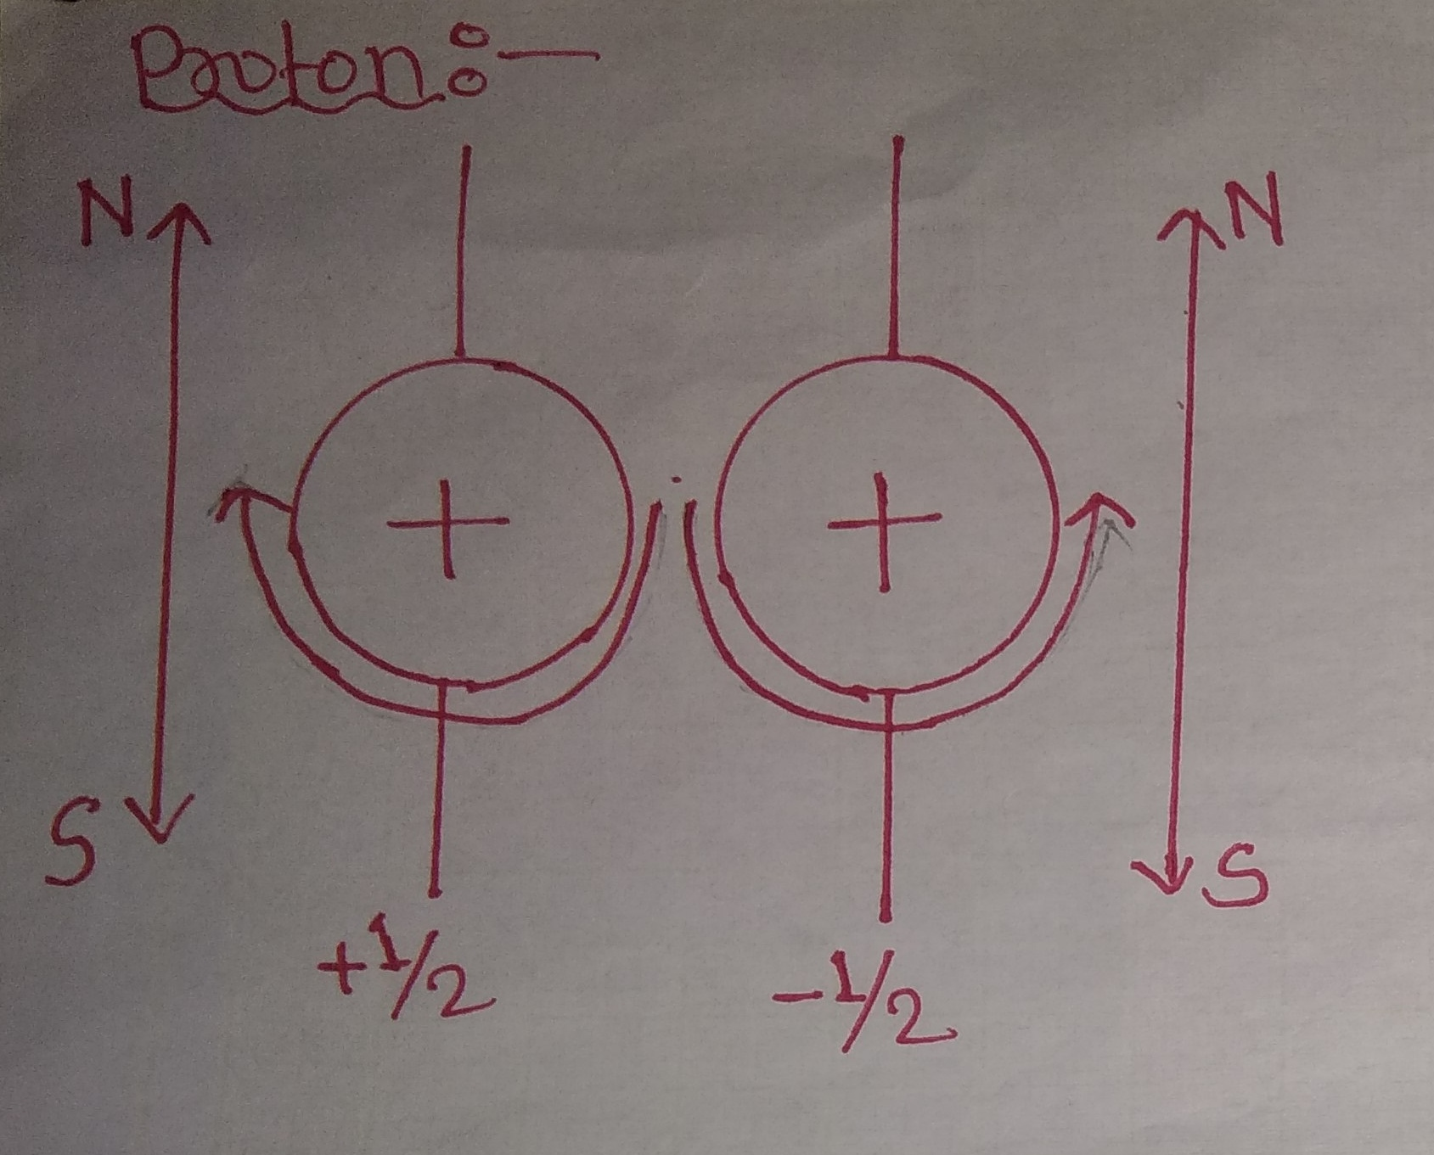
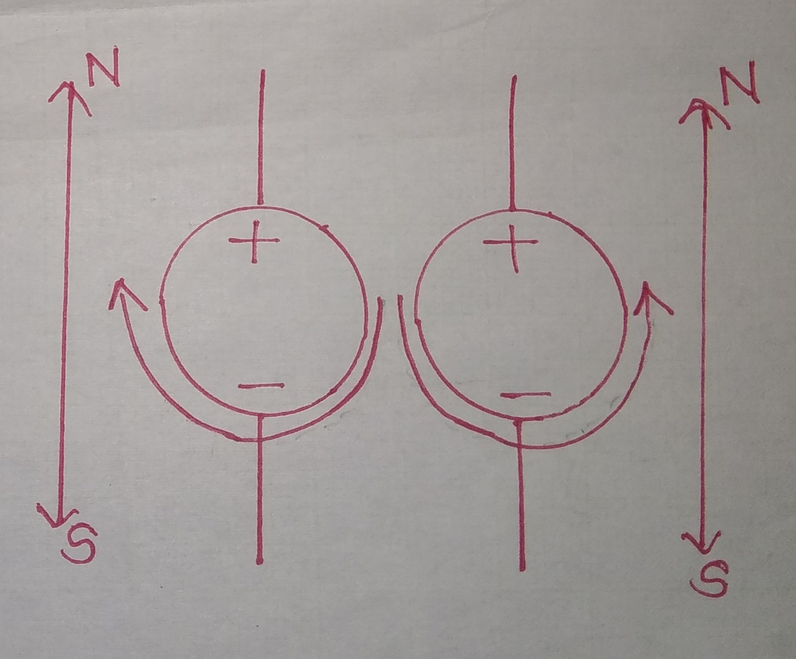
Neutron

Slide 10

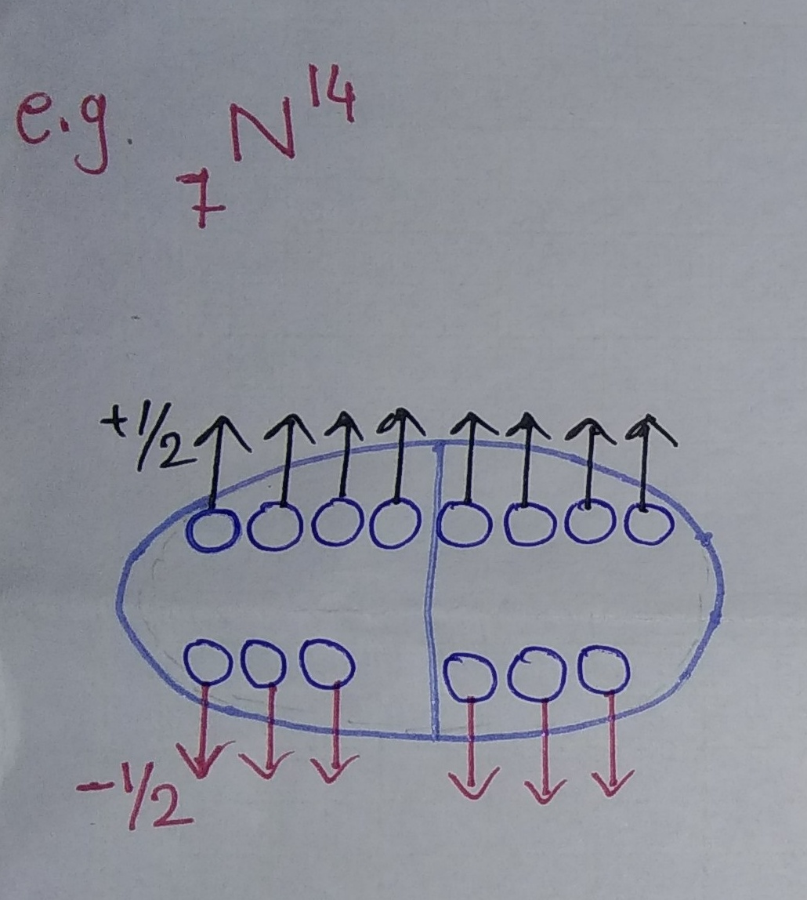
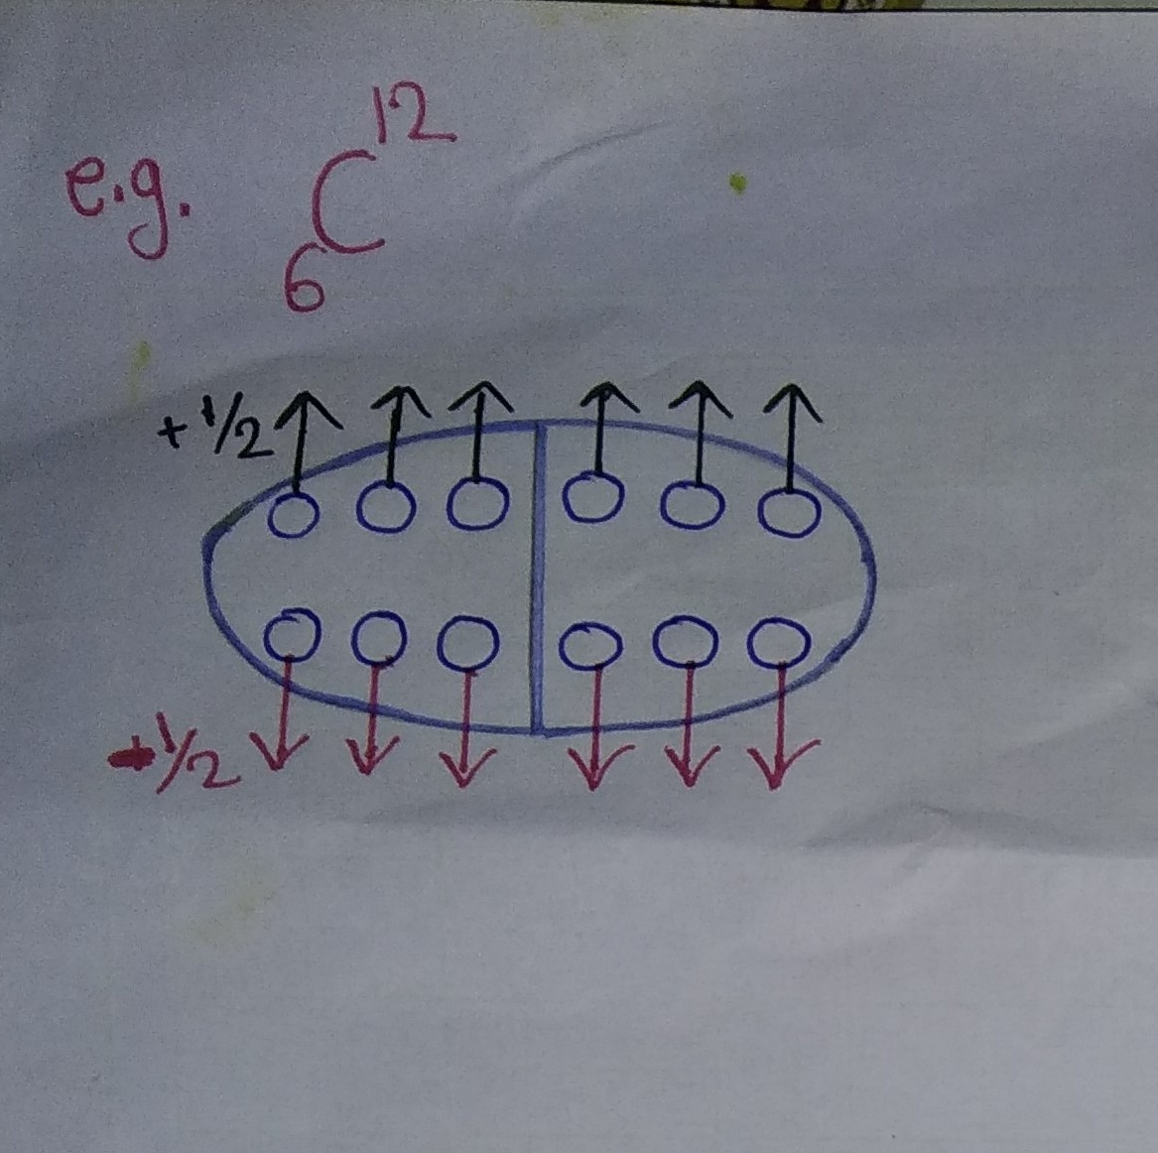

Slide 11
Thank You

