Slide 1
Thermodynamics

Slide 2
2.1: Introduction, Concept of Entropy
All real changes such as flow of heat from hot to cold body, flow of water from higher to lower level, expansion of gas, have a direction, are spontaneous and natural. These are thermodynamically irreversible. The first law of thermodynamics shows that energy is conserved in any process but it keeps silence on the direction of flow of energy, the direction of spontaneous change and whether the process can occur. To solve this problem, there exists a thermodynamic property which serves as criteria of spontaneity. This property is known as entropy (Greek - change) and is by symbol S. In this topic, we will discuss all details of entropy along with third law of thermodynamics.
According to second law of thermodynamics, heat cannot be completely converted into work. Some amount of heat is not available to do work. Clausius invented a term entropy S, which is a measure of such unavailable part of energy (e.g. heat) to do work. This can be clarified with following example.

Slide 3
This can be clarified with following example.
Process A: q amount of heat is absorbed by the gas filled in a cylinder fitted with an idealised piston. The gas will expand. Piston will be pushed. The work done (w) = P x ΔV.
Process B: Now work equivalent to PΔV, is done on the gas. The gas would be compressed. Heat will be evolved. However, the amount of heat evolved in process B is less than that absorbed in process A. It means that whole of the heat absorbed in process A is not converted into work.
When heat is absorbed by the gas, the kinetic energy of the gas molecules will be increased and the gas molecules move faster. They collide with (i) each other, (ii) the walls of container and (iii) the face of the piston, thereby pushing the piston. Only third type of collision brings the expansion of gas [Fig. 1.4 (b)]. The first and second types of collisions are not effective in bringing the expansion. Thus, some collisions and hence some fraction of heat is not utilised for expansion of the gas.
Therefore, the work due to expansion is not exactly equivalent to the amount of heat absorbed. Some heat goes waste only due to random motion of the gas molecules. Thus, randomness can be correlated with unavailable. i.e. entropy. So, entropy is a measure of randomness of a molecule.
In brief, it can be summarized as, entropy is a measure of energy system. (a) unavailable part of energy to do work and (b) order and disorder of the system.

Slide 4
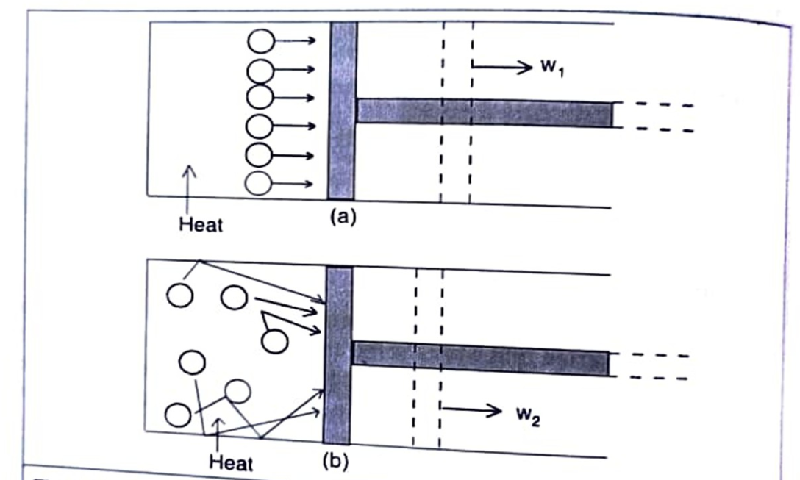
Fig. 1.4: Conversion of heat into work. (a) Ideal case of complete conversion. (b) Partial conversion due to randomness (dotted lines represent the position of the piston after expansion and w, > W₂).

Slide 5
Entropy (S) (Definition, Mathematical Expression, Entropy as a State function)
Entropy may be defined as, "the thermal property of the substance mathematically defined as, "the ratio of heat change to the temperature at which heat change occurs."
Thus, Clausius (1865), defined the entropy by the relation, (mathematical expression) as,
dS = dq_{rev} / T ........ (1.12)
Where, dq rev= heat absorbed by a system in an infinitesimal reversible process.
T= absolute temperature in Kelvins.
The entropy change from state 1 to state 2 is given by the integral of equ. (1.12),
ΔS = (S₂-S₁) = q_{rev} / T ........(1.13)
For an isothermal reversible process, the integral can be evaluated as,
ΔS = q_{rev}/ T ………...(1.14)
The value of ΔS depends only on the initial and final states of the system and not on the path. Hence, entropy is a state function. The entropy is a measure of the current state of disorder of the system and how that disorder was achieved is not relevant to its current value.
Unit of Entropy
The entropy is an extensive property. So, its value depends upon the quantity of substance. The units of entropy are Joules per degree Kelvin (JK-¹). When we use 1 mole substance, the entropy is molar entropy, an intensive property, with units Joules per degree Kelvin per mole (JK-mol-¹).

Slide 6
Physical Significance of Entropy
As mentioned earlier, entropy is a measure of order and disorder and unavailable energy of a system as well as probability which can be explained as follows:
Entropy as a measure of order and disorder:
Spontaneous processes are always accompanied by an increase in the 'disorder' or randomness' or 'chaos' of the system. Water, for example, can exist in two different states: Solid (ice) and Liquid (water). In ice, the molecules are arranged in an orderly way with the molecules in fixed positions in the crystal. Melting of ice is a spontaneous process. On melting, ice changes to liquid water. In water, molecules are free to move around. Orderly structure of ice is destroyed and disorderly arrangement of water molecules in water increases. Thus, disorder increases leading thereby increase in entropy.
The same type of change, order to disorder, occurs when one gas diffuses into another, when gas expands in vacuum, when a concentrated solution diffuses into pure water and so on for other spontaneous (irreversible) processes. All these processes are accompanied by increase in entropy. For example, disorder increases with increase in temperature from solid to liquid to gas and vice-versa as shown in Fig. 1.5.

Slide 7
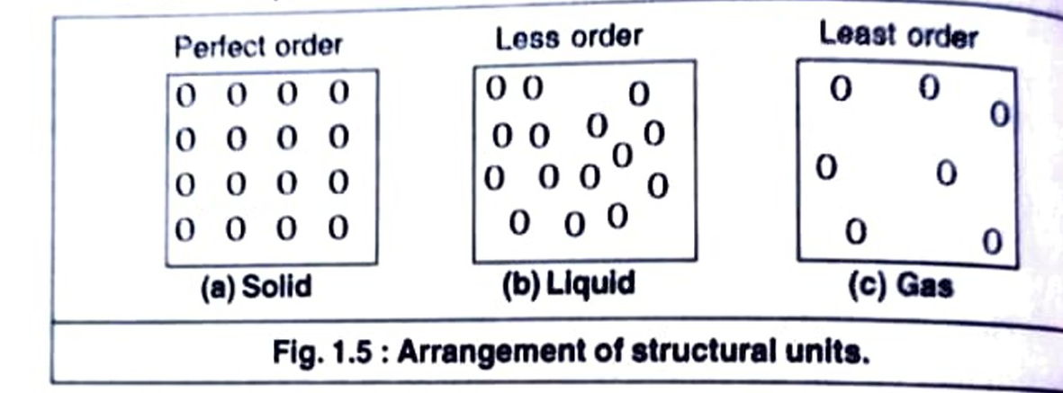
(b) Entropy as a measure of unavailable energy of a system:
According to second law, heat cannot be converted completely into work. It means some part of the total energy goes waste and is not available to do work. So, the total energy is made up of two parts:
Total energy = Available energy to do work (free energy) + unavailable energy
i.e. H = G + TS Or ΔG = ΔΗ + TΔS
The unavailable energy is represented as the product of entropy S and absolute temperature T. Thus, unavailable energy is TS. Higher the temperature, more is the disorder and more is the unavailable energy to do work. Thus, entropy becomes a measure of unavailable energy.
For example, when heat energy is supplied to a solid, some of the energy is used to melt the solid. This energy is unavailable part of energy i.e. entropy and remaining energy is used to do the work.

Slide 8
(c)Entropy and probability: It is found that the system has a tendency te sume the most probable state. The most probable state is the most random arrangement of the molecules in system. It means that there is a greater probability of the disordered state than the ordered state. The disordered state has higher, entropy than the ordered state. For example, water liquid has number of arrangements of H₂O molecules, while ice has a single ordered arrangement. Thus, water has higher entropy than that of ice.
Thus, we can identify the entropy as a function of the probability of thermodynamic state. Since both the entropy and thermodynamic probability increase simultaneously in a process, we can consider the state of equilibrium as the state of maximum probability. It means that a system tends to attain a state of equilibrium.
Third Law of Thermodynamics
Each of the first three laws of thermodynamics leads to the existence of a state function: The zeroth law leads to temperature, first law leads to the concept of internal energy, E and second law leads to the concept of entropy. S. However, first and second laws do not give any idea about the measurements of absolute values of E and S respectively. Determination of absolute value of energy is not feasible and only energy changes can be determined. However, the entropy concept is of great importance and its absolute value can be determined with the help of third law of thermodynamics.

Slide 9
Statement: The scientist Max Planck (1913) was the first to state the third law: The entropies of all perfectly crystalline substances are zero at 0 K
T. W. Richards and W. Nernst studied independently the entropy changes of certain isothermal chemical reactions and found that the change in entropy approaches zero as the temperature was reduced. This is true only in case of reactions, where the reactants and products are perfect crystals. Experimental evidences have shown that the entropy of solutions and supercooled liquids is not zero at 0 K. For pure crystalline substance, third law has been verified repeatedly and it was found that all pure crystals of pure substances have the same entropy at 0 K. If they have the same entropy at 0 K, this value might be taken as zero.
Absolute Entropy and Evaluation of Absolute Entropy
An important application of the third law of thermodynamics is that affirms that S (0 K)= 0 for any perfect crystalline substance, on this permits to calculate absolute entropies of the substances. The third law basis it is possible to calculate absolute entropies at some higher temperature, using the methods of thermochemistry. Suppose, we want S(298 K) for certain gaseous substance, then we start with crystal solid of that substance as close to 0 K as possible and determine the entropy change on warming it to its melting point.

Slide 10
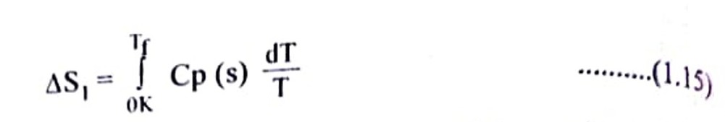
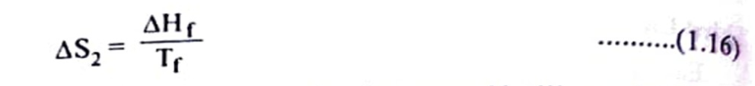
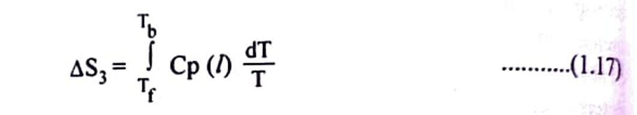
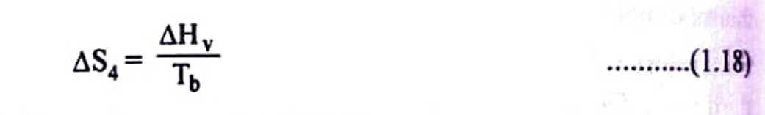
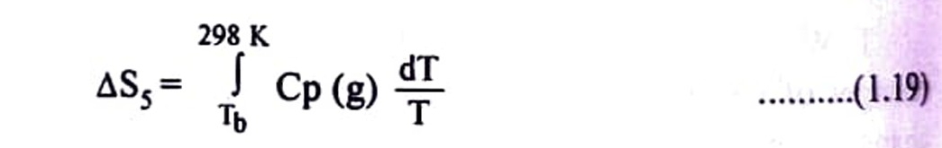
There is next entropy change due to melting of the solid,
The liquid is then further warmed to its normal boiling point, Tb and entropy change is given by,
Now, add entropy change due to vaporization of liquid,
Finally, the gas is warmed to 298 K,

Slide 11
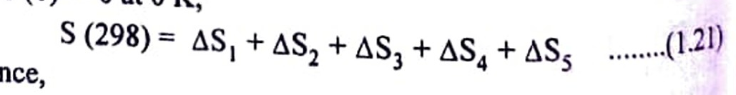
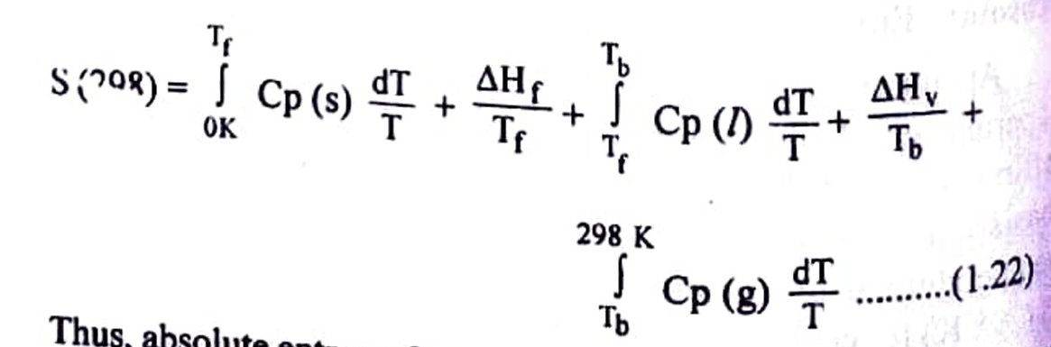
The sum of all above terms gives the entropy change as,
The sequence is illustrated in Fig. 1.6.
Since, S (0) = 0 at 0 K,
and hence,

Slide 12
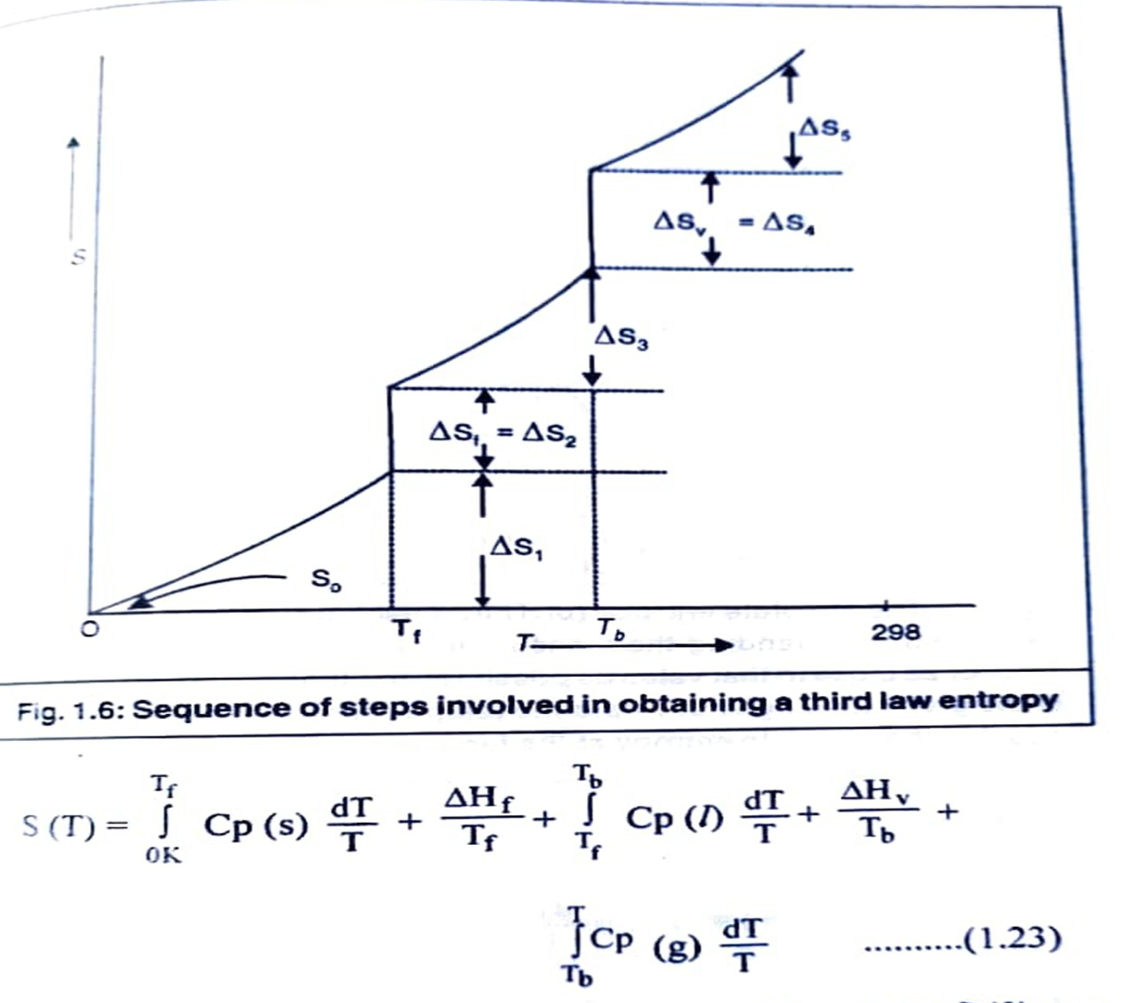
Thus, absolute entropy from 0 K to any desired temperature, T can be evaluated, using the above eqn. (1.22) as,

Slide 13
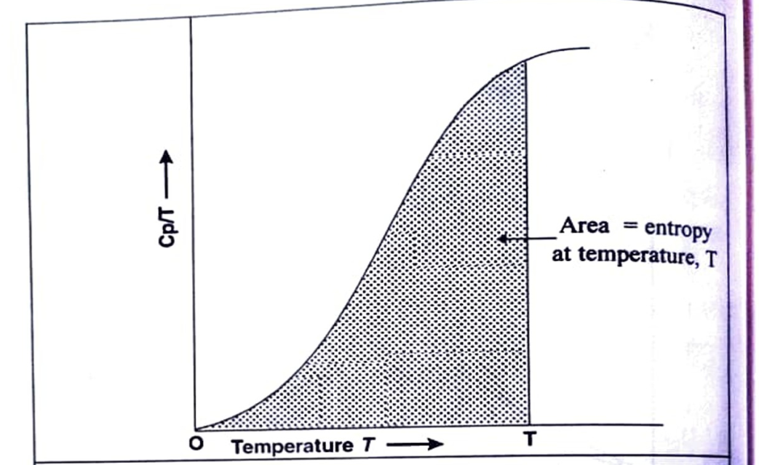
S(T) is always positive quantity. All the properties, except S (0), can be measured calorimetrically. The integrals can be evaluated by numerical integration or graphically. In a graphical method (Fig. 1.7), the area under the curve of Cp/T against T (or Cp vs In T) is the value of integral.
If there are various solid forms (e.g. SR -------- SM), corresponding entropies of transitions are also to be added in the above eqn. (1.23).
In practice, heat capacities, Cp, are usually measured from approximately 20 K to a desired temperature, T. At very low temperature (10 to 15 K), Cp values are obtained from Debye equation,
Cp = a T³.......(1.24)

Slide 14
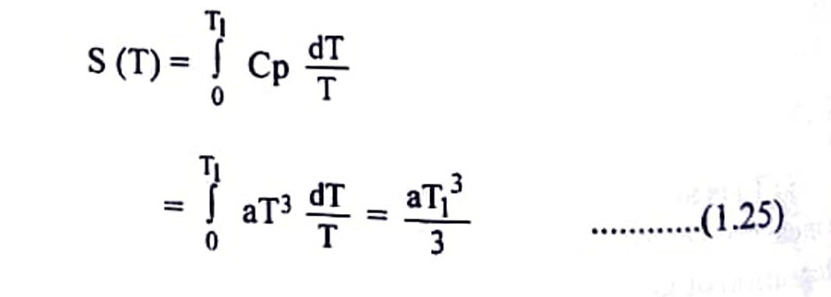
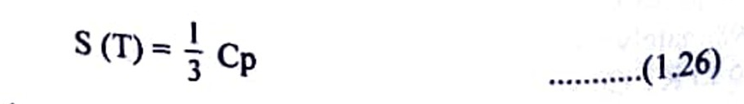
Fig. 1.7: The absolute entropy (or Third Law entropy) of a substance is calculated by extending the measurement of heat capacities down to T=0 (or as close to that value as possible) and then determining the area of the graph Cp/T against T upto the temperature of interest. The area is equal to the absolute entropy at the temperature T.
Then,
Thus, Debye equation is used to evaluate interval from 0 K to the lowest possible temperature T,. Since Cp = aT³, eqn. (1.25) becomes, over the interval
If a substance is solid at T, only the first integral of eqn. (1.23) applies with Tf= T, when it is liquid, the first three terms are used with Tb=T and when it is a gas, the full equation (1.23) must be used.

Slide 15
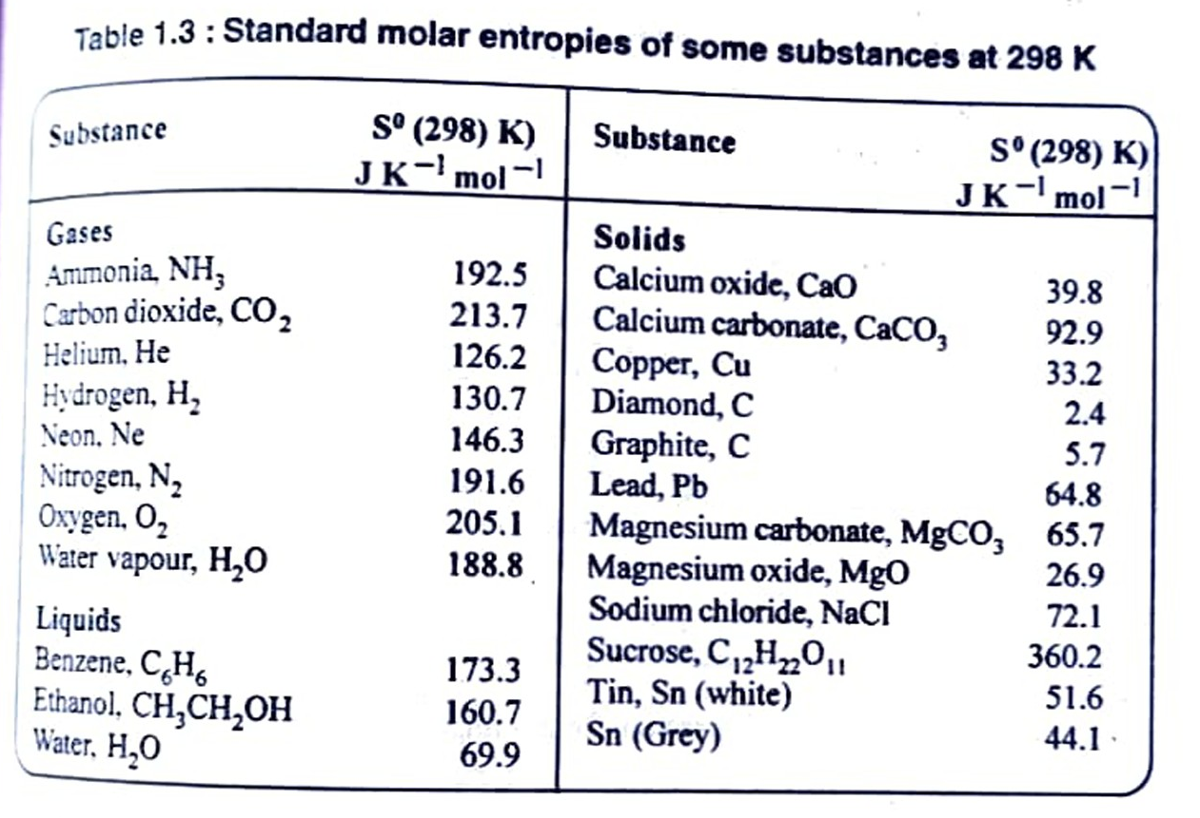
S(O)=0 for perfect crystals at 0 K. Entropies reported on the basis of S(0) 0. are called third law entropies. When the substance is in its standard state (The standard state of pure gas, pure liquid or pure solid substance is 1 bar pressure at each temperature) at temperature T, the standard (third law) entropy is denoted by S(T). Third law entropies of some substances are listed in Table 1.3.
Table 1.3: Standard molar entropies of some substances at 298 K

Slide 16
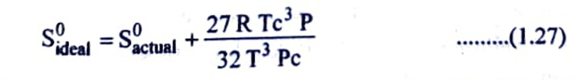
As an illustration, the determination of third law entropy, Sº (298), for SO, gas is shown in Table 1.4. The actual value is 247.85 J K-¹ mol-¹ at 298 K and at 1.01325 bar. A small correction due to non-ideality of the gas has to be applied using Berthelot equation,
Where, Tc and Pc are critical temperature and critical pressure. For SO2, Te 430.3 K, Pc 78.63 bar, P 1.01325 bar and T = 263.08 K (b.p.). The correction value comes to be 0.395. Hence, standard entropy (ideal) of SO₂(g) at 298 K is,
S⁰(298) = 247.85 +0.395 = 248.245 J K-mol-1.

Slide 17
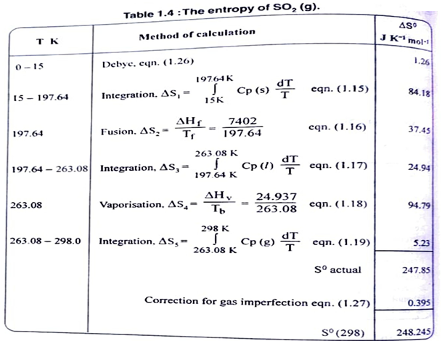

Slide 18
