Slide 1
UNIT 4
Heterocyclic Compounds
Introduction
Cyclic organic compound containing carbon atoms in their ring system are called as carbocyclic compounds e.g. cyclopropane, cyclobutane, naphthalene etc. All carbon atoms forming the ring are called as nuclear or ring atoms. The ring formed by replacement of one or more carbon atoms by corresponding number of heteroatoms is called as heterocyclic ring. Generally, heteroatom is polyvalent atom other than carbon atom. Nitrogen, oxygen, sulphur, phosphorus are the most common heteroatoms. The cyclic compounds containing one or more heteroatoms in their ring system are called as heterocyclic compounds. The heterocyclic compounds occur widely in nature and are essential to life. Various compounds such as antibiotics, amino acids, vitamins, haemoglobins, drugs, dye contain heterocyclic rings (Figure 4.1).

Slide 2
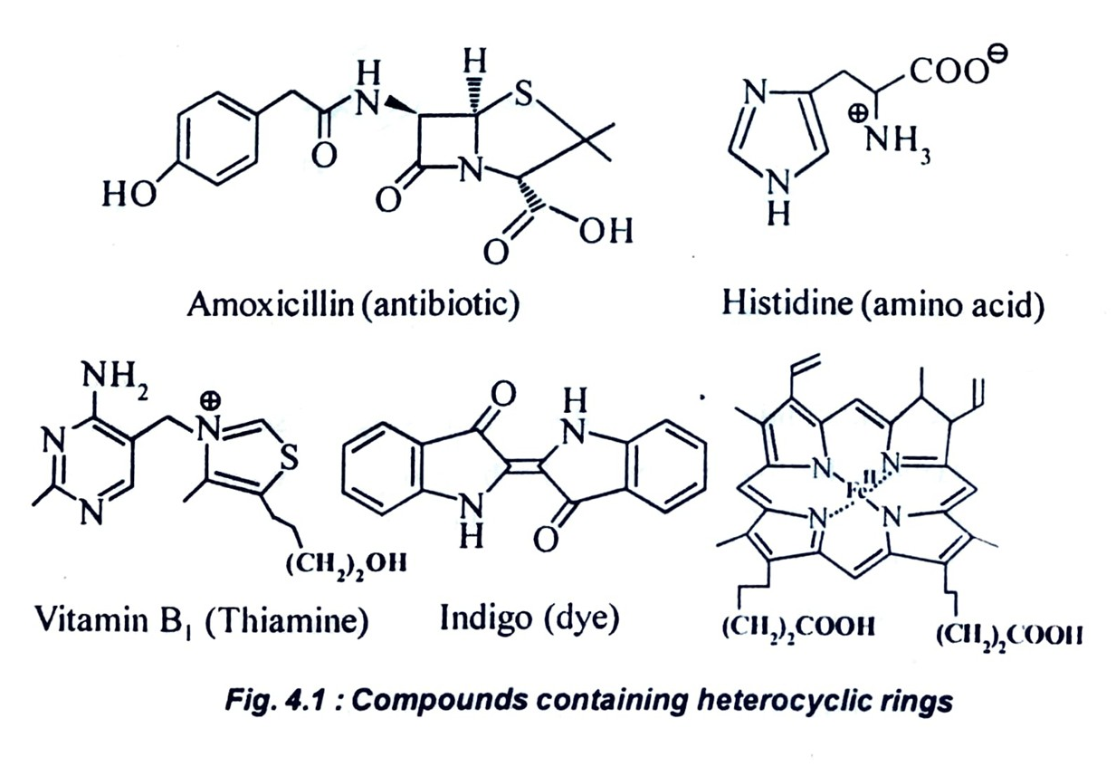

Slide 3
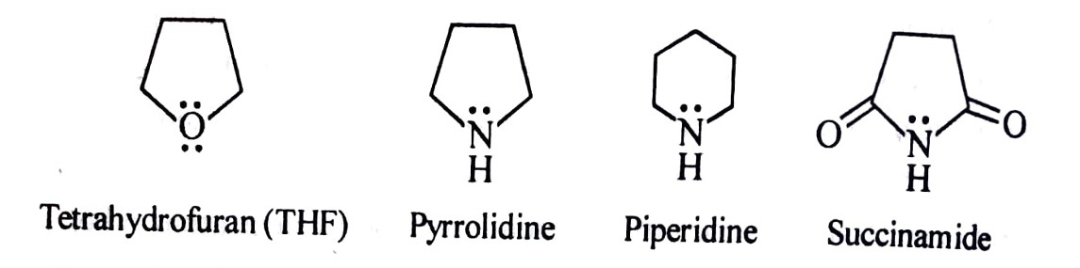
Classification of heterocyclic compounds
Generally, heterocyclic compounds are classified based on their properties, nature of hetero atoms and size of ring.
(A) Based on properties, heterocyclic compounds are divided into two classes.
(i) Heteroparaffins or non-aromatic heterocyclic compounds: are cyclic compounds with one or more heteroatoms in their ring and resembling paraffins e.g., tetrahydrofuran, pyrrolidine, piperidine, succinamide etc.
Generally, heteroparaffins are relatively unstable as they undergo ring opening upon hydrolysis. Hence, heteroparaffins are not true heterocyclic compounds.

Slide 4
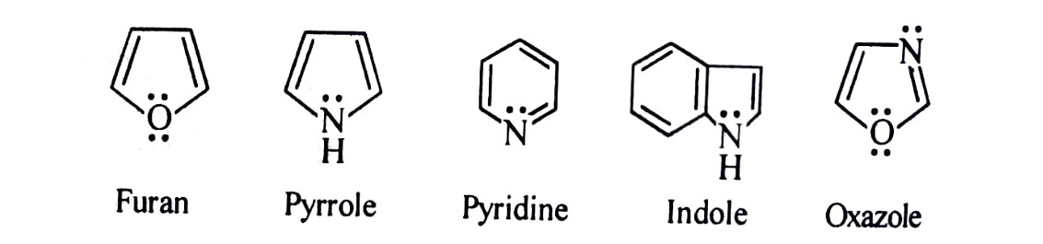
(ii) Heteroaromatics or aromatic heterocyclic compounds: These are aromatic compounds with one or more heteroatoms in their ring e.g., furan, pyrrole, pyridine, indole, oxazole etc.
Conventionally, the term heterocyclic compound is used for heteroaromatics or aromatic heterocyclic compounds.
(B) Nature of heteroatom: Based on nature of heteroatom, heterocyclic compounds are divided into following classes (Table 1).
(i) Oxygen heterocyclics: The heterocycles with oxygen as heteroatom are called as oxygen heterocyclics e.g., furan, pyrylium salt, benzopyran etc.

Slide 5
(ii) Nitrogen heterocyclics: The heterocycles with nitrogen as heteroatom are called as nitrogen heterocyclics e.g., pyrrole, pyridine, imidazole, quinoline etc.
(iii) Sulphur heterocyclics: The heterocylces with sulphur as heteroatom are called as sulphur heterocyclics e.g., thiophene, thiopyrylium salt, benzothiophene etc.
Moreover, phosphorous, selenium, boron, silicon containing heterocycles are also present. But, oxygen, nitrogen and sulphur heterocycles have immense biological importance.
(C) Size of ring: Based on size of ring, heterocyclic compounds are divided into number of classes. In view of instability of heteroparaffins and three, four membered heteroatomatics, the most stable are considered for classification. (Table 1)
(i) Five membered heterocyclics: The five membered or pentacyclic ring is present in these compounds. These are sub-divided based on number of heteroatoms as follows.

Slide 6
Five membered heterocycles with one heteroatom e.g., pyrrole, furan, thiophene etc.
(b) membered heterocycles with more than one heteroatom e.g., oxazole, imidazole, thiazole etc.
(ii) Six-membered heterocyclics: The six membered or hexacyclic ring is present in these compounds. These are also sub-group based on number of heteroatoms.
i) Six membered heterocycles with one heteroatom e.g., pyridine, salt etc.
ii) Six membered heterocycles with more than one heteroatom e.g., pyrazine, pyrimidine, oxazine, diazine, thiazine etc.
Table 1: Classes of heterocycle based on ring size and nature of hetero atom

Slide 7
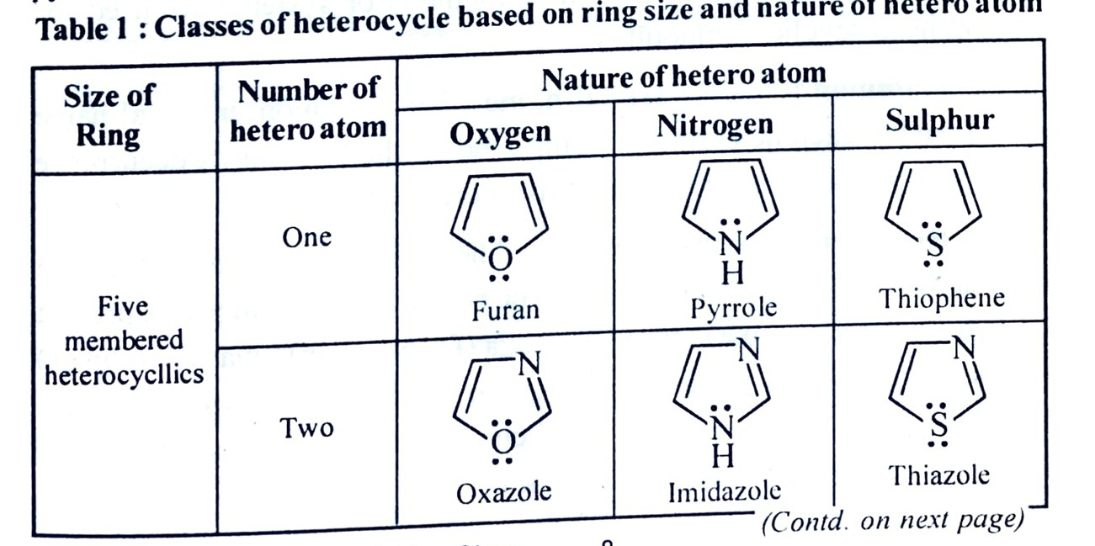
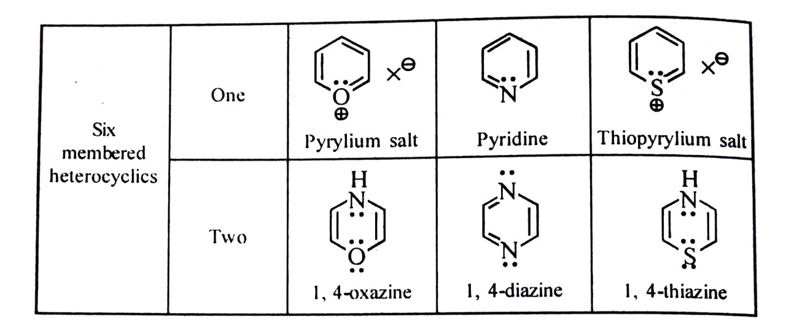

Slide 8
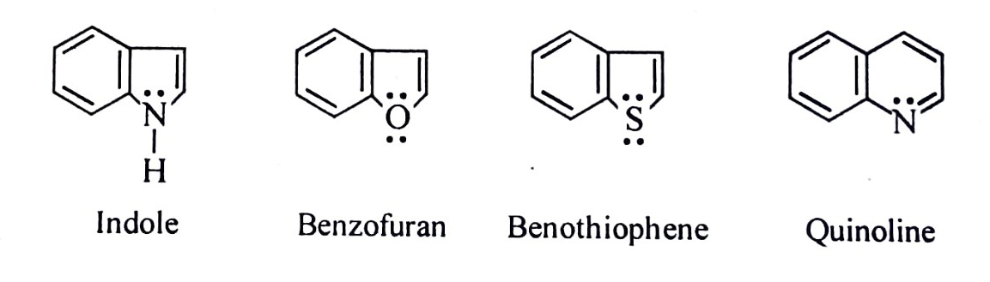
Furthermore, condensed or fused heterocyclics is another class of heteroaromatics.
Condensed or fused heterocyclics: The fusion of two or more rings together forms fused or condensed heterocyclic compounds. In these compounds, at least one ring is heterocyclic in nature e.g. indole, quinoline, benzofuran, benzothiophene etc.

Slide 9
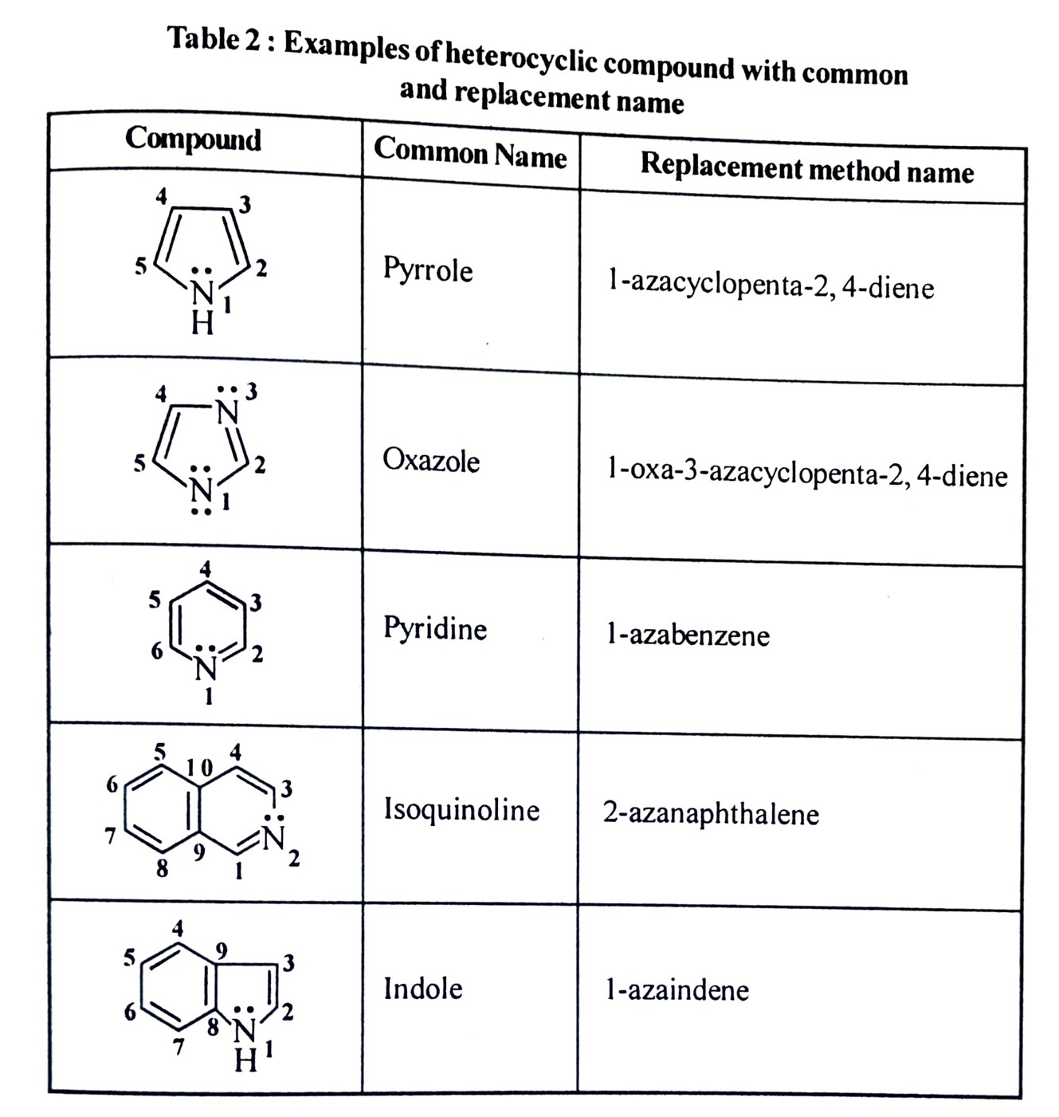
Nomenclature: Generally, three methods or systems are used for naming heterocyclic compounds.
1. Common name or trivial name: The common or trivial name is assigned to each heterocyclic compound on the basis of its occurrence or its preparation or its special properties (Table 2).
2. Replacement method name: The replacement name is derived name of corresponding ring and elemental prefix present in ring. The prefixes oxa (for oxygen) aza (for nitrogen), thia (for sulphur) are used and order of preference is oxygen > sulplur> nitrogen (Table 2). The numbering of ring begins with heteroatom and denoted by number 1, 2, 3 ......etc. (exception isoquinoline).

Slide 10
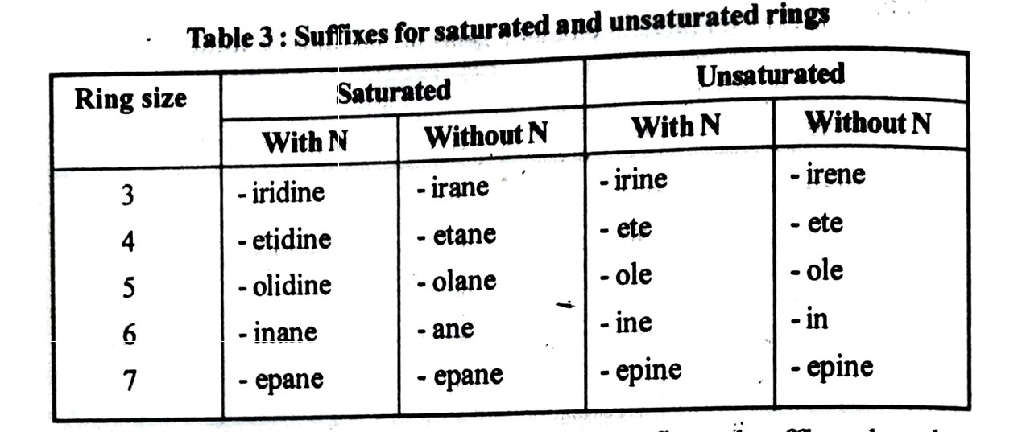
3. IUPAC Nomenclature: It was proposed by Arthur Hantzch and Karl Widman hence named as Hantzch-Widman nomenclature. The type of heteroatom, size of ring and degree of unsaturation in the ring are an important aspects of this nomenclature.
a) The heteroatoms are indicated by prefixes oxa (for oxygen). aza (for nitrogen) and thia (for sulphur).
b) Size of ring and degree of unsaturation are indicated by suffixes (Table 3).

Slide 11
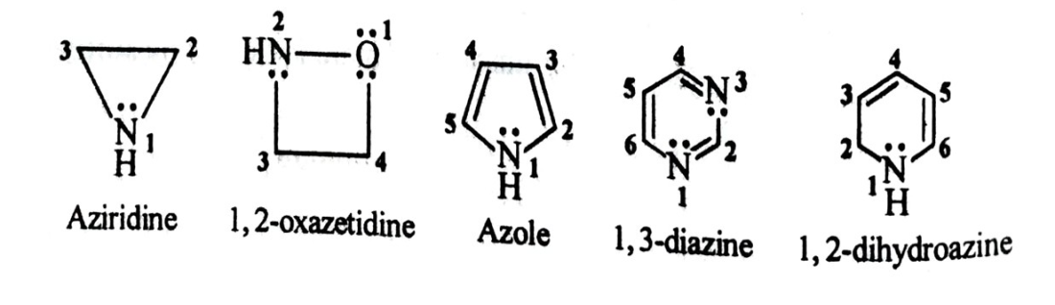
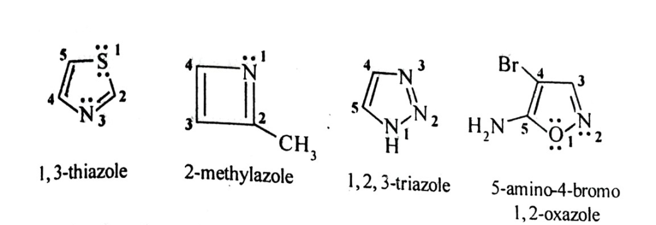
(A) Monocyclic heterocycles : Beside prefix and suffix rule, other rules are also considered for naming.
(i) The numbering of ring begins with heteroatom and denoted by numbers 1, 2, 3, ..... or Greek letters a, B, y, ...... etc. The numbering is continued in such a way that substituent or other heteroatom get lowest number.
(ii) In case of more than one similar heteroatom, multiplicative prefixes such as di, tri tetra etc. are used. In case of more than one different heteroatoms, order of precedence oxygen > sulplur> nitrogen should be considered for numbering.
(iii) Prefixes such as dihydro, tetrahydro are used for partially reduced heterocycles while perhydro is used for fully reduced heterocycles.
(iv) Saturated heteroatom is given preference over unsaturated heteroatom, if similar heteroatoms are present in ring.
(v) IU PAC Name = locant + prefix + suffix. While combining prefix and suffix, terminal 'a' of prefix is usually omitted. In case of two different heteroatoms in monocyclic ring, suffix is choosen in the order of preference N > S > 0.

Slide 12
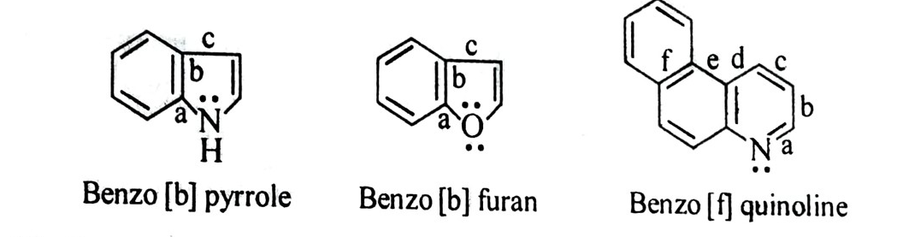
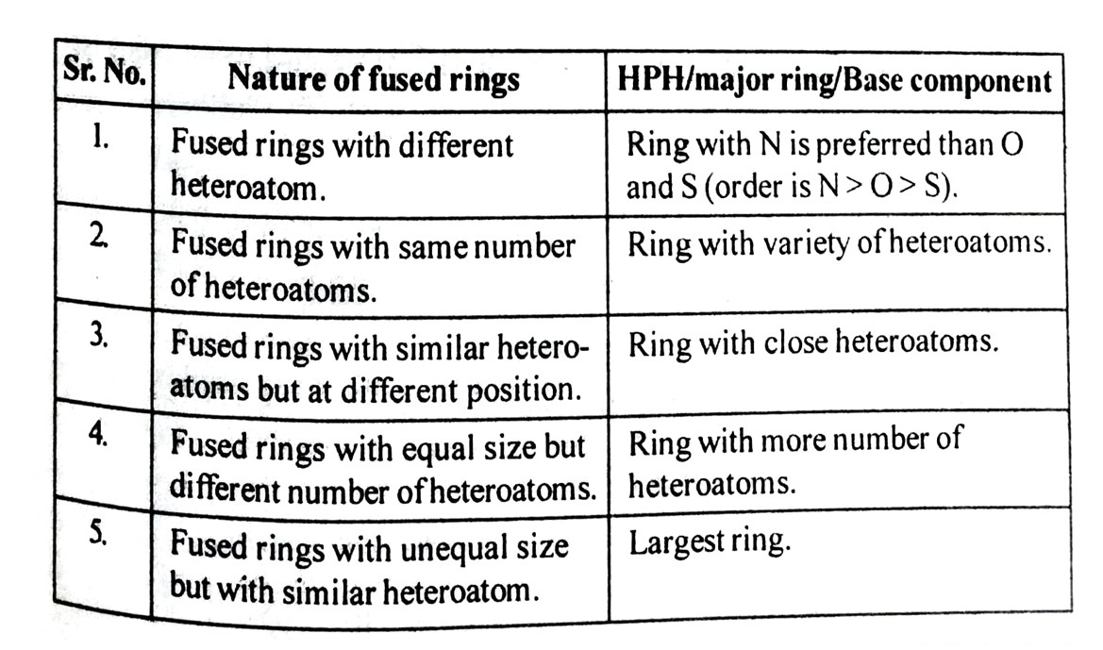
(B) Condensed or fused heterocycles :
If benzene ring is fused with heterocyclic ring, then prefix benzo is used. The position of fusion is indicated by alphabetical letters assigned to peripheral bonds of heterocyclic ring.
(ii) If heterocyclic rings are fused together, then name is given by identifying higher priority heterocycle (HPH)/ major ring/base component as suffix and lowest priority heterocycle (LPH) / minor ring / attached component as prefix. The priority is decided by using following points.

