Slide 1
INFRA RED SPECTROSCOPY

Slide 2
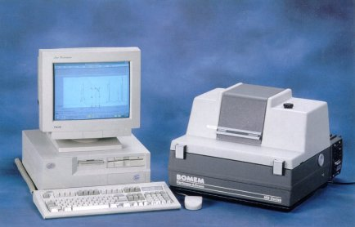

Slide 3
Infrared Spectroscopy
The region just below Visible.
It is not electronic spectroscopy.
It is vibrational Spectroscopy.
Infrared spectroscopy deals with study of molecular phenomenon of absorption of IR radiation.
The energy of IR radiation is insufficient to cause electronic transition but sufficient to increase vibrations of atoms or groups of organic compounds. So IR- Spectroscopy is called as vibrational spectroscopy.

Slide 4
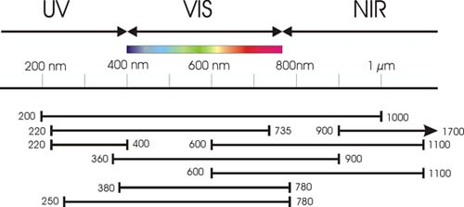
Principle of IR
In the context of infra red spectroscopy the term "infra red" covers the range of the electromagnetic spectrum between 0.78 and 1000 mm.

Slide 5
Infrared radiation
λ = 2.5 to 15 μm
υ = 4000 to 667 cm⁻¹
These frequencies match the frequencies of covalent bond stretching and bending vibrations. Infrared spectroscopy can be used to find out about covalent bonds in molecules.
IR is used to tell:
1. what type of bonds are present
2. some structural information

Slide 6
Regions of Infrared radiation
Wavenumber range (cm-1)
Near IR 0.8 - 2.5 μm / 12500 – 4000cm⁻¹
Middle IR 2.5 – 15 μm / 4000- 667cm⁻¹
Far IR 15 -200 μm / 667 - 50cm⁻¹
The most useful I.R. region lies between
4000 - 667cm⁻¹.

Slide 7
Fundamental Modes of Vibrations
The atoms of molecule at all temp. including absolute zero vibrate and rotate in variety of ways. During these vibrational motions the change in bond length (Stretching) and change in bond angle (Bending) vibrations are known as Fundamental Modes of Vibrations.
  Number of possible modes
    Nonlinear molecule: 3N – 6
    Linear molecule: 3N – 5
  3 degrees of freedom – i.e., 3 coordinates in space
  3 translations and 3 rotations account for 6 motions of molecule
  Rotation about center bond in linear molecule is indistinguishable
  Remaining degrees of motion represent vibrational motion (i.e., number of vibrations within the molecule)

Slide 8
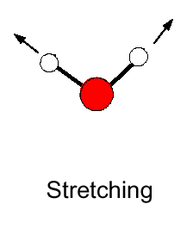
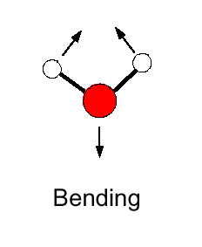
Vibration Types
• There are two different types of vibrational modes:
Vibrations can either involve a change in bond length (stretching) or bond angle (bending)

Slide 9
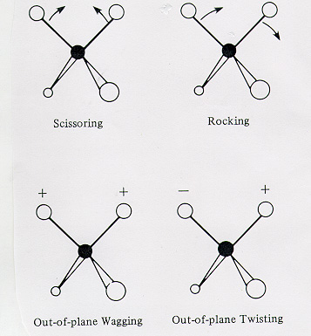
The bending vibrations are often subdivided into scissoring, rocking, wagging, and twisting.

Slide 10
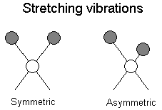
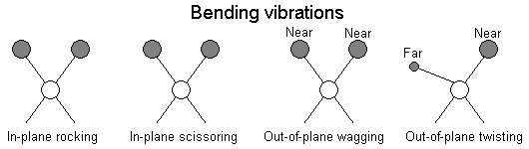
Molecular vibrations
The positions of atoms in a molecules are not fixed; they are subject to a number of different vibrations.

Slide 11
Selection Rules
Conditions for the Absorption of IR –radiation
1.The natural frequency of vibration of the molecule must be equal to frequency of incident radiation.
2.Changes in vibrations must stimulate change in dipole moment.
3. The intensity of absorption must be proportional to the rate of change of dipole.

Slide 12
• Selection Rule
The selection rule for IR spectrum says that, only those vibrations are effective in causing IR- Absorption which are not centro-symmetric that is vibrations are not symmetric about the centre of molecule.
So we have,
IR-active Transitions: The vibrations that generate oscillating dipole moment absorb in IR and are known as IR-active Transitions. e.g. H-Cl, I-Cl, CHCl3
A molecule will absorb infrared radiation if the change in vibrational states is associated with a change in the dipole moment (μ) of the molecule.

Slide 13
II) IR-inactive Transitions: The vibrations that does not generate oscillating dipole moment do not absorb in IR and are known as IR-inactive Transitions. e.g. H2, Cl2,N2, CCl4.
Symmetrical Stretching of C=C of ethylene will not produce change in dipole moment of the molecule. Therefore this mode of vibrations infrared inactive.
Vibrations which do not change the dipole moment are Infrared Inactive (homonuclear diatomics).
III) Allowed and Forbidden Transitions
Only the transitions from Vo to the next higher level V1 or V1 toV2 are allowed for idealized system. Such as perfectly hormonic oscillator. These are called fundamental transitions and only these transitions are allowed.
Generally molecular vibrations are not strictly hormonic. So, overtone bands are also seen and there frequency will be 2v,3v etc. These are known as Forbidden transitions.

Slide 14
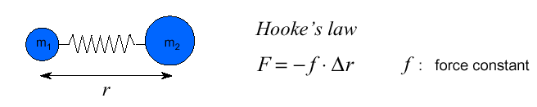
Vibrational spectra (I): Harmonic oscillator model
• Infrared radiation in the range from 10,000 – 100 cm ^{–1} is absorbed and converted by an organic molecule into energy of molecular vibration
–> this absorption is quantized:
A simple harmonic oscillator is a mechanical system consisting of a point mass connected to a massless spring. The mass is under action of a restoring force proportional to the displacement of particle from its equilibrium position and the force constant f (also k in followings) of the spring.

Slide 15
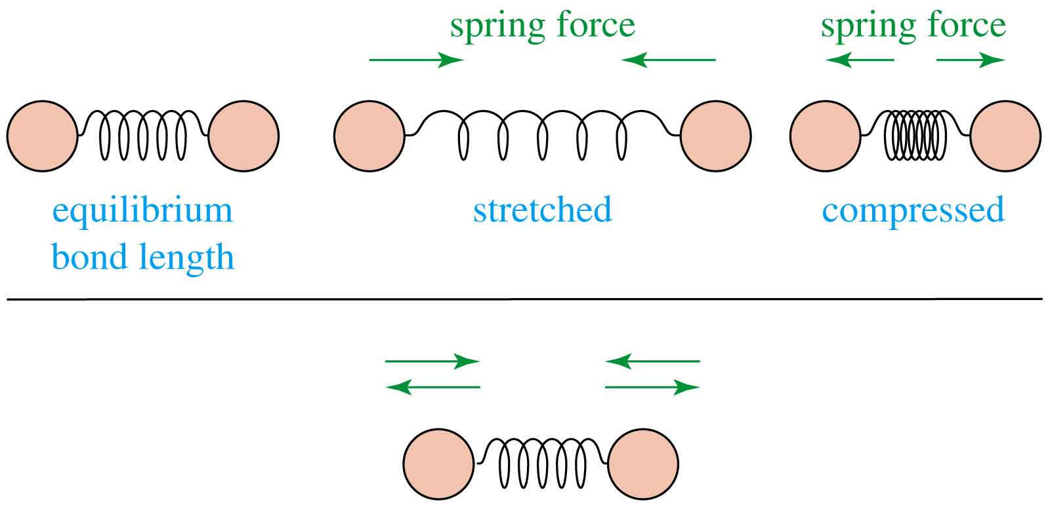
Infrared radiation is largely thermal energy.
It induces stronger molecular vibrations in covalent bonds, which can be viewed as springs holding together two masses, or atoms.
Specific bonds respond to (absorb) specific frequencies
Graphics source: Wade, Jr., L.G. Organic Chemistry, 5th ed. Pearson Education Inc., 2003

Slide 16

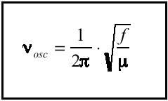
• The vibrational energy V(r) can be calculated using the (classical) model of the harmonic oscillator:
• Using this potential energy function in the Schrödinger equation, the vibrational frequency can be calculated:
The vibrational frequency is increasing with:
• increasing force constant f = increasing bond strength
• decreasing atomic mass
• Example: f _{c≡c} > f _{c=c} > f _{c-c}

Slide 17
Vibrational Frequency: The natural frequency of the oscillation is
ν_{m} = natural frequency
m = mass of the attached body
k = force constant of the spring

Slide 18
…continued…
The equation may be modified to describe the behavior of a system consisting of two masses m₁ and m₂ connected by a spring. Here, it is only necessary to substitute the reduced mass μ for the single mass m where
Thus, the vibrational frequency for such a system is given by

Slide 19
…continued…
Quantum Treatment of Vibrations
The radiation in wavenumbers,

Slide 20
Where, ν is the wavenumber of an absorption peak in cm⁻¹, k is the force constant for the bond in newtons per meter (N/m), c is the velocity of light in cm/s, and the reduced mass μ has units of kg. k has been found to lie in the range between 3 x 10² and 8 x 10² N/m for most single bonds, with 5 x 10² serving as a reasonable average value. Double and triple bonds are found by this same means to have force constants of about two and three times this value (1 x 10³ and 1.5 x 10³ , respectively).

Slide 21
Group frequencies
With certain functional or structural groups, it has been found that their vibrational frequencies are nearly independent of the rest of the molecule – group frequencies.
Carbonyl group 1650 to 1740 cm⁻¹ various aldehydes and ketones
For many groups involving only two atoms, the approximate frequency of the fundamental vibration can be calculated from a simple harmonic oscillator model.
In practical, the region from 4000 to 1300 cm⁻¹ is often called the group frequency region.
The presence of various group vibrations in the IR spectrum is of great assistance in identifying the absorbing molecule.

Slide 22
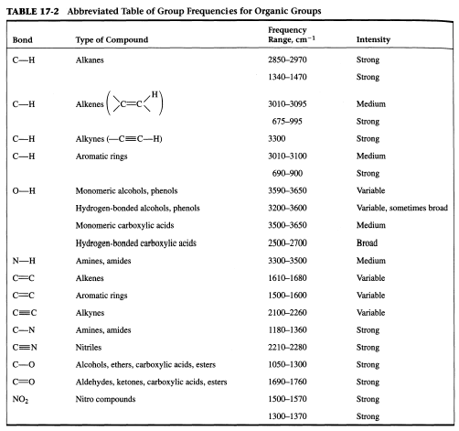

Slide 23
Typical Infrared Absorption Frequencies
 | Stretching Vibrations |  |  | Bending Vibrations
Functional Class | Range (cm⁻¹) | Intensity | Assignment | Range (cm⁻¹) | Intensity | Assignment
Alkanes | 2850-3000 | str | CH₃, CH₂ & CH 2 or 3 bands | 1350-1470 1370-1390 720-725 | med med wk | CH₂ & CH₃ deformation CH₃ deformation CH₂ rocking
Alkenes | 3020-3100 1630-1680 1900-2000 | med var str | =C-H & =CH₂ (usually sharp) C=C (symmetry reduces intensity) C=C asymmetric stretch | 880-995 780-850 675-730 | str med med | =C-H & =CH₂ (out-of-plane bending) cis-RCH=CHR

Slide 24
Alkynes | 3300 2100-2250 | str var | C-H (usually sharp) C≡C (symmetry reduces intensity) | 600-700 | str | C-H deformation
Arenes | 3030 1600 & 1500 | var med-wk | C-H (may be several bands) C=C (in ring) (2 bands) (3 if conjugated) | 690-900 | str-med | C-H bending & ring puckering
Alcohols & Phenols | 3580-3650 3200-3550 970-1250 | var str str | O-H (free), usually sharp O-H (H-bonded), usually broad C-O | 1330-1430 650-770 | med var-wk | O-H bending (in-plane) O-H bend (out-of-plane)
Amines | 3400-3500 (dil. soln.) 3300-3400 (dil. soln.) 1000-1250 | wk wk med | N-H (1°-amines), 2 bands N-H (2°-amines) C-N | 1550-1650 660-900 | med-str var | NH₂ scissoring (1°-amines) NH₂ & N-H wagging (shifts on H-bonding)

Slide 25
Aldehydes & Ketones | 2690-2840(2 bands) 1720-1740 1710-1720 1690 1675 1745 1780 | med str str str str str str | C-H (aldehyde C-H) C=O (saturated aldehyde) C=O (saturated ketone) aryl ketone α, β-unsaturation cyclopentanone cyclobutanone | 1350-1360 1400-1450 1100 | str str med | α-CH₃ bending α-CH₂ bending C-C-C bending

Slide 26
Carboxylic Acids & Derivatives | 2500-3300 (acids) overlap C-H 1705-1720 (acids) 1210-1320 (acids) 1785-1815 ( acyl halides) | str str med-str | O-H (very broad) C=O (H-bonded) O-C) | 1395-1440 | med | C-O-H bending

Slide 27
Nitriles Isocyanates,Isothiocyanates, Diimides, Azides & Ketenes | 2240-2260 2100-2270 | med med | C≡N (sharp) -N=C=O, -N=C=S -N=C=N-, -N₃, C=C=O

Slide 28
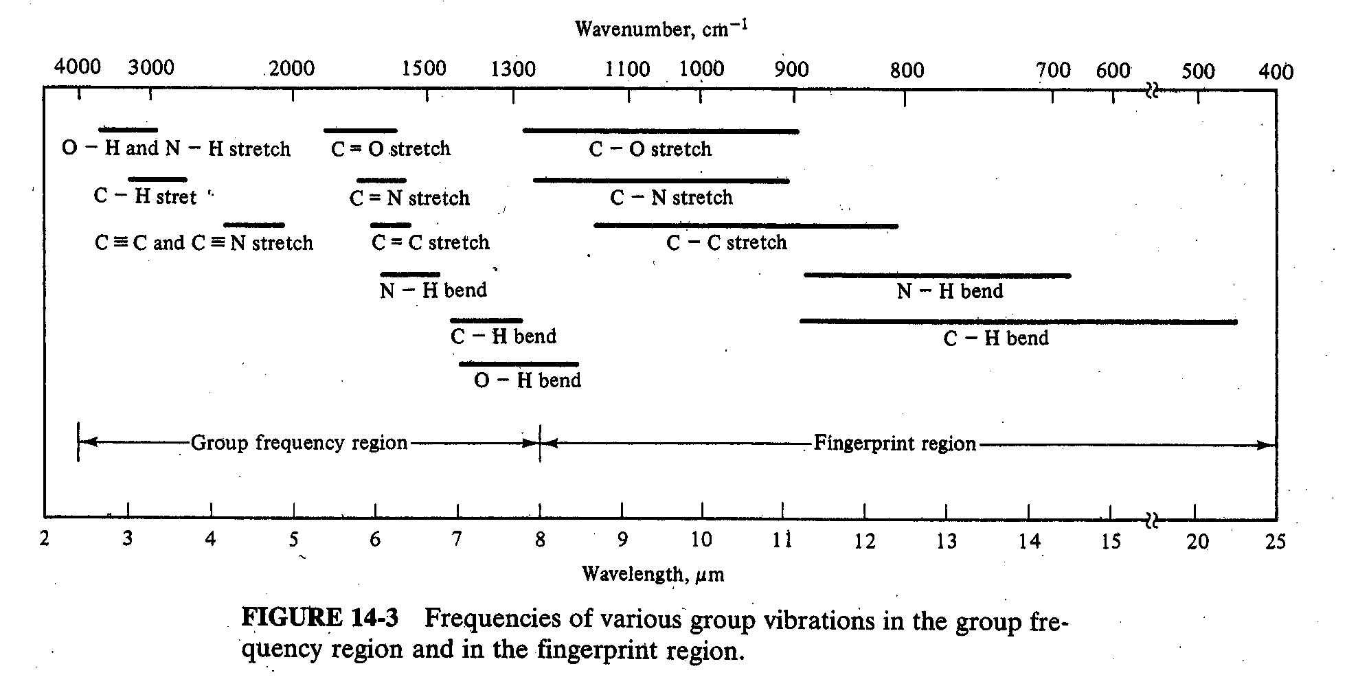
Fingerprint region
In the region from ≈ 1400 to 665 cm⁻¹, vibrational frequencies are affected by the entire molecule, as the broader ranges for group absorptions in the figure below – fingerprint region.
Absorption in this fingerprint region is characteristic of the molecule as a whole. This region finds widespread use for identification purpose by comparison with library spectra.

Slide 29
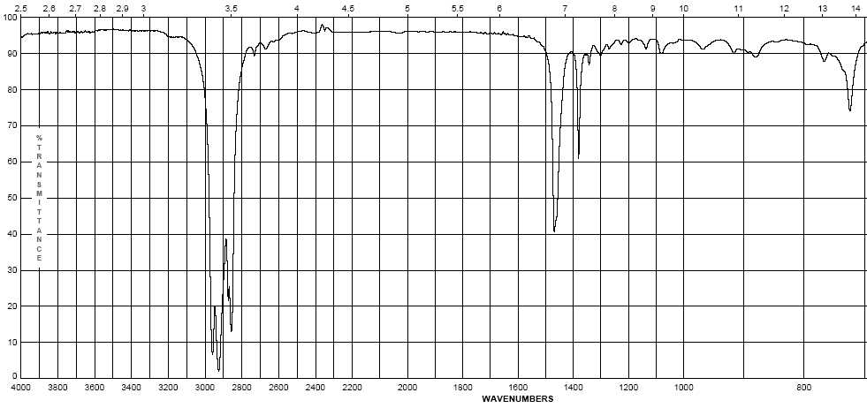
Infrared Spectroscopy
Octane
  Alkanes – combination of C-C and C-H bonds
    C-C stretches and bends 1360-1470 cm⁻¹
    CH₂-CH₂ bond 1450-1470 cm⁻¹
    CH₂-CH₃ bond 1360-1390 cm⁻¹
    sp³ C-H between 2800-3000 cm⁻¹
(w – s)
(m)

Slide 30
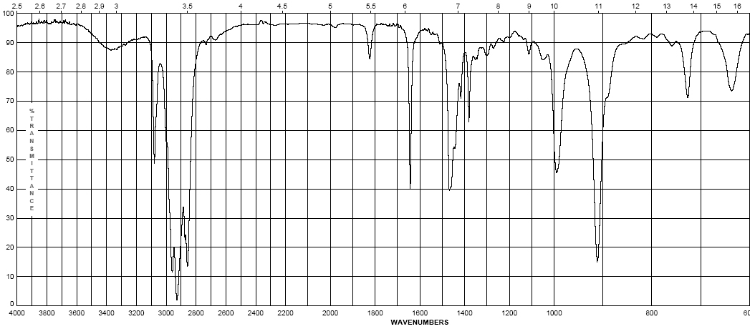
Infrared Spectroscopy
1-Octene
  Alkenes – addition of the C=C and vinyl C-H bonds
    C=C stretch at 1620-1680 cm⁻¹ weaker as substitution increases
    vinyl C-H stretch occurs at 3000-3100 cm⁻¹
    The difference between alkane, alkene or alkyne C-H is important! If the band is slightly above 3000 it is vinyl sp² C-H or alkynyl sp C-H if it is below it is alkyl sp³ C-H
(w – m)
(w – m)

Slide 31
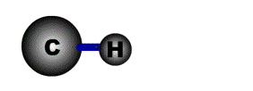
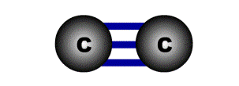
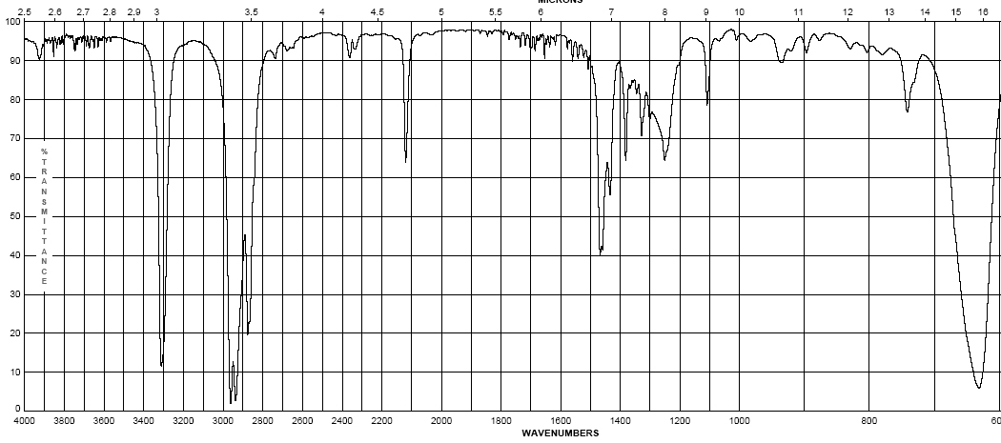
Infrared Spectroscopy
1-Octyne
  Alkynes – addition of the C=C and vinyl C-H bonds
    C≡C stretch 2100-2260 cm⁻¹; strength depends on asymmetry of bond, strongest for terminal alkynes, weakest for symmetrical internal alkynes
    C-H for terminal alkynes occurs at 3200-3300 cm⁻¹
    Internal alkynes ( R-C≡C-R ) would not have this band!
(w-m)
(m – s)

Slide 32
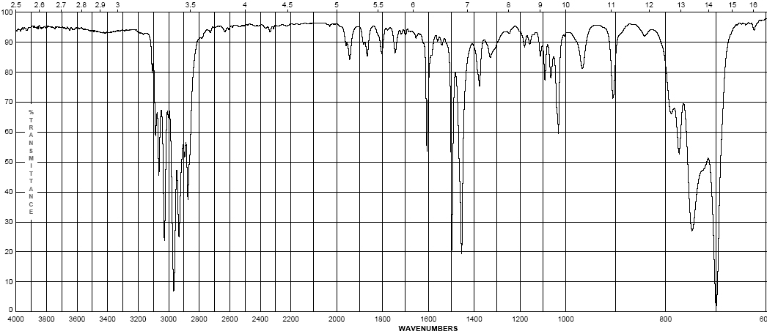
Infrared Spectroscopy
Ethyl benzene
  Aromatics
    Due to the delocalization of e⁻ in the ring, C-C bond order is 1.5, the stretching frequency for these bonds is slightly lower in energy than normal C=C
    These show up as a pair of sharp bands, 1500 & 1600 cm⁻¹, (lower frequency band is stronger)
    C-H bonds off the ring show up similar to vinyl C-H at 3000-3100 cm⁻¹
(w – m)
(w – m)

Slide 33
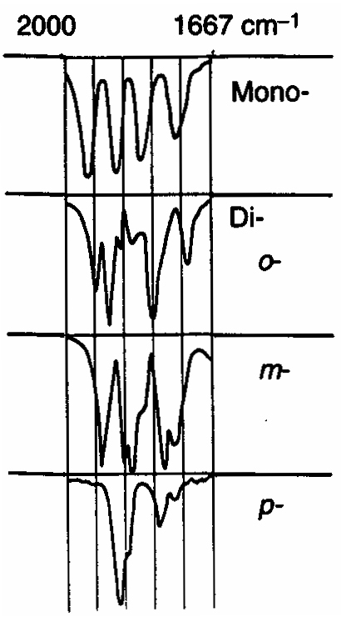
Infrared Spectroscopy
  Aromatics
    If the region between 1667-2000 cm⁻¹ (w) is free of interference (C=O stretching frequency is in this region) a weak grouping of peaks is observed for aromatic systems
    Analysis of this region, called the overtone of bending region, can lead to a determination of the substitution pattern on the aromatic ring
Monosubstituted
1,2 disubstituted (ortho or o-)
1,2 disubstituted (meta or m-)
1,4 disubstituted (para or p-)

Slide 34
Infrared Spectroscopy
  Unsaturated Systems – substitution patterns
    The substitution of aromatics and alkenes can also be discerned through the out-of-plane bending vibration region
    However, other peaks often are apparent in this region. These peaks should only be used for reinforcement of what is known or for hypothesizing as to the functional pattern.

Slide 35
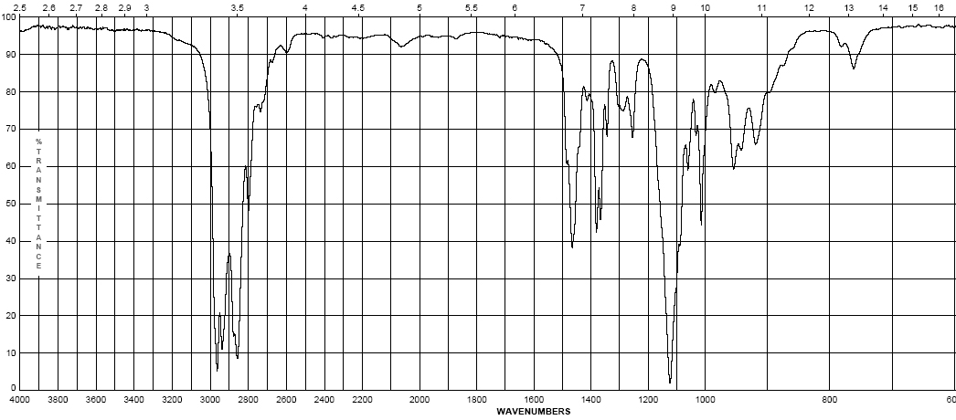
Infrared Spectroscopy
Diisopropyl ether
  Ethers – addition of the C-O-C asymmetric band and vinyl C-H bonds
    Show a strong band for the antisymmetric C-O-C stretch at 1050-1150 cm⁻¹
    Otherwise, dominated by the hydrocarbon component of the rest of the molecule
(s)

Slide 36
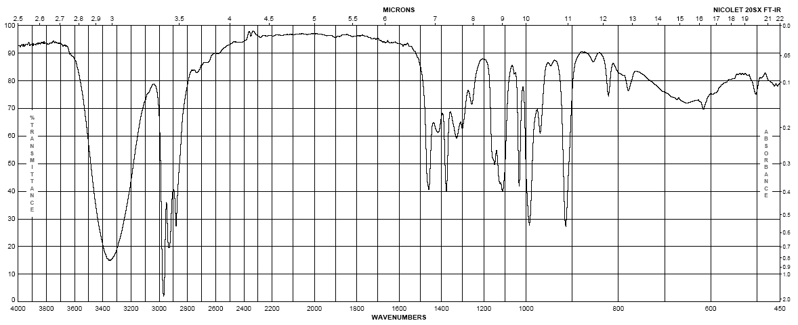
Infrared Spectroscopy
1-butanol
Alcohols
  Strong, broad O-H stretch from 3200-3400 cm⁻¹
  Like ethers, C-O stretch from 1050-1260 cm⁻¹
  Band position changes depending on the alcohols substitution: 1° 1075-1000; 2° 1075-1150; 3° 1100-1200; phenol 1180-1260
  The shape is due to the presence of hydrogen bonding
(m– s)
br
(s)

Slide 37
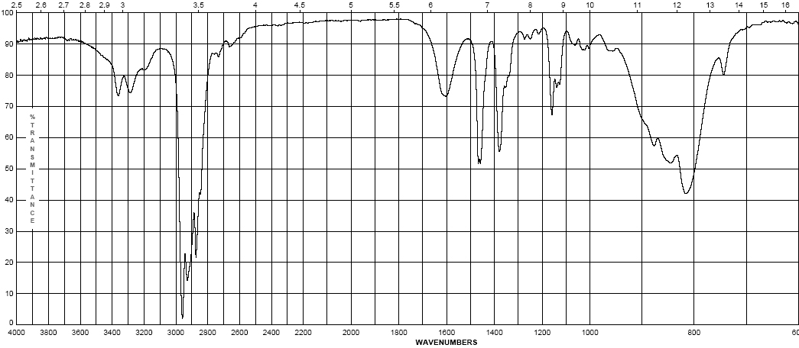
Infrared Spectroscopy
2-aminopentane
  Amines - Primary
    Shows the –N-H stretch for NH₂ as a doublet between 3200-3500 cm⁻¹ (symmetric and anti-symmetric modes)
    -NH₂ has deformation band from 1590-1650 cm⁻¹
    Additionally there is a “wag” band at 780-820 cm⁻¹ that is not diagnostic
(w)
(w)

Slide 38
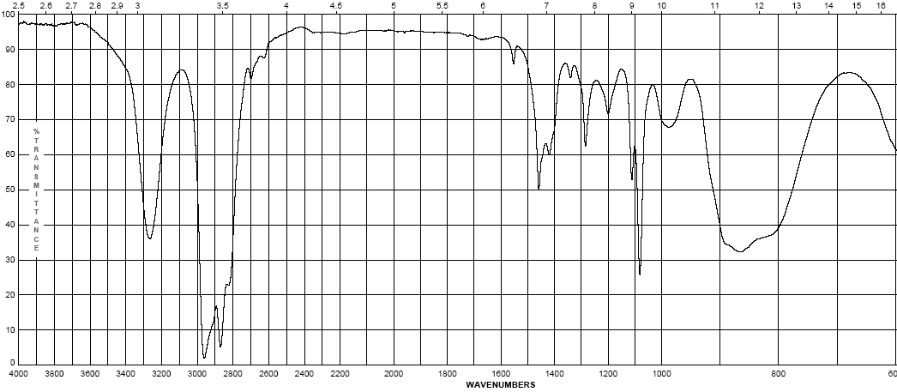
Infrared Spectroscopy
pyrrolidine
  Amines – Secondary
    N-H band for R₂N-H occurs at 3200-3500 cm⁻¹ as a single sharp peak weaker than –O-H
    Tertiary amines (R₃N) have no N-H bond and will not have a band in this region
(w – m)

Slide 39
Infrared Spectroscopy
  Pause and Review
    Inspect the bonds to H region (2700 – 4000 cm⁻¹)
    Peaks from 2850-3000 are simply sp³ C-H in most organic molecules
    Above 3000 cm⁻¹ Learn shapes, not wavenumbers!:
V-shape peak
-N—H bond for 2º amine (R₂N—H)
Broad U-shape peak
-O—H bond
W-shape peak
-N—H bond for 1º amine (RNH₂)
Sharp spike
-C≡C—H bond
3000 cm⁻¹
Small peak shouldered just above 3000 cm⁻¹ C=C—H or Ph—H

Slide 40
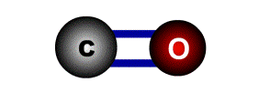
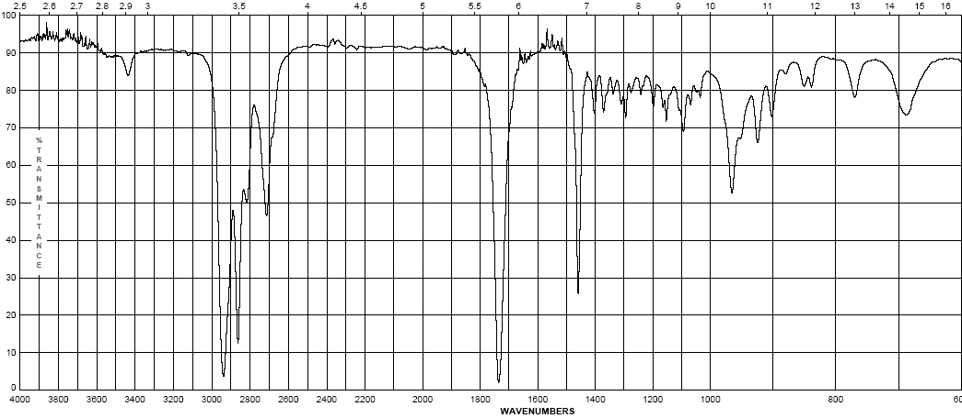
Infrared Spectroscopy
Cyclohexyl carboxaldehyde
  Aldehydes
    C=O (carbonyl) stretch from 1720-1740 cm⁻¹
    Band is sensitive to conjugation, as are all carbonyls (upcoming slide)
    A highly unique sp² C-H stretch appears as a doublet, 2720 & 2820 cm⁻¹ called a “Fermi doublet”
(w-m)
(s)

Slide 41
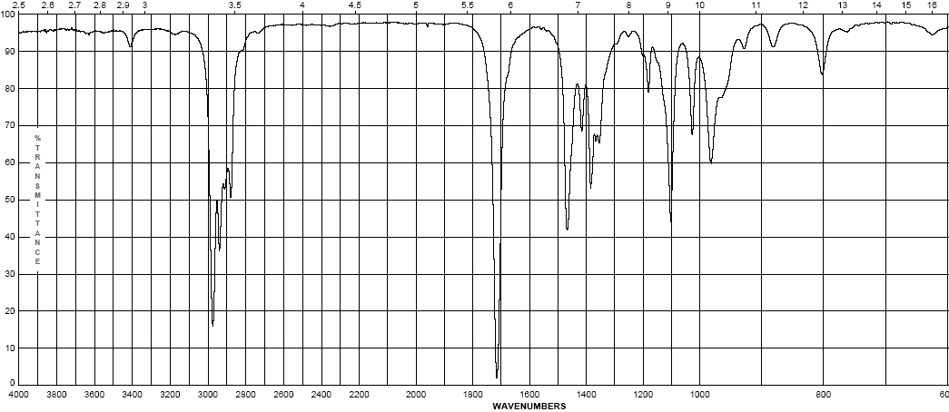
Infrared Spectroscopy
3-methyl-2-pentanone
  Ketones
    Simplest of the carbonyl compounds as far as IR spectrum – carbonyl only
    C=O stretch occurs at 1705-1725 cm⁻¹
(s)

Slide 42
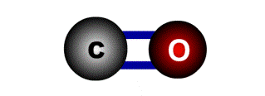
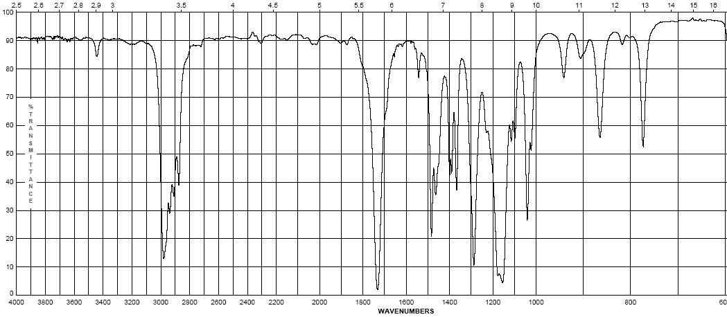
Infrared Spectroscopy
Ethyl pivalate
  Esters
    C=O stretch at 1735-1750 cm⁻¹
    Strong band for C-O at a higher frequency than ethers or alcohols at 1150-1250 cm⁻¹
(s)
(s)

Slide 43
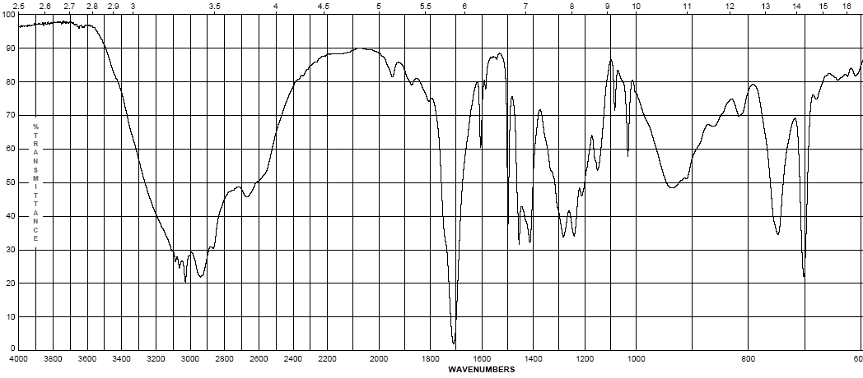
Infrared Spectroscopy
4-phenylbutyric acid
  Carboxylic Acids:
    Gives the messiest of IR spectra
    C=O band occurs between 1700-1725 cm⁻¹
    The highly dissociated O-H bond has a broad band from 2400-3500 cm⁻¹ covering up to half the IR spectrum in some cases
(w – m)
br
(s)
(s)

Slide 44
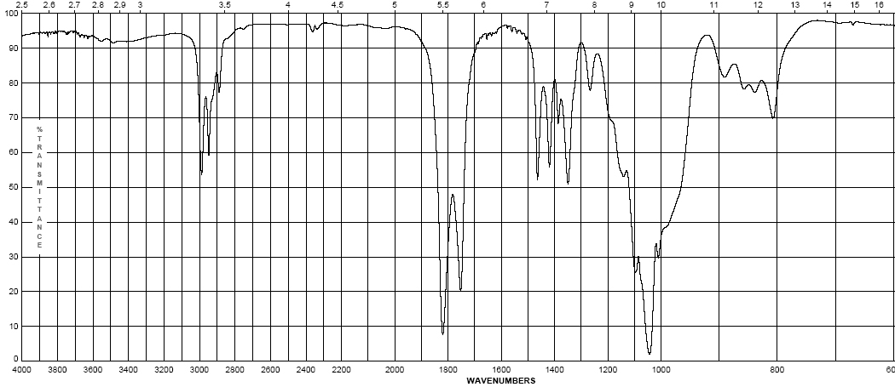
Infrared Spectroscopy
Propionic anhydride
  Acid anhydrides
    Coupling of the anhydride though the ether oxygen splits the carbonyl band into two with a separation of 70 cm⁻¹
    Bands are at 1740-1770 cm-1 and 1810-1840 cm⁻¹
    Mixed mode C-O stretch at 1000-1100 cm⁻¹
(s)
(s)

Slide 45
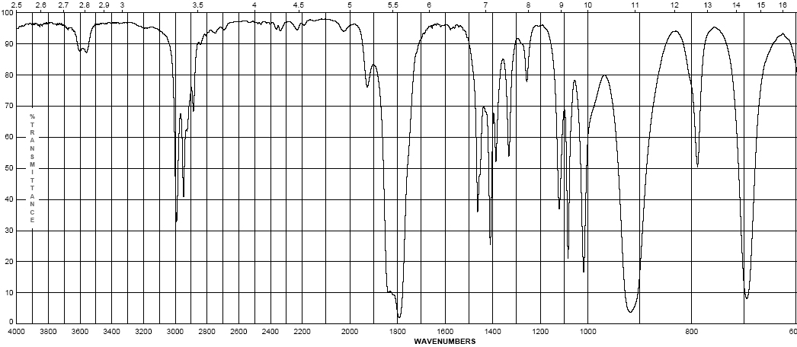
Infrared Spectroscopy
Propionyl chloride
  Acid halides
    Clefted band at 1770-1820 cm⁻¹ for C=O
    Bonds to halogens, due to their size (see Hooke’s Law derivation) occur at low frequencies, only Cl is light enough to have a band on IR, C-Cl is at 600-800 cm⁻¹
(s)
(s)

Slide 46
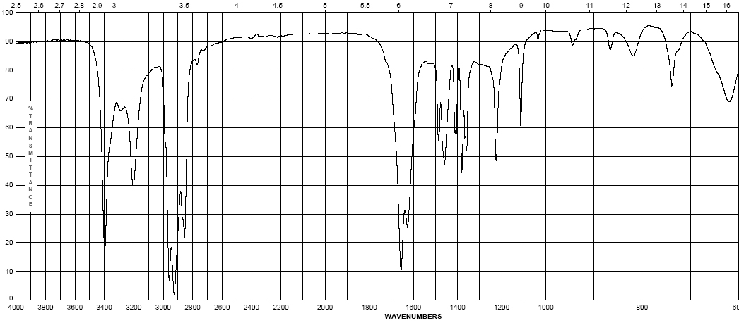
Infrared Spectroscopy
pivalamide
  Amides
    Display features of amines and carbonyl compounds
    C=O stretch at 1640-1680 cm⁻¹
    If the amide is primary (-NH₂) the N-H stretch occurs from 3200-3500 cm⁻¹ as a doublet
    If the amide is secondary (-NHR) the N-H stretch occurs at 3200-3500 cm⁻¹ as a sharp singlet
(m – s)
(s)

Slide 47
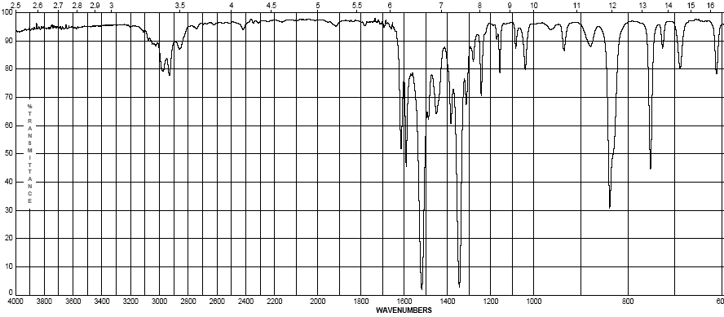
Infrared Spectroscopy
2-nitropropane
  Nitro group (-NO₂)
    Proper Lewis structure gives a bond order of 1.5 from nitrogen to each oxygen
    Two bands are seen (symmetric and asymmetric) at 1300-1380 cm⁻¹ and 1500-1570 cm⁻¹
    This group is a strong resonance withdrawing group and is itself vulnerable to resonance effects
(s)
(s)

Slide 48
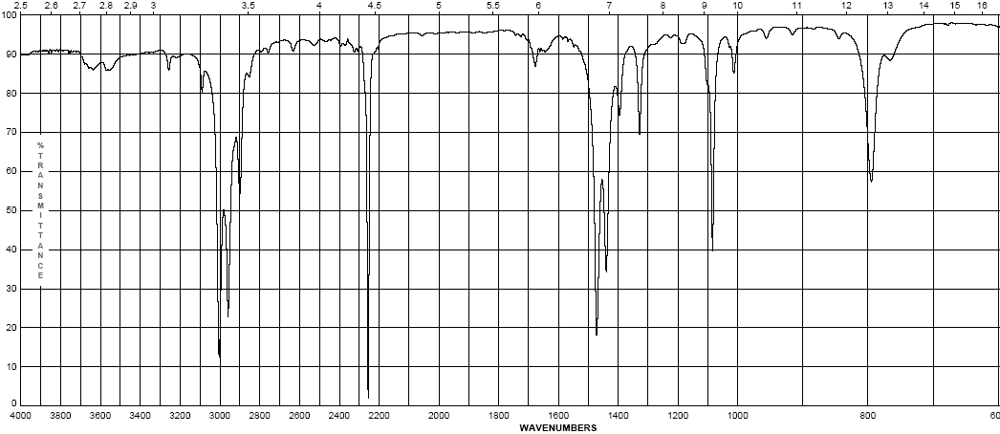
Infrared Spectroscopy
propionitrile
  Nitriles (the cyano- or –C≡N group)
    Principle group is the carbon nitrogen triple bond at 2100-2280 cm⁻¹
    This peak is usually much more intense than that of the alkyne due to the electronegativity difference between carbon and nitrogen
(s)

Slide 49
    Effects on IR bands
    Conjugation – by resonance, conjugation lowers the energy of a double or triple bond. The effect of this is readily observed in the IR spectrum:
      Conjugation will lower the observed IR band for a carbonyl from 20-40 cm⁻¹ provided conjugation gives a strong resonance contributor
      Inductive effects are usually small, unless coupled with a resonance contributor (note –CH₃ and –Cl above)

Slide 50
    Steric effects – usually not important in IR spectroscopy, unless they reduce the strength of a bond (usually π) by interfering with proper orbital overlap:
      Here the methyl group in the structure at the right causes the carbonyl group to be slightly out of plane, interfering with resonance
    Strain effects – changes in bond angle forced by the constraints of a ring will cause a slight change in hybridization, and therefore, bond strength
      As bond angle decreases, carbon becomes more electronegative, as well as less sp² hybridized (bond angle < 120°)

Slide 51
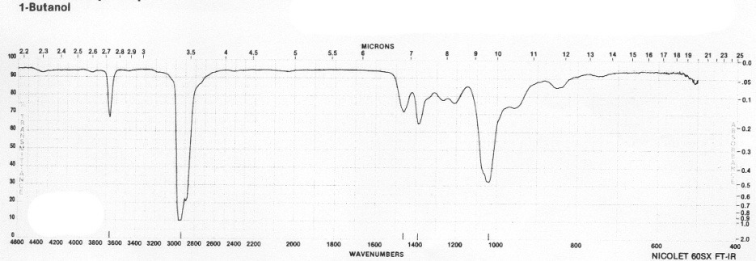
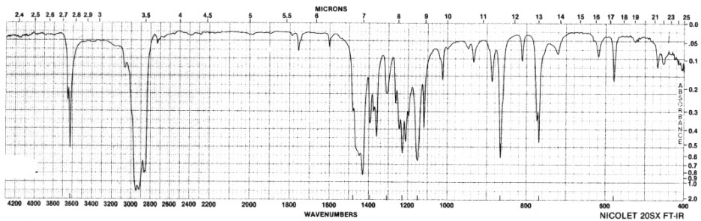
    Hydrogen bonding
      Hydrogen bonding causes a broadening in the band due to the creation of a continuum of bond energies associated with it
      In the solution phase these effects are readily apparent; in the gas phase where these effects disappear or in lieu of steric effects, the band appears as sharp as all other IR bands:
      Gas phase spectrum of
      1-butanol
      Steric hindrance to H-bonding
      in a di-tert-butylphenol
      H-bonding can interact with other functional groups to lower frequencies

Slide 52
THANK YOU

