Slide 1
BIO-INORGANIC CHEMISTRY
Mrs.Renuka Pawar
Shri.Vijaysinha Yadav College,Peth Vadgaon

Slide 2
ELEMENTS IN BIOLOGICAL PROCESSES
Essential Elements-Elements necessary for life process.Its absence may cause ill effects.Metals-Na,K,Mg,Ca. Non-metals-C,N,O,P,I,Cl,S.
Beneficial Elements-Elements helps growth & reproduction. Its absence may not cause ill effects.
Trace Elements-Elements required in trace amount. Mn,Fe,Co,Cu,Zn,V,Ni,Cr,Mo,B,Al,I,Si,F,Se.
Toxic Elements-Elements neither essential nor beneficial & cause ill effects.

Slide 3
BIOLOGICAL ROLE OF ESSENTIAL ELEMENTS
Atomic no. | Elements | Biological role
1 | Hydrogen | Constituent of all organic molecules
5 | Boron | Essential in plants, biological role in animals is unknown.
6 | carbon | Main element in all organic molecules.
7 | Nitrogen | Synthesis of proteins & many organic .
8 | Oxygen | Essential for respiration of living body, Atom present in many organic compound.
9 | Flourine | Probably essential at trace level.
11 | Sodium | Important in nerve functioning.

Slide 4
Atomic no. | Elements | Biological role
12 | Magnesium | Essential to all organisms,Present in chlorophylls & enzyme activator.
14 | Silicon | Essential for growth of chicks & rats,essential in higher plants.
15 | Phosphorous | Main & important part of DNA, RNA, teeth, bones, lipids, ADP, ATP, & metabolic intermediates.
16 | Sulphur | Essential atom of the proteins.
17 | Chlorine | Nacl electrolyte & HCL in digestive juices ,Essential part of body fluids.
19 | potassium | Transmission of nerve impulse & cardiac function, Essential to almost all organisms.
20 | Calcium | Major structural component in cells, bones, involved in blood clotting.

Slide 5
Atomic no. | Elements | Biological role
23 | Vanadium | Essential to sea squarts, chicks, rats & deficiencies may cause reduced growth, reproduction, impaired tooth & bone metabolism.
24 | Chromium | Potentiates effect of insulin, involved in glucose metabolism & diabetis.
25 | Manganese | Activates numerous enzymes, Deficiency causes infertility in mammales.
26 | Iron | Essential to all organisms as a main part of blood
27 | Cobalt | Essential to many organisms, activates no. of enzymes, vitamin B-12.
28 | Nickel | Active metal in several hydrogenases & plant ureases.
29 | Copper | Constituents of redox enzymes & haemocyanin, electron transfer.

Slide 6
Atomic no. | Elements | Biological role
30 | Zinc | Used in >70 enzymes,plays role in sexual maturation & reproduction.
34 | Selenium | Essential to mammals & some higher plants, protects against heavy metal ions.
35 | Bromine | Essential to algae & mammals
42 | Molybdenum | Essential to all organisms except green algae, in nitrogen fixing bacteria.
53 | Iodine | Essential in many organisms, important in thyroxine metabolism & growth regulation.

Slide 7
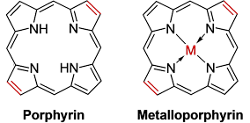
Metalloporphyrins:

Slide 8
Metalloporphyrins:
The complexes between metal ion and porphyrin
Ligands.
Important type of compounds in biological processes.
In plant, magnesium attaches porphyrin and forms Chlorophyll .
In chordates iron attaches to porphyrin and forms haemoglobin.

Slide 9
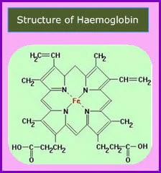
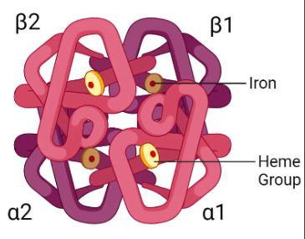
Structure and Function of Hemoglobin
- Hemoglobin is a protein in red blood cells
- Responsible for transporting oxygen from lungs to body tissues
Also carries carbon dioxide from tissues to lungs
- Hemoglobin is a tetrameric protein (four subunits)
- Each subunit consists of a heme group and a globin chain
- Heme group contains iron ion (Fe2+) that binds oxygen
- Heme group consists of porphyrin ring and iron ion
- Porphyrin ring is a planar, heterocyclic compound
Iron ion is coordinated to four nitrogen atoms of porphyrin ring
- Globin chain is a polypeptide chain
- Consists of alpha-helices and beta-sheets
- Provides structural support and facilitates binding of oxygen
- Oxygen binds to iron ion in heme group
- Binding of oxygen causes conformational change in globin chain
- Increases affinity for oxygen

Slide 10
Co-operativity:
Co-operativity is the phenomenon where Binding of one oxygen molecule increases the affinity for the next oxygen molecules
This interaction occurs between the four subunits of haemoglobin
Mechanism of Co-operativity
First O₂ binds with difficulty, strain generated is somehow communicated to other Fe(II) porphyrin sites.
This binding causes:
  Structural (conformational) change in haemoglobin
Subsequent O₂ molecules bind more easily
This continues until all four sites are occupied
Factors Affecting Cooperativity
Partial pressure of oxygen (pO₂)
Carbon dioxide concentration
pH (Bohr effect)
Temperature

Slide 11
Biological Role Of Alkali & Alkaline Earth Metal Ions-
Role of Na+ & K+ in biological process:-
Source-
Na+-Common salt used in cooking
K+- All foods prepared from plants e.g.
tea, coffee, vegetables, milk, bananas
fish, meat etc.
Adsorption & Distribution:-
Adsorbed from gastrointestinal tract.
Distributed as the salts of organic
acids, inorganic acids & proteins.
Functions:-
1] To maintain sensitivity of nerves.
2] Maintenance of osmotic pressure of different body fluids.
3] pH regulation of extracellular & intracellular fluids.
4] CO2 transport.
5] Effective role in secretion of digestive fluid
e.g. gastric juice, pancreatic juice.
6] Maintain viscosity of blood

Slide 12
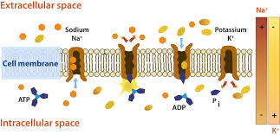
Sodium Potassium Pump (Na+/K+ ATPase)-
The sodium–potassium pump (sodium–potassium adenosine triphosphatase,
also known as Na⁺/K⁺-ATPase, Na⁺/K⁺ pump, or sodium–potassium ATPase)
is an enzyme found in the membrane of all animal cells. It performs several
functions in cell physiology. It was discovered in 1957 by the Danish
Scientist Jens Christian Skou, who was awarded a Nobel Prize for his
work in 1997.
3Na+ are extracellular and 2K+ are intracellalar .

Slide 13
Role of Ca2+ in biological processes:
Building strong bones and teeth as apatite [Ca3(PO4)2] and
fluoroapatite [Ca3(PO4)2.CaF2] .
Clotting blood.
Sending and receiving nerve signals.
Squeezing and relaxing muscles.
Messenger for harmonal action
Keeping a normal heartbeat.
Helps in conformational changes in many proteins
Formation of pyrophosphate linkage
Functions as a bridge between different protein segments by
binding to anionic part of the ligands.

Slide 14

E-mail- renukapawar71@gmail.com
Contact No.- 8329197439

